Slide 1
Realistic Medicine Conference Monday 22 April 2024
Understanding and Addressing Health Inequalities

Slide 2
SAS – Strategic Position
SAS 2030 strategy - Save more lives, improve the health of Scotland's population and reduce health inequalities
HI – avoidable, unfair, systemic differences in health between different groups of people
Utilise the reach of all our clinical and organisational improvement programs to address and reduce HI

Slide 3
Differences
SIMD
Geography
Hard to reach groups
Protected characteristics

Slide 4
Aiming for consistent practice and standards
SAS – try to do everything the same!
Same ambulances
Same clinical guidance
Same drugs & equipment

Slide 5
However...
SAS Atlas of Variation
Societal factors 80%/Health Care 20%
Inequity of outcomes
Inequity of access
Disease burden
So - what do we need to do differently?

Slide 6
Transforming Clinical Services

Slide 7
Out of Hospital Cardiac Arrest

Slide 9
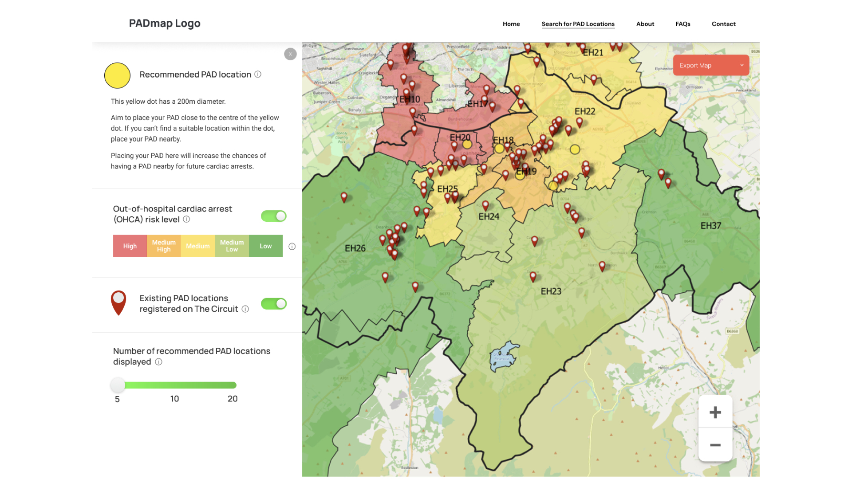
PAD Mapping - Edinburgh

Slide 10
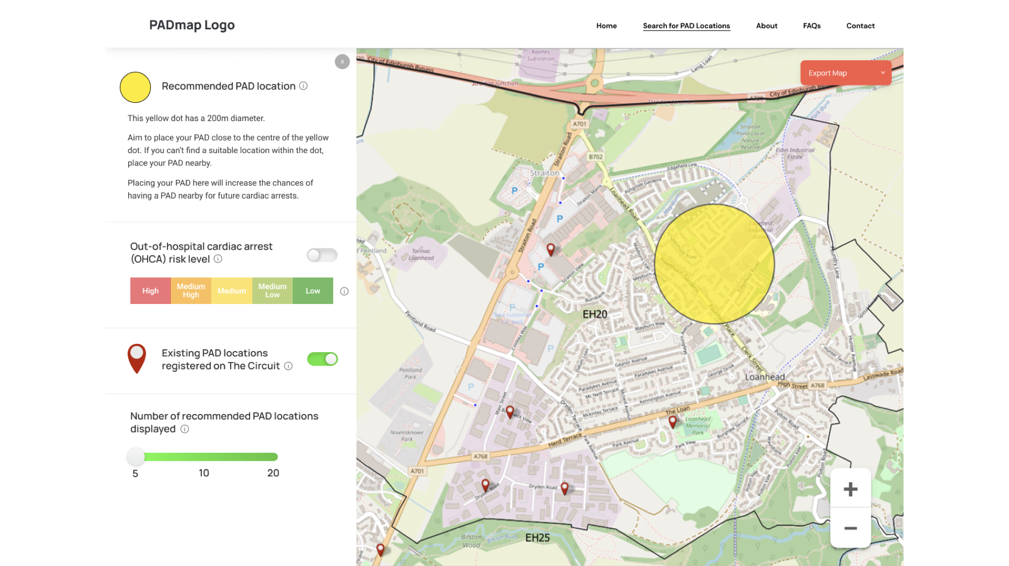
Where should the next PAD go?

Slide 11
Healthcare Inequalities: SAS Ambitions
Existing work
Looking to the future:
SAS Clinicians as care facilitators
Don't walk by...
Working with partners
Challenges:
Complex care takes time
More & more work now in UPC space

Slide 12
Healthcare Inequalities: SAS Ambitions
Healthcare inequalities and RM:
Unwarranted variation
Shared decision making
Personalised care
Reduce harm and waste

Slide 13
Unwarranted Variation

Slide 14
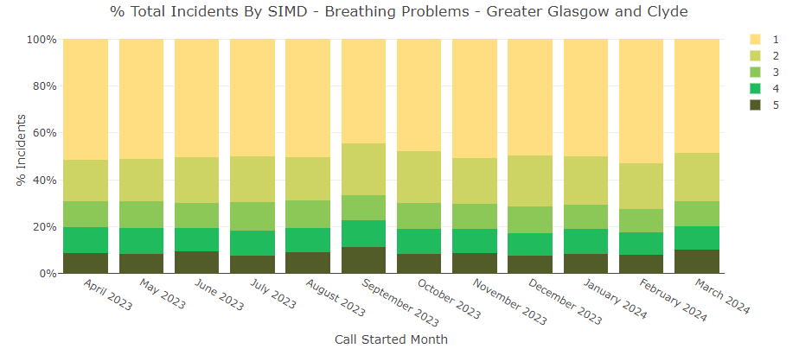
Unwarranted Variation

Slide 15
Why?

Slide 16
Why?
Current cigarette smoking prevalence (age-standardised) among adults aged 16+, 2003-2021, by area deprivation
The Scottish Health Survey 2021 - volume 1: main report

Slide 17
Shared Decision Making
Autonomy & Justice
Difficult discussions
Prof-2-prof support
No clinician should feel alone supporting people to make difficult decisions about their health.

Slide 18
Personalised Care
Listening to what is important to people
See things in context
Always look for alternatives to ED

Slide 19
Reduce Harm and Waste
PAD/THN
Take the patient with you...
Reducing ambulance journeys reduces carbon and plastic!

Slide 20
Join us on our journey...
Do you have a HI project that SAS can help you with?
Drive-by screening
Use our data to plan services (CRT, H@H, etc)
Tell us what you think and how we can improve things...

