Slide 1
Setting the context and the Angus PPC program
Dr Fatim Lakha, Consultant in Public Health Medicine, NHS Tayside and PHS
Ruth Mackay, Deputy CEO Voluntary Action Angus
April 2022
Notes:
Slide will need to be a Tayside headed slide.

Slide 2
OVERVIEW
National and local context
Angus PPC project
Brechin pilot and evaluation

Slide 3
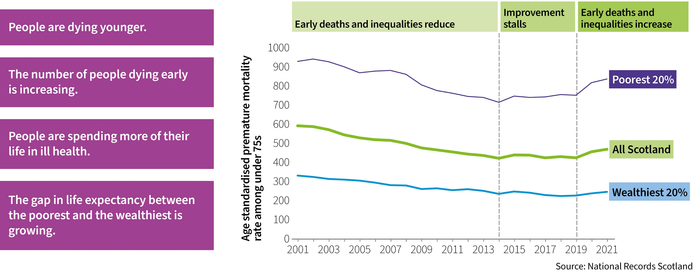
Scotland’s health is now worsening

Slide 4
Causes of premature (<75y) mortality in Tayside
Notes:
Comparison of top 10 main causes within most and least deproved areas. Based on 5y aggregate data (2017-2021)
There are differences in the main causes of premature death when the most and least deprived areas in Tayside are examined (table 4). While lung cancer and myocardial infarction (heart attack) were the most common cause of death in the least deprived areas, substance use (drugs) followed by lung cancer were the most common drivers of premature mortality in the most deprived areas.

Slide 5
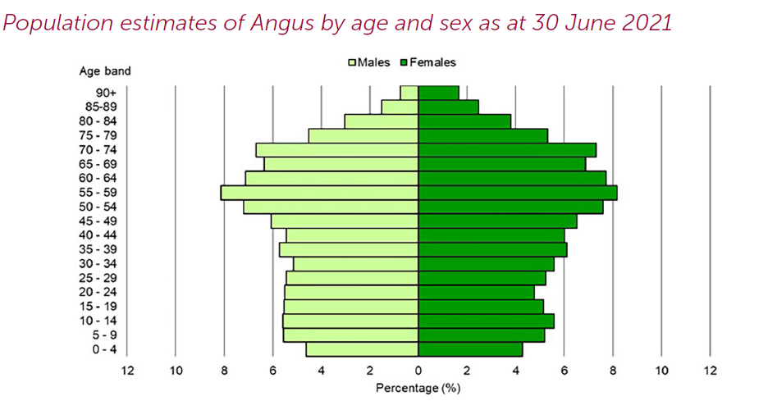
The population is ageing
Source: National records Scotland MYPE
Notes:
The size of the population in Tayside overall has increased but over the last 5y not changed so much. But the shape of that population has and is changing The first thing to say is that the population is ageing. This means that the needs and demands are changing and we need to bear that in mind as we design services and think wider – housing, transport, keeping people healthier for longer , the workforce require
The number of people aged 75+ is expected to increase by 24% between 2018 and 2028 – we are already halfway through that so …..

Slide 6
An aging population increases the prevalence of chronic illness and multimorbidity
Prevalence of multimorbidity by age and socioeconomic status
Number of chronic disorders by age-group
Barnett et al. Epidemiology of multimorbidity and implications for health care,
research, and medical education: a cross-sectional study. Lancet. 2012 Jul 7;380(9836):37-43.

Slide 7
The burden of disease is forecast to increase by 21%

Slide 8
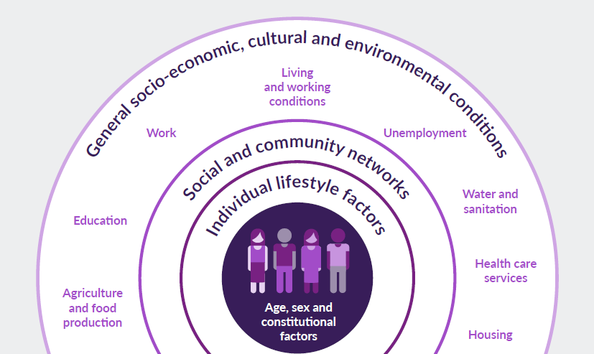
1. Protect investment in the building blocks of health
Source: Dahlgren and Whitehead 1993
Notes:
Just how much each of these factors contributes to our health is hard to measure
precisely due to the different methods, data and time periods of different
studies, and because it is innately difficult to disentangle empirically what may
be clear conceptually

Slide 9
2. Prevention and early intervention are key
Aging population
Aging population
Low
Impact on cost
High
High
Low
Impact on Population Health
Notes:
Three levels of prevention
Change is necessary – and possible, through investment in prevention – we know prevention works. Through a whole system approach, working with our partners to tackle all the building blocks of health.
Investment towards primary prevention and working collaboratively with partners – SG, local government and stakeholders across the whole system, focused on our shared National Outcomes, will help deliver improvements in a number of areas.
Secondary and tertiary prevention remain important too but longer-term we need to invest in primary prevention to help shift the weight of demand to free up resources to combat the demands of our ageing population.
There are two approaches to prevention:
Targeting everyone regardless of level of risk (measures like pricing, restricting marketing etc)
Targeting those at the highest risk of harm (provision of treatment, support for recovery, smoking cessation, weight management services).
Population level approaches are most effective when there is a clear ‘dose response’ relationship (i.e. risk increases with increased exposure - this is the case for most of these situations). It is also effective in shifting the behaviours of a large number of people who are at increased (but not the highest risk).
Targeted approaches are more socially desirable, they are also important for supporting those at the highest risk of harm. However, as the diseases are rare, most people who are supported by a targeted intervention will not benefit directly, some will and will benefit enormously. The greatest limitation of targeted approaches alone is that they do not reach the large number of people with small to moderate risk - and this is why both population level and targeted approaches are needed.
Public health approach to prevention and the role of NHSScotland - Publications - Public Health Scotland
The case for prevention and sustainability of health services - Publications - Public Health Scotland

Slide 10
3. Sustained whole system collaboration: every sector has a role
Notes:
We need collective action to improve life expectancy, reduce health inequalities and ensure sustainable services

Slide 11
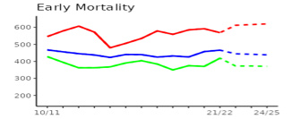
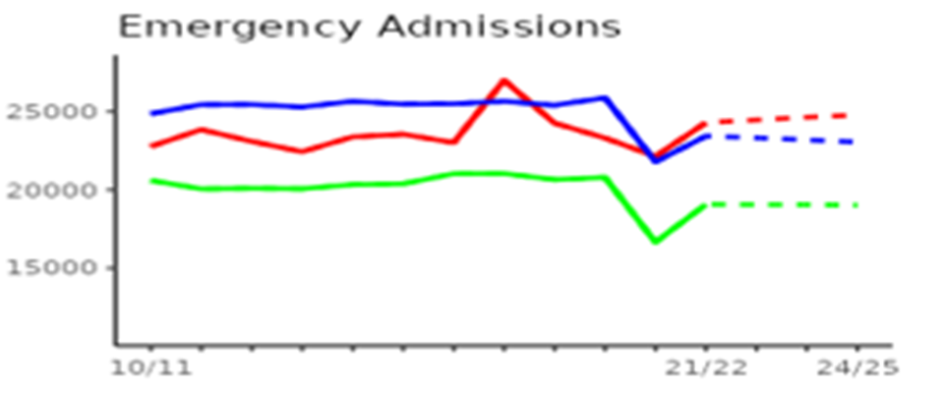
Angus Prevention and Proactive Care – Brechin pilot
Notes:
List size of 8,630 people with 7,346 (85%) aged 15+
926 (11%) registered people are aged 75+
50/50 even split between males and females
39% live in SIMD areas 1 and 2 (two most deprived quintile areas)

Slide 12
Theory of change

Slide 13
Evaluation
Mixed methods:
In-depth interviews with social prescriber;
Focus groups with service users and providers;
Surveys with service users
Quantitative data extraction from routine datasets

Slide 14
Angus Prevention and Proactive Care
Scottish Patients At Risk of Readmissions and Admissions (SPARRA)
Notes:
SPARRA is a risk prediction tool that allows us to assign risk scores for hospital admission over the next 12 months to each individual in our population.
The SPARRA model is split into 3 sub-cohorts: the frail elderly which comprises of patients aged 75+ who may not suffer from a particular condition but may be more at risk due to their increasing years and associated frailty; Long Term Conditions which includes patients aged between 16 and 74 who have a long term condition; and the younger emergency department group which includes people between 16 and 55 who have at least one A&E attendance in the last 12 months and possible characteristics are alcohol and substance misuse and frequent A&E attendances.
This in total equates to around 4,000 people in Angus who have a score above 30% and about 320 in Brechin where the pilot will commence.

Slide 15
Video: Ruth Mackay, Deputy CEO of VAA explaining the pilot

Slide 16
Questions seeking to answer
To what extent is the model of care meeting the needs of the target population?
To what extent are the interventions offered meeting the needs of the population?
What are the barriers and facilitators to implementation and effectiveness?
What are the best practices and lessons learned from the pilot and interventions that can inform future interventions and programs?
What are the experiences and perceptions of the target population and healthcare providers with the interventions?
Are we achieving our personal, program and population outcomes?
How sustainable is the model of care and the basket of interventions in terms of funding, staffing, and community support?
Notes:
We’re looking to answer 7 key questions around need, effectiveness, barriers, experiences and sustainability.

Slide 17
Alternatives to Prescribed Medicines
Dr Alison Clement
GP/Associate Medical Director, Angus Health and Social Care Partnership
Notes:
Slide will need to be a Tayside headed slide.

Slide 18
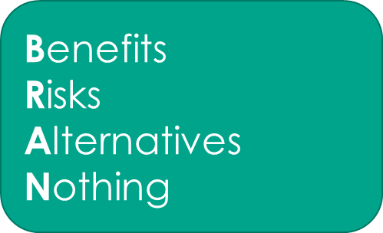
Alternatives
Pulmonary Rehabilitation
Strength and Balance Exercises
Exercise and exercise therapies for chronic pain
Nature Prescribing
Talking therapies
Caffeine reduction and pelvic floor exercises

Slide 19
What we’re doing in Angus
Blair Finlay
Programme Manager (Prevention and Proactive Care, Angus Health and Social Care Partnership, AHSCP)
Notes:
Slide will need to be a Tayside headed slide.

Slide 20
Good Conversations and Realistic Medicine
Value based – doing the right thing/what matters to you
Towards wellness/not just treatment of ill health
Collaboration/shared decision making
Supported self-management
Strength based orientation
Health literacy

Slide 21
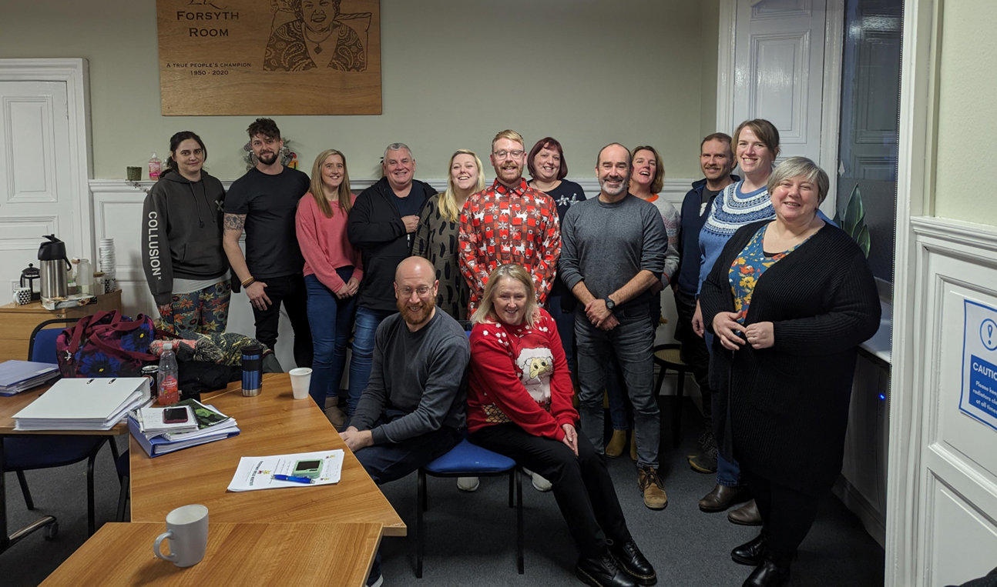
Angus Collaboration with the Thistle Foundation – Lifestyle Management

Slide 22
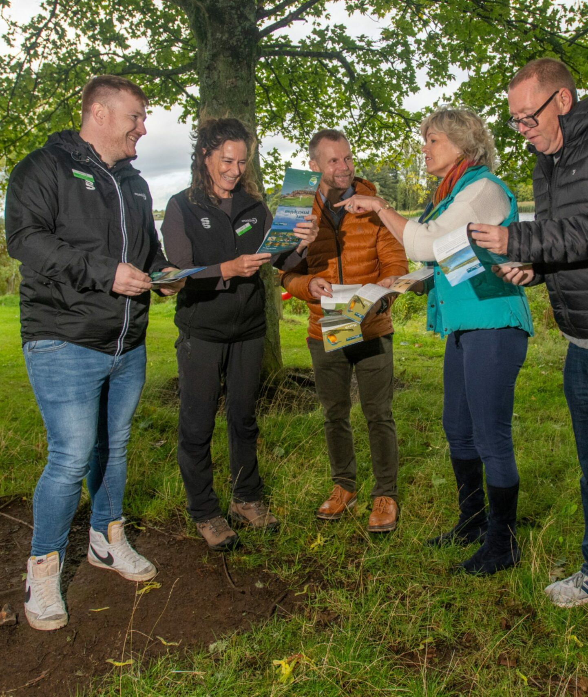
Nature Prescribing

Slide 23
Improving access to information

Slide 24
BE ACTIVE… Live Well Programme
Kirstie Abbey
Health and Wellbeing Lead, ANGUSalive
Notes:
Slide will need to be a Tayside headed slide.

Slide 25
physical activity
Sep 14
Oct 28
increased self-esteem
Aug 10
Wonder Drug!
Sep 18
Nov 4
Dec 1
improved sleep
Today
Aug 2
Aug 19
Sep 28
Nov 11
Dec 15
2016
Oct 22
2016
Sep 7
Oct 9
Nov 1
improved mood and overall wellbeing
increased social connection
reduced risk of further ill-health

Slide 26
prehab & rehab before / after treatment
injury
health event
Sep 14
Oct 28
Aug 10
Sep 18
Nov 4
Dec 1
Today
Aug 2
Aug 19
Sep 28
Nov 11
Dec 15
2016
Oct 22
mental health
2016
long term condition(s)
Sep 7
Oct 9
Nov 1
obesity
inactivity
at risk of long term condition(s)

Slide 27
HCP Referral or Self Referral
Refer On / Signpost
No LTC / risk
Currently engaging in PA at levels above Live Well sessions
April 2015
3
Sep 14
Oct 28
Active Start (free)
12wk structured programme offering medium-high level support
Questionnaires (activity levels & wellbeing) and biometric data collected
Sep 18
Stay Active (paid)
Low-level support / maintenance classes for people living with LTCs
Aug 10
Nov 4
Dec 1
Today
Aug 2
Aug 19
Sep 28
Nov 11
Dec 15
2016
Oct 22
2016
Sep 7
Oct 9
Nov 1
Independently Active Mainstream / Community Activity

Slide 28
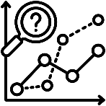
Streamlined Referrals
Built-in Questionnaires
Built-in Messaging, incl. SMS
Comprehensive Reporting
Reduced Admin Time
April 2015
3
Improved Participant Outcomes
Maximise Data Collection
Effective Data Analysis

Slide 30
Thank you for listening!
For further information, please contact Blair Finlay or Sally Wilson:
Blair Finlay (Programme Manager, Prevention and Proactive Care, AHSCP) Email: blair.finlay@nhs.scot
Sally Wilson (Service Manager - Integration, AHSCP) Email: sally.wilson@nhs.scot
Notes:
Slide will need to be a Tayside headed slide.

