Slide 1
How to….reduce waste and harm
Conference 2024:
Reform and Recovery
@realisticmed
Dr Iain Wilson and Dr Emily Kennedy
Clinical team, Effective Prescribing and Therapeutics Division, Scottish Government
#RealMed2024
www.realisticmedicine.scot

Slide 2
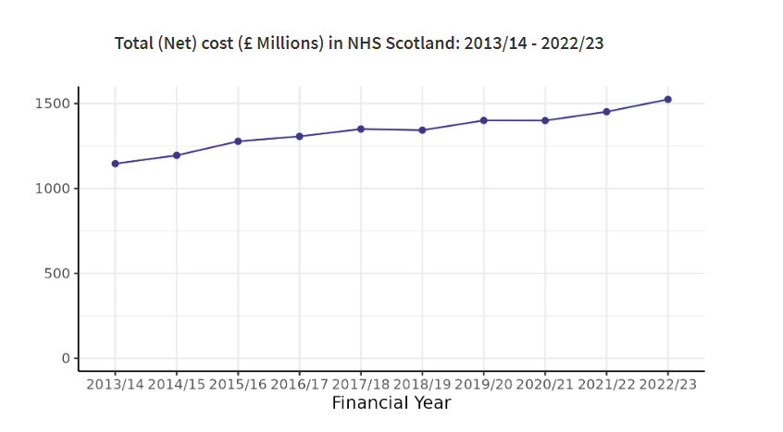
Prescribing: scale of the problem
Medication is the most common form of medical intervention in acute and chronic conditions
Rising levels of volume and cost prescribing in Scotland
110.3 million items reimbursed in the community 2022/23
Dispenser payments and prescription cost analysis - Financial year 2022 to 2023 - Dispenser payments and prescription cost analysis - Publications - Public Health Scotland
Notes:
Data presented only covers community dispensing (£1.52 billion for 2022/23) not acute prescribing expenditure. Total prescribing spend estimated at £2.2 billion

Slide 3
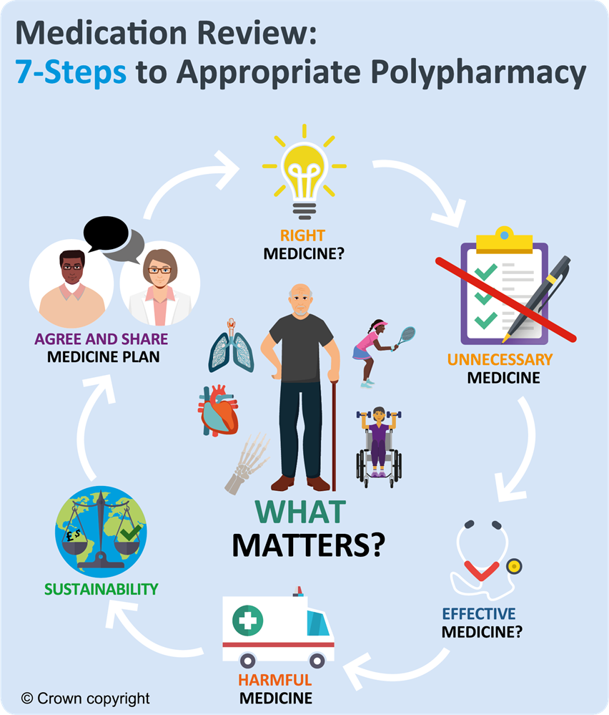
What is iSIMPATHY?
Notes:
Implementing Stimulating Innovation in the Management of Polypharmacy and Adherence Through the Years (iSIMPATHY) was a three-and-a-half-year European Union (EU) funded project and managed by the Special EU Programme Body in Northern Ireland, Scotland and the Republic of Ireland. The project aims were to ensure the most sustainable use of medicines for patients by training pharmacists and other healthcare professionals to deliver person-centred medicines reviews and embedding a shared decision-making approach to managing polypharmacy (the use of multiple medicines).
There are 8.6 million unplanned hospital admissions across Europe each year due to adverse drug events, of which approximately 50% are potentially preventable (figure 2).
The iSIMPATHY project embedded a multi-disciplinary collaborative way to deliver pharmacist-led, person-centred medicines reviews using the 7-Steps methodology.

Slide 4
How were iSIMPATHY’s objectives achieved?
Used a systems approach that has multidisciplinary clinical and policy leadership
Nurtured a culture that encourages and prioritises the safety and quality of prescribing
Ensured patients were integral to the decisions made about their medicines and were empowered and supported to do so
Used data to drive and measure change
Adopted an evidence based approach with a bias towards action
Utilised, developed and shared tools to support implementation
Notes:
Draws on the 6 key recommendations from SIMPATHY

Slide 5
Project outputs achieved
>6000 people engaged in
7 Steps Medicine Reviews
188 Healthcare Professionals trained
Significant number of Healthcare Professionals in-directly trained

Slide 6
Project developments
PC MAI
Accredited Healthcare Professionals training
Mobile tools : PROMS
Notes:
Person Centred MAI = harm assessment tool

Slide 7
iSIMPATHY - Environmental & personal impact of addressing prescribing
https://www.isimpathy.eu/
Notes:
7-steps medication review process
Optimise disease control
Opportunity to explore environmental issues
Manage Medicines app

Slide 8
Patient Reported Outcome Measures (PROMS)
PROMS were collected from some Patients before and after review
89% of patients had not had a medicine review before
After having had their review
91% felt that their review helped their understanding of their medicines
Patients reported reduced side-effects, 64% pre-review, reducing to 38% post-review
89% felt that all or most of their concerns were considered
“I’m definitely less short of breath and dizzy now”
“Pains in my legs used to limit my walking distance, but this has improved after my medication”
“Dad’s mood and appetite are much better since his medication review”

Slide 9
Economic
Economic analysis is being completed – these preliminary findings are based on data collected earlier in the project and are on the basis of per 100 reviews:
Total associated staff costs average £7500 (8786 euros)
Cost implication from net medication changes – net reduction of £13,100 (15346 euros )
Potential Costs avoided from avoided healthcare resources used £168,800 (this is based on quantifying Eadon score patient health consequences) & 7.4 QALY

Slide 10
Environmental
Ensuring indication for every medicine
Ensuring ongoing effectiveness of treatment
Optimising medication regimens e.g. inhaler devices
Reduction of medicines waste (reduction of 1 medication per review)

Slide 11
Evidence based Polypharmacy reviews and the 7 step process
A new accredited* Polypharmacy training course is available for all healthcare professionals.
To access the training go to https://learn.nes.nhs.scot/
For more information about iSIMPATHY visit www.isimpathy.eu
*3 points of external CPD by Royal College of Physicians, London
Modules include:
ONE – Why should we address Polypharmacy Definition and dangers of Polypharmacy Medication Adherence Adverse Drug reactions Criteria for selection for Polypharmacy reviews Short introduction to the ‘7 step’ medication review process
TWO – 7 Steps Methodology The 7 Step Medication review process Numbers Needed to Treat The 7 steps review process in practice High risk medicines combinations
THREE – Change Methodology and Numbers Needed to Treat Implementing Change Methodology, Case study example of the 7 steps in practice ‘Understanding NNT’s’ - Numbers Needed to Treat
. .
iSIMPATHY is supported by the European Union’s INTERREG VA Programme and managed by the Special EU Programmes Body (SEUPB).
Notes:
The training equips healthcare professionals including doctors, nurses and pharmacists to undertake comprehensive person-centred medicines reviews using the patient centred ‘7 steps’ process.
If out with Scotland access the Turas Log-in instructions that are on the website under resources

Slide 12
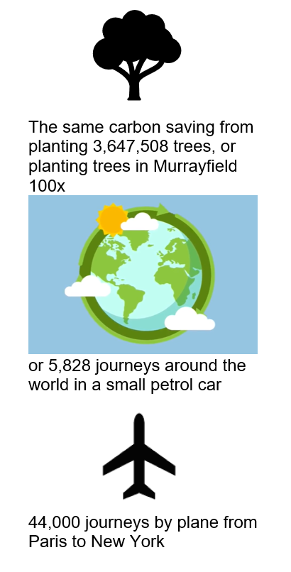
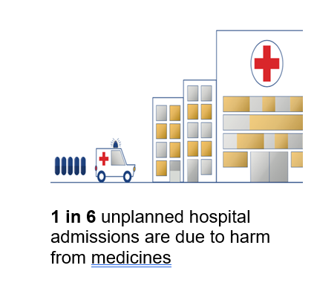
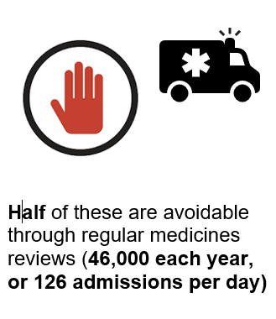
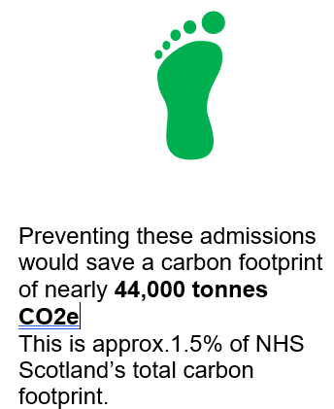
Environmental impact from medicine harms
Notes:
Impact of harm from medicines (due to adverse drug reactions), not only on the patient, but on carbon emissions (also cost, not included here)
Calculated from average 7.7 day stay from unplanned admissions

Slide 13
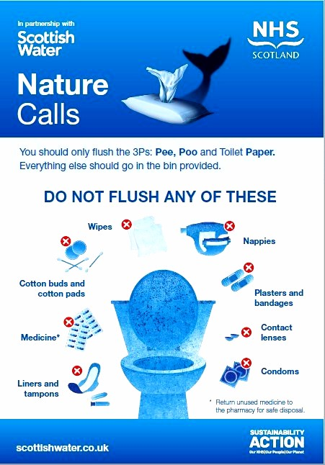
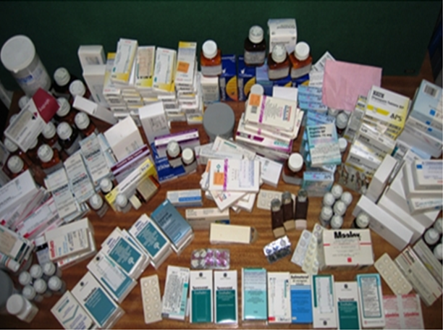
Reducing medicines waste - Safe disposal of medicines including inhalers
Incineration is better than disposing in domestic waste
All medicines including inhaler devices should be returned to pharmacies to be disposed of as medicines waste
Notes:
When aerosol inhalers are disposed of as domestic waste, the residual propellant gas escapes and causes global warming
Returning to the pharmacy ensures that inhalers are disposed of as medical waste and this means that they are incinerated at high temperatures, destroying the propellant and reducing the climate change impact.
Some pharmacies offer recycling facilities, although currently this is still a very small number UK wide.

Slide 14
Person-centred medicines reviews
Increased prescribing and an aging population means more people taking multiple medicines.
Taking multiple medicines can be beneficial but there can be potential harms and increased medicine waste as a result
We promote the 7-Steps medicine review process to ensure the right medicine for the individual. Step 6 of the process is - Sustainability
Individuals’ needs and evidence bases around medicines can change over time, so it is important to regularly review prescriptions. Tools available include ManageMeds app with Patient Reported Outcome Measures (PROMs) to ensure person centred reviews
Notes:
One of the key messages

Slide 15
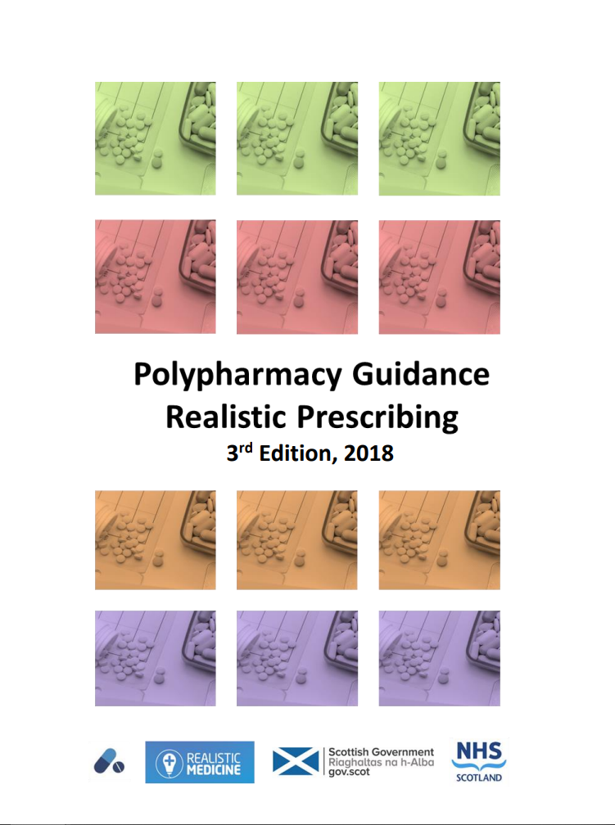
National Polypharmacy guide
Encourages appropriate use of medicines: improving medicines safety and prescribing practice
Clear structure for person-centred medicines review
Targets those at high risk
Promotes prevention of ill-health and consideration of non-pharmacological approaches
Worked case studies illustrating how to use the 7-Steps medication review process
International interest in polypharmacy management
Notes:
Approx 10% medicines thought to be inappropriately prescribed
Only 16% of people take a new medicine as intended

Slide 16
Quality Prescribing for Respiratory Guide. Key messages
Improved outcomes by conducting person-centred medication review​s
Person-centred care: Optimise disease control
Minimise over-reliance on short acting reliever inhalers ​
Ensure inhaler technique taught and checked
Support the use of propellant free inhaler options where appropriate
Support safe disposal of inhalers
Notes:
Quality prescribing guide was co-designed with experts by experience and patient-friendly versions of the guide will be available too in order to promote greater patient understanding of the medications.
Acknowledges the impact of respiratory conditions on those who have them – chronic and long-lasting conditions which impact on health and quality of life.
Guide intends to support clinicians and shared decision making for people with respiratory conditions, putting the person at the centre of their treatment
Quality prescribing guide is being published shortly after a full public consultation

Slide 17
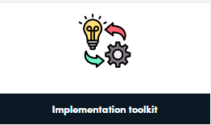
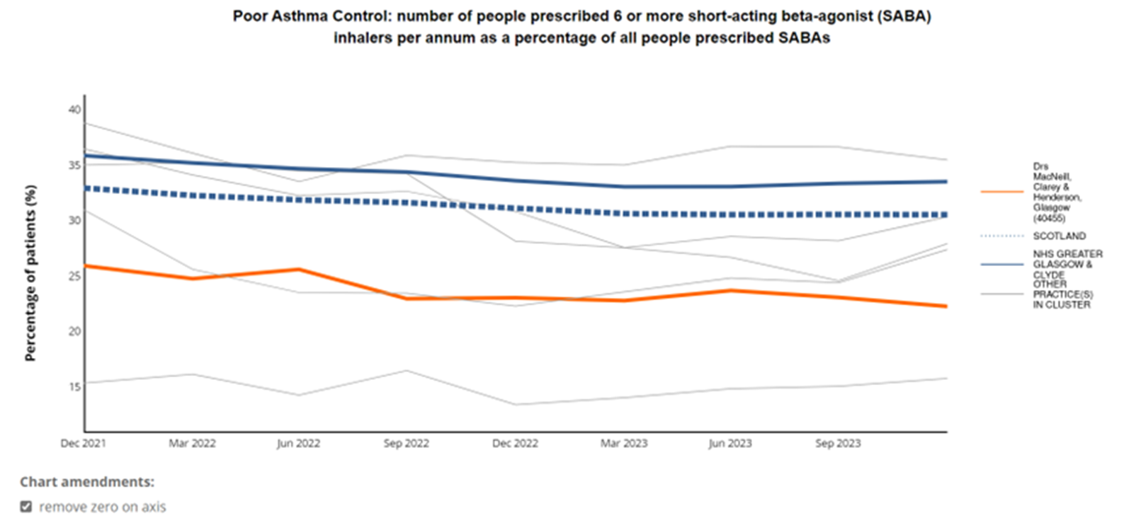
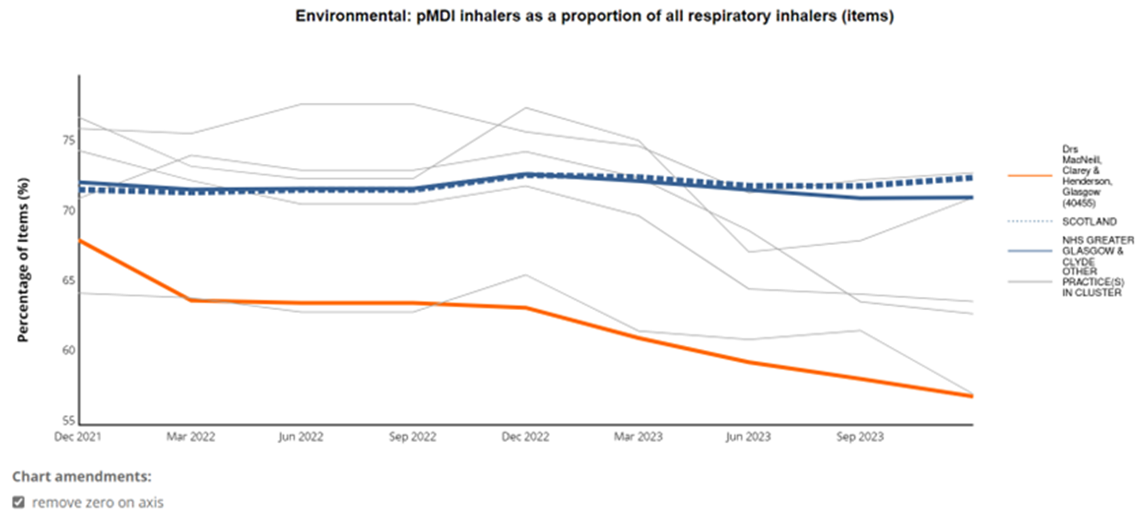
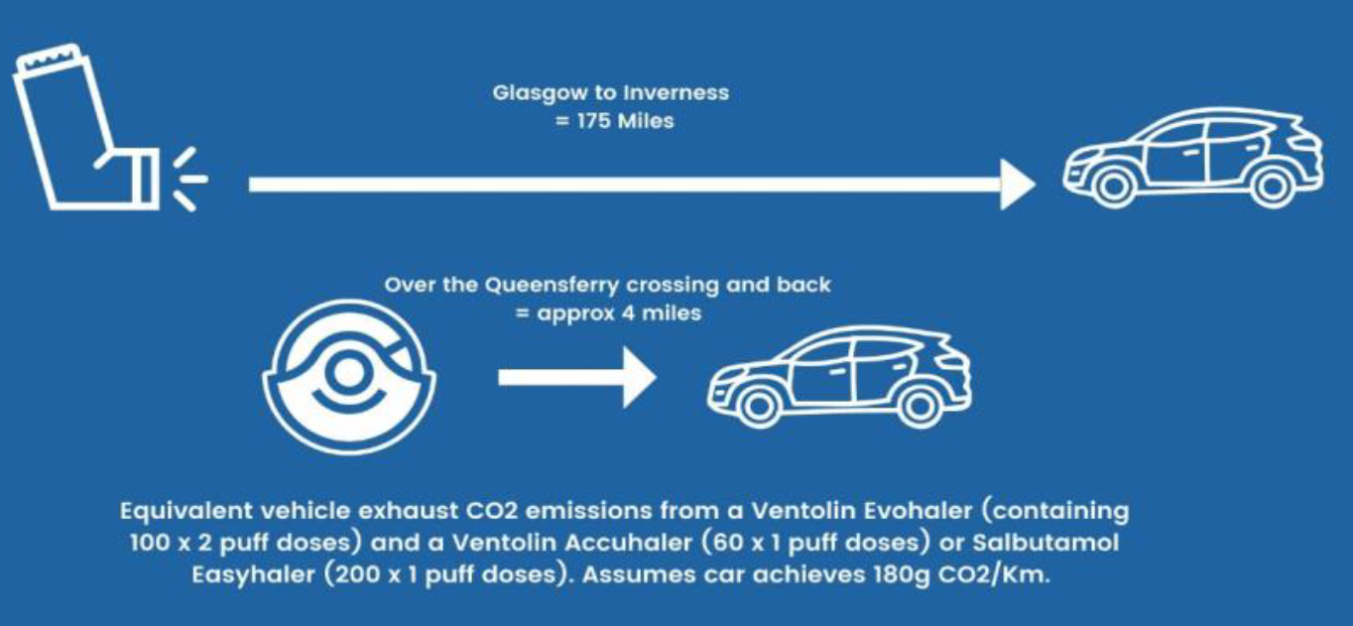
Benefits of implementing respiratory review work
National Therapeutic Indicators from early adopters:
Financial: 7.4 % reduction in SABA volume (MDI and DPI) and 4.9% reduction in cost
Patient Care: Evidence of reduced health care utilisation when SABA use reduced
Notes:
Early adopters completed : Patient review
Audit tool for collection of data
Review details i.e. Face to face, telephone
Inhaler change
Inhaler disposal data pre and post review
Quarterly prescribing report- Percent reduction in MDI to DPI ratio (NTI illustrated) amd reduction in SABA use shown

Slide 18
Carbon footprint of Inhalers

Slide 19
Right diagnosis
Patients on inhalers without a diagnosis!
Disease control - Right drug
Address over-reliance on relievers (SABA/LABA), under-use of preventers (ICS)
Right device
Right disposal
Dry powder inhalers or soft mist inhalers where clinically appropriate
Return all aerosol inhalers for incineration / recycling
If aerosol (pMDI) inhalers are needed, then choose brand and regime to minimise carbon footprint
RESPIRATORY
Better care, greener care
Pollution, smoke, housing…
Optimise local return schemes
Severe asthma vs suboptimal inhaler technique
Optimise according to guidelines e.g. consider MART (combined maintenance and reliever therapy)
Optimise drug delivery / inhaler technique
Adapted from Greener practice slides. www.greenerpractice.co.uk
Notes:
Use the 4 D’s to achieve both better respiratory care and patient outcomes as well as reducing impact on climate of respiratory care
Diagnosis
Drug
Device
Disposal

Slide 20
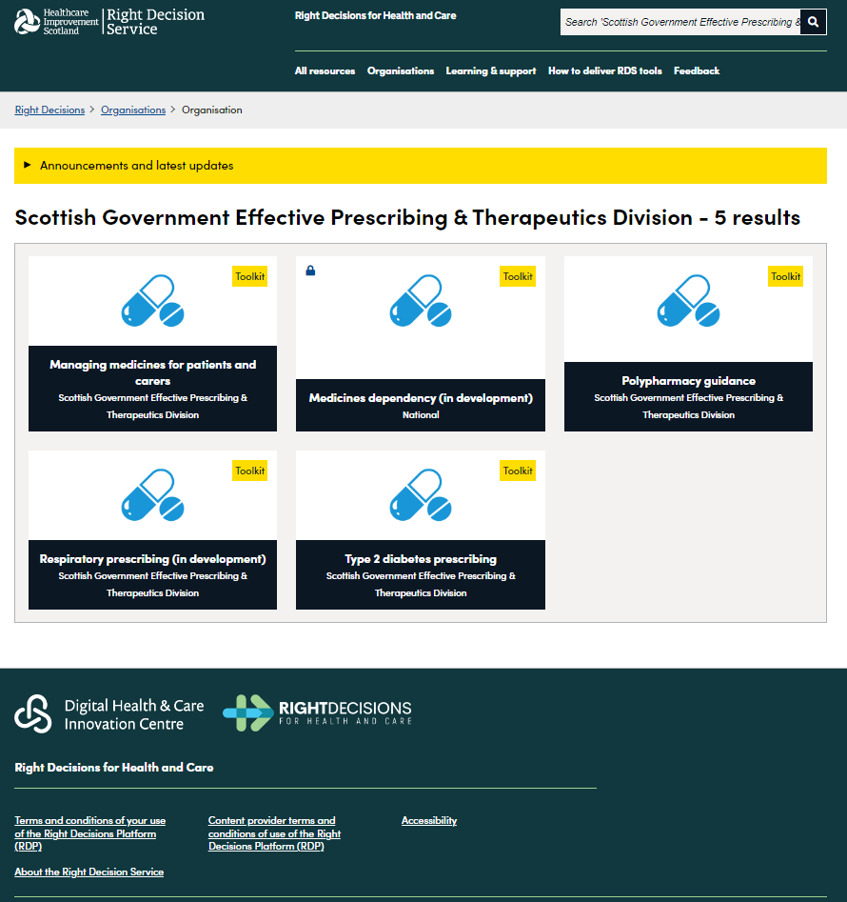
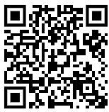
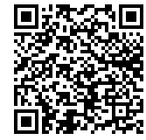
Right Decision Service: Effective Prescribing and Therapeutics resources
Search effective prescribing for respiratory, diabetes, polypharmacy toolkits
Apple
Android
Right Decision Service website

Slide 21
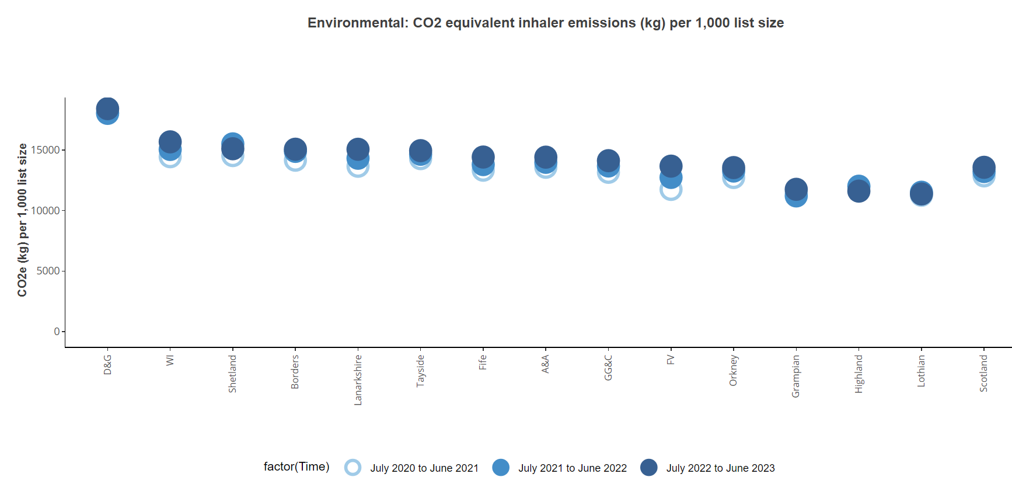
Tools and monitoring - National Therapeutic Indicators (NTIs)

Slide 22
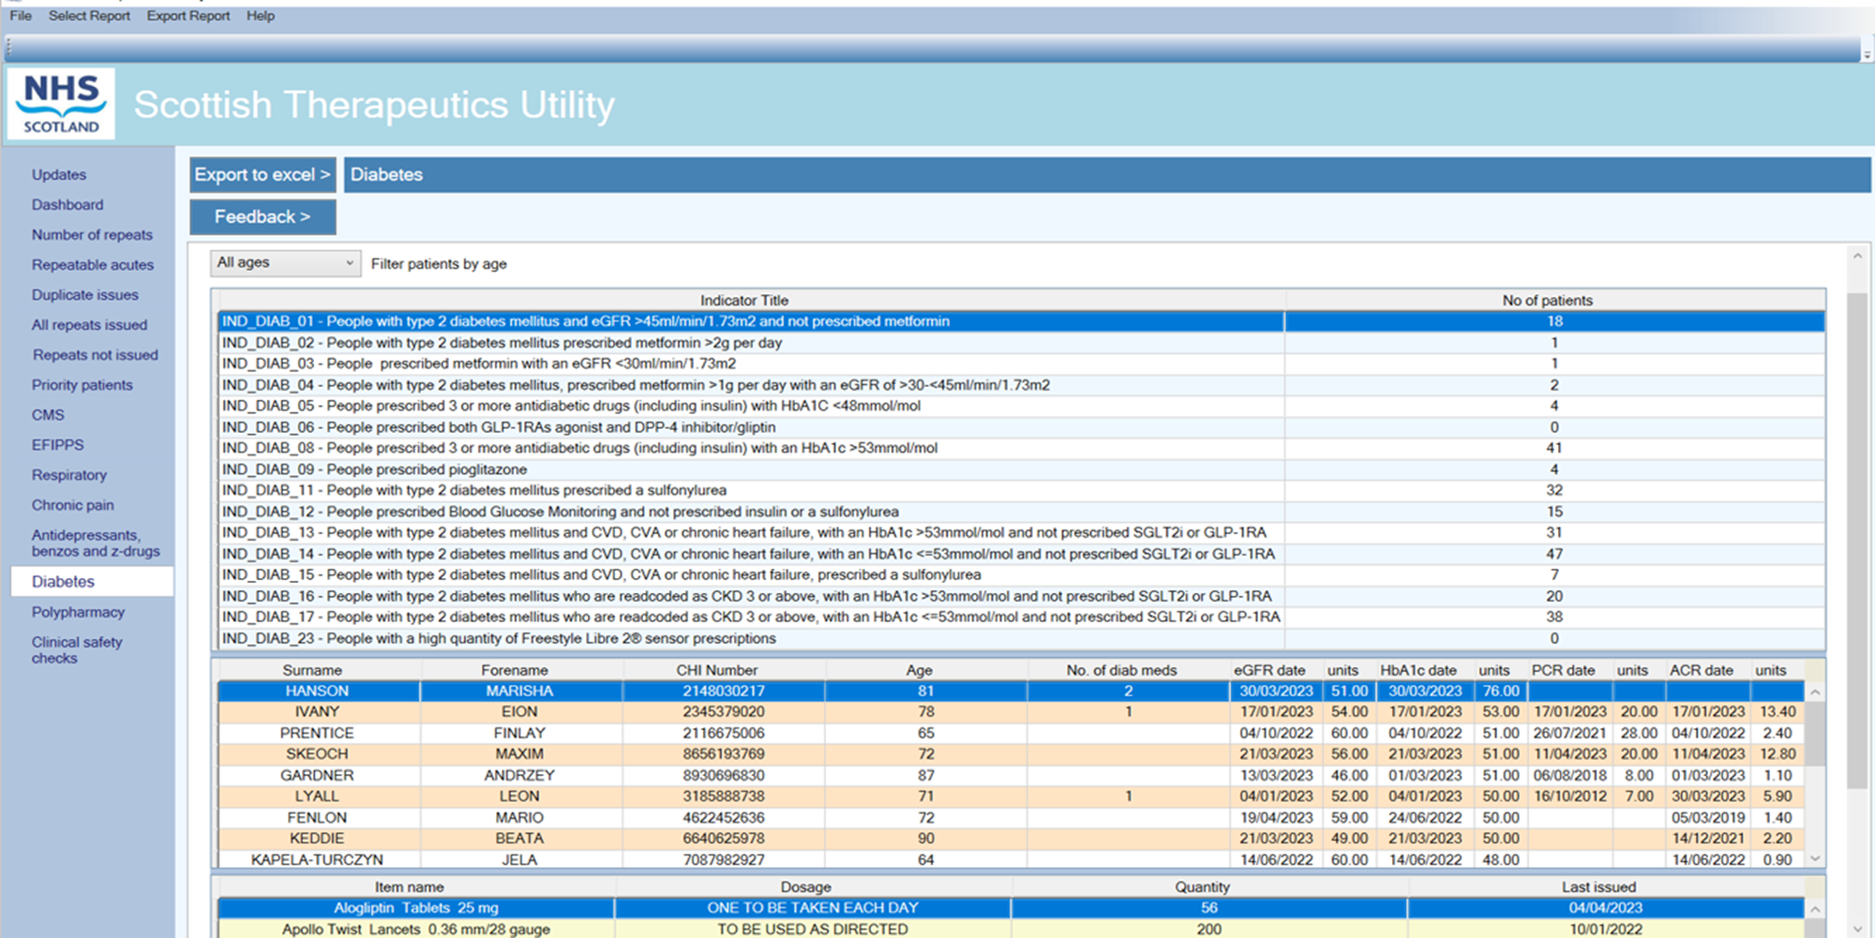
Case finding in General Practice- Scottish Therapeutics Utility (STU)

Slide 23
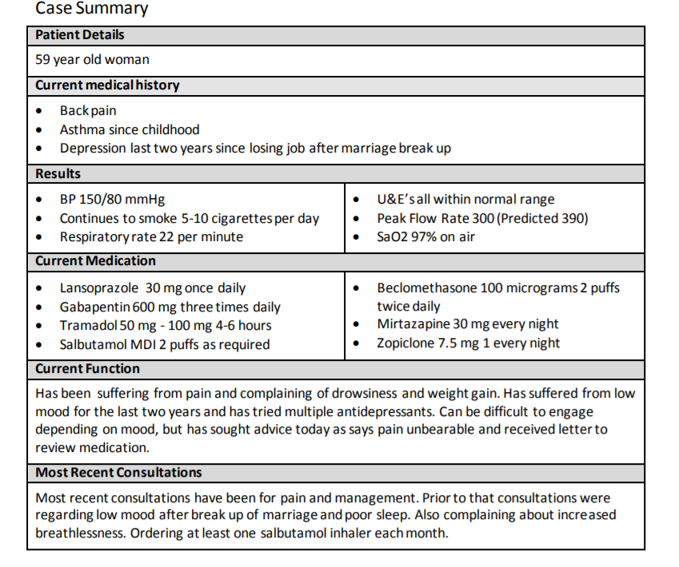
Case study
‘I am in pain constantly but especially when getting up from my chair. I feel like I cannot catch my breath and need to use my salbutamol inhaler all the time’
Clenil MDI

Slide 24
Steps | Process
1. Aims What matters to the individual about their condition(s)? | Review diagnoses and consider: Therapeutic objectives of drug therapy | Management of existing health problems. Prevention of future health issues, including lifestyle advice
2. Need Identify essential drug therapy | Identify essential drugs (not to be stopped without specialist advice) Drugs that have essential replacement functions (e.g. levothyroxine) Drugs to prevent rapid symptomatic decline (e.g. drugs for Parkinson’s disease, heart failure)
3. Does the individual take unnecessary drug therapy? | Identify and review the continued need for drugs what is medication for? with temporary indications with limited benefit in the person under review (see Drug efficacy & applicability (NNT) table) | with higher than usual maintenance doses with limited benefit/evidence for use | with higher than usual maintenance doses with limited benefit/evidence for use
4. Effectiveness Are therapeutic objectives being achieved? | Identify the need for adding/intensifying drug therapy to achieve therapeutic objectives to achieve symptom control to achieve biochemical/clinical targets to prevent disease progression/exacerbation is there a more appropriate medication to achieve goals?
5. Safety Does the individual have or is at risk of ADR/ Side effects? Does the person know what to do if they’re ill? | Identify individual safety risks by checking for appropriate individual targets e.g. HbA1c, BP drug-disease interactions drug-drug interactions (see ADR table) monitoring mechanisms for high-risk drugs risk of accidental overdosing | Identify adverse drug effects by checking for specific symptoms/laboratory markers (e.g. hypokalaemia) cumulative adverse drug effects (see ADR table) drugs used to treat side effects caused by other drugs Medication Sick Day guidance
6. Sustainability Is drug therapy cost-effective and environmentally sustainable | Identify unnecessarily costly drug therapy by considering more cost-effective alternatives, safety, convenience | Consider the environmental impact of Inhaler use Single use plastics Medicines waste Water pollution
7. Person centeredness Is the person willing and able to take drug therapy as intended? | Does the person understand the outcomes of the review? Consider Teach back Ensure drug therapy changes are tailored to individual’s preferences. Consider is the medication in a form they can take? is the dosing schedule convenient? what assistance is needed? are they able to take medicines as intended? | Agree and communicate plan discuss and agree with the individual/carer/welfare proxy therapeutic objectives and treatment priorities include lifestyle and holistic management goals inform relevant health and social care providers of changes in treatments across the transitions of care
Key concepts in this case
Notes:
A one page summary of the seven steps for reference

Slide 25
Steps | Process | Person specific issues to address
1. Aims What matters to the individual about their condition(s)? | Review diagnoses and consider: Therapeutic objectives of drug therapy Management of existing health problems. Prevention of future health issues, including lifestyle advice

Slide 26
Steps | Process | Person specific issues to address
1. Aims What matters to the individual about their condition(s)? | Review diagnoses and consider: Therapeutic objectives of drug therapy Management of existing health problems. Prevention of future health issues, including lifestyle advice | ‘I am in pain constantly but especially when getting up from my chair. I feel like I cannot catch my breath and need to use my salbutamol inhaler all the time’ Pain management Asthma management

Slide 27
2. Need Identify essential drug therapy | Identify essential drugs (not to be stopped without specialist advice) Drugs that have essential replacement functions (e.g. levothyroxine) Drugs to prevent rapid symptomatic decline (e.g. drugs for Parkinson’s disease, heart failure)
3. Does the individual take unnecessary drug therapy? | Identify and review the continued need for drugs what is medication for? with temporary indications with higher than usual maintenance doses with limited benefit/evidence for use with limited benefit in the person under review (see Drug efficacy & applicability (NNT) table)

Slide 28
2. Need Identify essential drug therapy | Identify essential drugs (not to be stopped without specialist advice) Drugs that have essential replacement functions (e.g. levothyroxine) Drugs to prevent rapid symptomatic decline (e.g. drugs for Parkinson’s disease, heart failure) | Inhaled corticosteroid for asthma: Inhaler technique and adherence should be checked (Over-reliance on salbutamol)
3. Does the individual take unnecessary drug therapy? | Identify and review the continued need for drugs what is medication for? with temporary indications with higher than usual maintenance doses with limited benefit/evidence for use with limited benefit in the person under review (see Drug efficacy & applicability (NNT) table) | Treatment dose PPI: check indication and aim for lowest dose to manage symptoms Pain management: Pain is constant and in the low back with no referred pain or neurological effects. Gabapentin is not indicated so consider alternatives and dose reduction and withdrawal Insomnia management long term zopiclone, which will no longer be effective and is causing symptoms Depression management: discuss depression and review current treatment. Explore other support that may be available locally

Slide 29
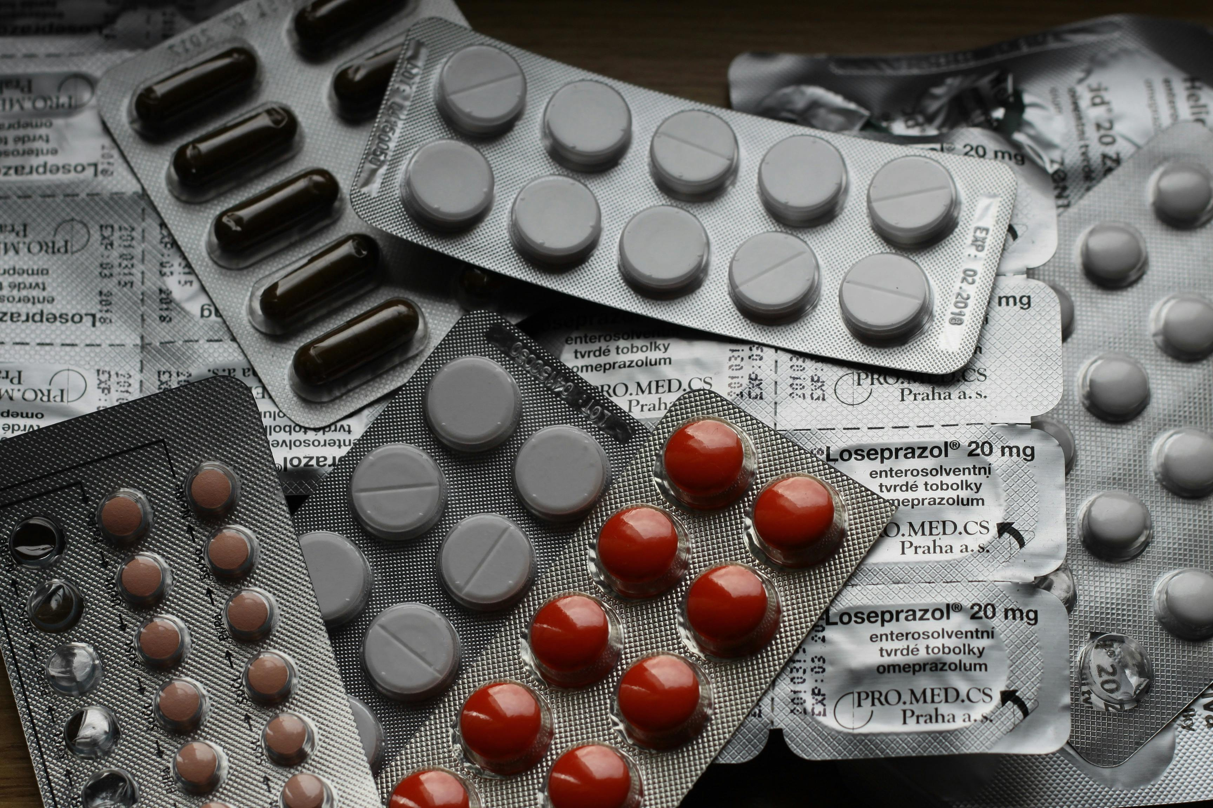
Why deprescribing matters
Deprescribing - reducing or stopping medications that may harm or no longer benefit a patient - decreases the likelihood of an adverse event and reduces the financial burden of paying for a multitude of medications AND the environmental impact of unnecessary medicines

Slide 30
4. Effectiveness Are therapeutic objectives being achieved? | Identify the need for adding/intensifying drug therapy to achieve therapeutic objectives to achieve symptom control to achieve biochemical/clinical targets to prevent disease progression/exacerbation is there a more appropriate medication to achieve goals?

Slide 31
4. Effectiveness Are therapeutic objectives being achieved? | Identify the need for adding/intensifying drug therapy to achieve therapeutic objectives to achieve symptom control to achieve biochemical/clinical targets to prevent disease progression/exacerbation is there a more appropriate medication to achieve goals? | Pain control: Review expectations and current regimen to manage pain more appropriately. Existing treatments should be reduced and withdrawn before considering additional analgesia. Insomnia control: review expectations and need for ongoing hypnotic Smoking cessation: consider options for smoking cessation and referral for support Asthma control: ensure adequate treatment plan for asthma. Over-use of salbutamol suggesting under treatment. Review inhaler technique and use of preventative treatment. If these are appropriate then consider stepping up treatment and/or COPD assessment given smoking history

Slide 32
Drug Efficacy: Core concept
There is a strong tendency to prescribe medication without considering just how effective it is going to be in the individual
IV Antibiotics for Meningitis >>> super effective
Statin for primary prevention >> effective but less so
Prescribers in general (and you all in particular) have to develop a good awareness of efficacy
Esp in Complex Patients

Slide 33
5. Safety Does the individual have or is at risk of ADR/ Side effects? Does the person know what to do if they’re ill? | Identify individual safety risks by checking for appropriate individual targets e.g. HbA1c, BP drug-disease interactions drug-drug interactions (see ADR table) monitoring mechanisms for high-risk drugs risk of accidental overdosing Identify adverse drug effects by checking for specific symptoms/laboratory markers (e.g. hypokalaemia) cumulative adverse drug effects (see ADR table) drugs used to treat side effects caused by other drugs Medication Sick Day guidance

Slide 34
5. Safety Does the individual have or is at risk of ADR/ Side effects? Does the person know what to do if they’re ill? | Identify individual safety risks by checking for appropriate individual targets e.g. HbA1c, BP drug-disease interactions drug-drug interactions (see ADR table) monitoring mechanisms for high-risk drugs risk of accidental overdosing Identify adverse drug effects by checking for specific symptoms/laboratory markers (e.g. hypokalaemia) cumulative adverse drug effects (see ADR table) drugs used to treat side effects caused by other drugs Medication Sick Day guidance | All bloods normal Actual ADR: drowsiness with zopiclone and drug to drug interaction with tramadol and gabapentin. Resulting cognitive impairment may effect activities such as driving Risk of dependence: zopiclone, gabapentin and tramadol Risk of overdose: high doses of analgesics and adjuvants increase potential for accidental overdose

Slide 35
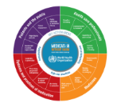
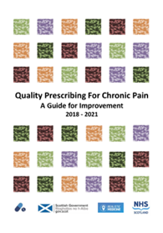
High-risk situations
Some high-risk (high-alert) medications are associated with significant harm when used in error (e.g. APINCH)
A – anti-infective
P – Potassium & other electrolytes
I – Insulin
N – Narcotics (opioids) & other sedatives
C – Chemotherapeutic agents
H – Heparin & anticoagulants
Other high-risk medications identified by local health facilities
High risk meds and situations in primary care:
Mair A, Wilson M, Dreischulte, T.Addressing the Challenge of Polypharmacy Annu.Rev.Pharmacol.Toxicol.2020.60:33.1– 33.21
Notes:
A-PINCH:
A: anti-infective
P: Potassium and other electrolytes (inj. Magnesium, calcium, hypertonic NaCl)
I: Insulin
N: Narcotics (opiods, e.g. morphine, fentanyl) and other sedatives (benzodiazepines, e.g. diazepam, midazolam, propofol & other short term anaesthetics)
C: Chemotherapeutic agents (Vincristine, methotrexate, azathioprine)
H: Heparin & anticoagulants (e.g. warfarin, enoxaparin, dabigatran)
Other: High-risk medicines identified by local health district

Slide 36
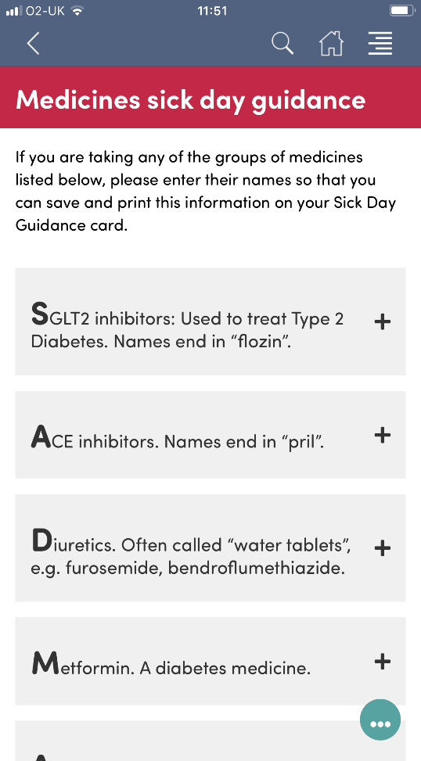
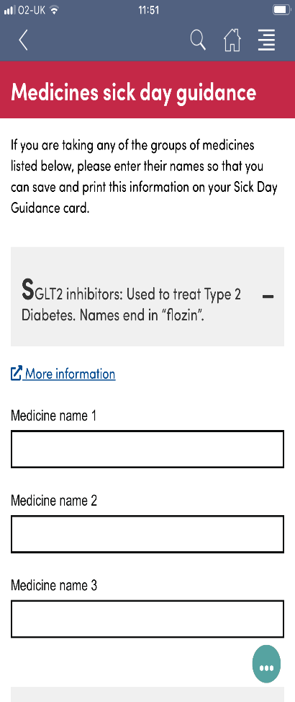
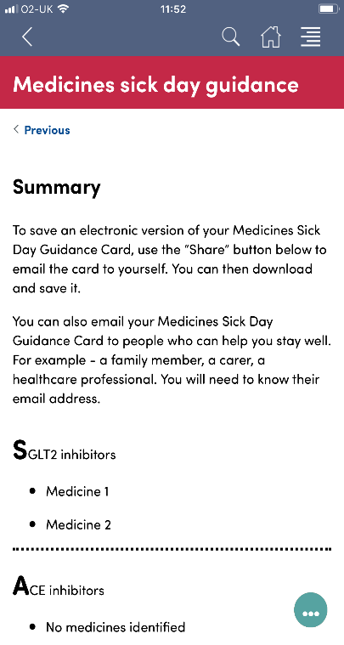
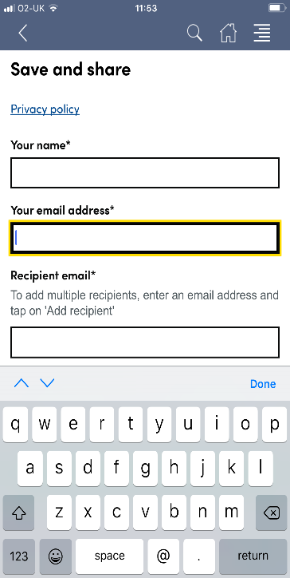
Empowering patients and carers
Notes:
Medicine sick day guidance is available through the Manage Meds app or website – including the ability to print out a list personalised to the patient

Slide 37
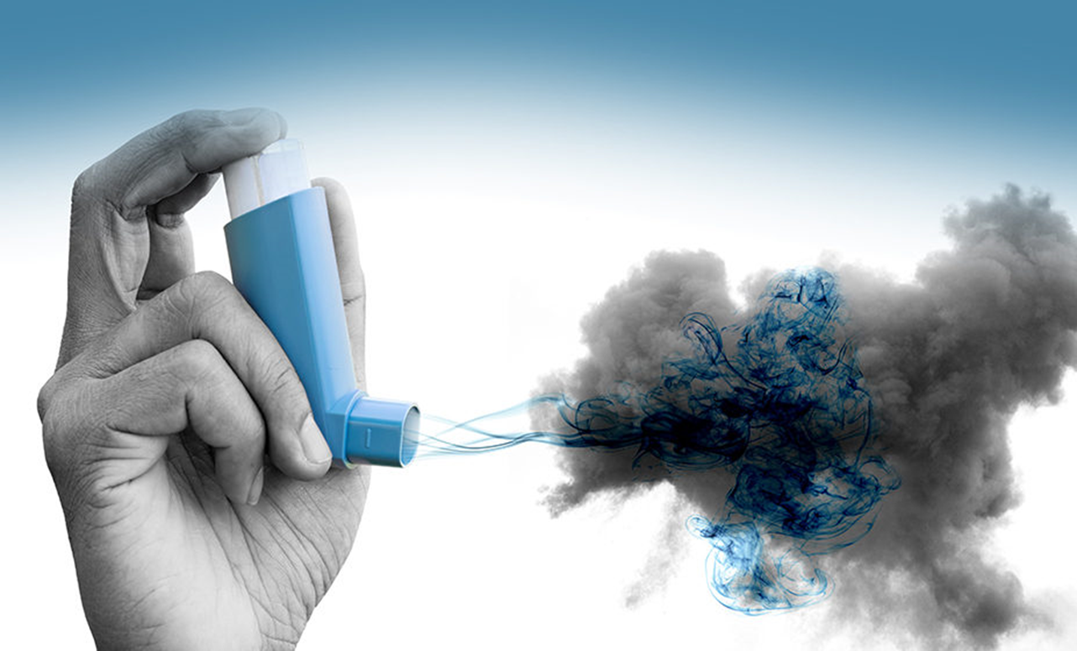
What proportion of environmental impact is due to Salbutamol inhalers alone?

Slide 38
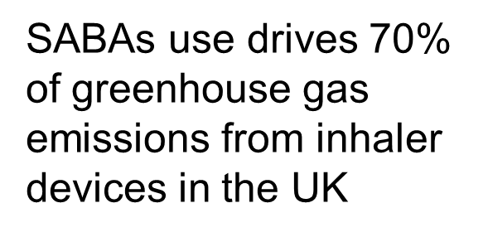
What proportion of environmental impact is due to Salbutamol inhalers alone?

Slide 39
6. Sustainability Is drug therapy cost-effective and environmentally sustainable | Identify unnecessarily costly drug therapy by considering more cost-effective alternatives, safety, convenience Consider the environmental impact of Inhaler use Single use plastics Medicines waste Water pollution

Slide 40
6. Sustainability Is drug therapy cost-effective and environmentally sustainable | Identify unnecessarily costly drug therapy by considering more cost-effective alternatives, safety, convenience Consider the environmental impact of Inhaler use Single use plastics Medicines waste Water pollution | Inhaler formulation could be changed to a Dry Powder inhaler (DPI) – check inhaler technique and use of MART reduces number of inhalers needed Prescribing in keeping with current formulary recommendations Advised to dispose of medicines through community pharmacy Advised to only order what is needed, do not stockpile medicines

Slide 41
7. Person centeredness Is the person willing and able to take drug therapy as intended? | Does the person understand the outcomes of the review? Consider Teach back Ensure drug therapy changes are tailored to individual’s preferences. Consider is the medication in a form they can take? is the dosing schedule convenient? what assistance is needed? are they able to take medicines as intended? Agree and communicate plan discuss and agree with the individual/carer/welfare proxy therapeutic objectives and treatment priorities include lifestyle and holistic management goals inform relevant health and social care providers of changes in treatments across the transitions of care | Asthma management: struggles to remember to use preventer inhaler. Frequent use of reliever when feels short of breath. MART asthma management plan, education and support may help. Smoking cessation: patient doesn’t feel ready to stop and so decision to ‘park’ this for now and review at later stage Non-medication pain management: Signpost to other strategies patients can engage with for pain management. She is not yet convinced of the benefits so will require further encouragement Medication reduction: patient agrees to a ‘go slow’ approach to medication reduction and thinks that she will benefit from regular support and review
Notes:
MART = Maintenance and Reliever Therapy – no need for separate SABA

Slide 42
Implementing change in practice: sphere of influence
Slido poll, word cloud:
What will be the action you take back to your practice to reduce harm and waste from medicines?
https://learningloop.io/glossary/circles-of-influence
Notes:
The circles of influence framework was popularised in Stephen Covey’s book: The 7 habits of Highly Effective People Focusing on the smaller circle initially where the aspects lie that we can directly shape – and if we can nurture our circle of control, we enhance our wellbeing.

Slide 43
What are the actions YOU can take to make the biggest difference in prescribing to reduce harm and waste?
Provide lifestyle advice for long term conditions: diet, activity and smoking cessation
Review medication when appropriate
Reduce the number of investigations you request
Check inhaler technique at every opportunity
Consider low global warming potential inhalers (DPI, SMI)
Optimise and encourage regular use of preventer therapy in asthma
Promote correct disposal of medicines including inhalers
Use the ManageMedicines app to access all of the resources

Slide 44
Better care is better for the person and the environment If you have any queries, please email EPandT@gov.scot
@realisticmed
#RealMed2024
www.realisticmedicine.scot

