Slide 1
How to measure shared decision making?
Conference 2024:
Reform and Recovery
Julia Mackel
RM Lead and Principal Lead, NES QI Team
Ali Keast
Senior Educator, NES QI Team
@realisticmed
#RealMed2024
www.realisticmedicine.scot

Slide 2
Realistic Medicine Conference
How to measure shared decision making?
Conference 2024: Reform and Recovery

Slide 3
Julia Mackel
Realistic Medicine Lead and Principal Lead
NES QI Team
Ali Keast
Senior Educator
NES QI Team
Conference 2024: Reform and Recovery
Notes:
Introduce team

Slide 4
Aim of the session
Explain the toolkit to measure Shared Decision Making and how to use the toolkit.
Conference 2024: Reform and Recovery

Slide 5
You will be able to:
Implement Measuring Shared Decision Making in your team/service.
Conference 2024: Reform and Recovery
Notes:
This session IS about how to use a toolkit for measuring shared decision making. It is not saying this is the only approach. It is not saying everyone has to use it if they have existing systems in place.
We won’t be covering the evidence base for collaboRATE or SURE.
If you want to use the tool this session is for you.

Slide 6
Conference 2024: Reform and Recovery
Notes:
Shared Decision Making -Citizens Jury 2018 told us that people want to involved in decisions about their care. There are a number of ways we can look at this but one way to support and educate our teams has been by providing SDM module developed by NES and this can be found on Turas learn. So far this has been completed or started by around 4500 people. SDM module
link and discuss Realistic Conversations toolkit
SDM links closely with -

Slide 7
Scoping
Testing
Toolkit
Conference 2024: Reform and Recovery
Notes:
Image by <a href="https://pixabay.com/users/8385-8385/?utm_source=link-attribution&utm_medium=referral&utm_campaign=image&utm_content=55067">8385</a> from <a href="https://pixabay.com//?utm_source=link-attri
bution&utm_medium=referral&utm_campaign=image&utm_content=55067">Pixabay</a>
The landscape
Scoping activity took place from October-December 2022. This included:
One to one interviews with 6 clinical subject matter experts and those already using collaboRATE
Online survey sent to RM Clinical Leads and Programme Managers
Discussion with NHS England on their use of CollaboRATE
A testing period took place from January-March 2023. Several volunteers were willing to test the collaboRATE tool within their own specialty and area. The NES RM Team created a testing toolkit which contained the tool itself (paper survey), a data collection spreadsheet, and a survey for collating feedback on the practicalities of using the tool.
Created a toolkit and tested and got feedback from 5 boards and this is what we will showcase today

Slide 8
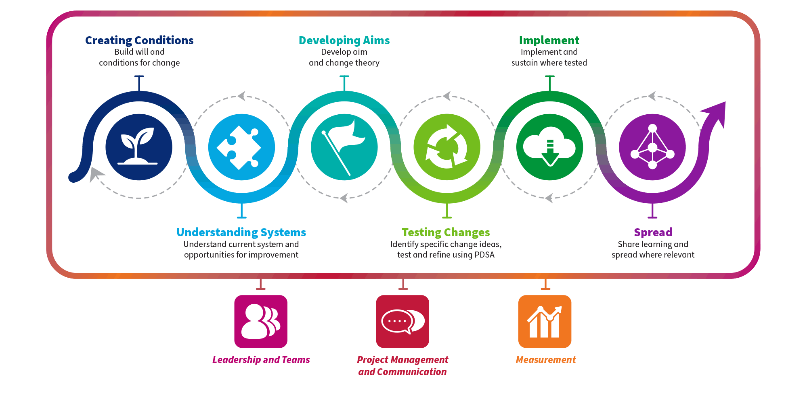
Conference 2024: Reform and Recovery
Notes:
In terms of implementing a way to measure shared decision making it can be useful to consider the Quality improvement journey. Before you start to implement its good to consider if there is will for change and create the conditions for change.
What we found in our test period is there was will for something as people feel they have not system in place and it would be good to start somewhwere
Understanding system – its god to know you’re starting point
Project management and communication is key to implementation who do you need to link with who do you need to communicate with.
Measurement is key and the toolkit includes data spreadsheet however it is important to know how masuring is going to work in practice

Slide 9
Conference 2024: Reform and Recovery
Notes:
Questions/comments

Slide 10
Conference 2024: Reform and Recovery

Slide 11
Conference 2024: Reform and Recovery
Notes:
Questions/comments

Slide 12
Resources
Patient Information
Staff Information
Patient Surveys
Conference 2024: Reform and Recovery
Notes:
In the CollaboRATE Toolkit you can find downloadable leaflets for patients, flyers for Staff information and patient Surveys in both printable and electronic versions.

Slide 13
CollaboRATE
Creating a QR Code
Live Demo
Measuring shared decision making
Conference 2024: Reform and Recovery
Notes:
10 mins
Let me show you how to create a survey and QR code before you have a go.
Scroll down to Patient Surveys and select the tool you’d like to use. How to measure shared decision making? (cloud.microsoft)
This will open up the survey in a new tab on your screen and it will have a button at the top saying “Duplicate it”.
It will take a moment to copy to your personal MS Forms account where it will then change to read “copy”. You can simply click over this area and it will allow you to amend the text.
When you are happy with the wording of the survey and you are ready to share this, simply click on “Collect Responses”
Make sure you select “Anyone can respond” and then select the QR Code option
Select Download, where you can then save it to your files and add it to a poster of flyer.

Slide 14
Conference 2024: Reform and Recovery

Slide 15
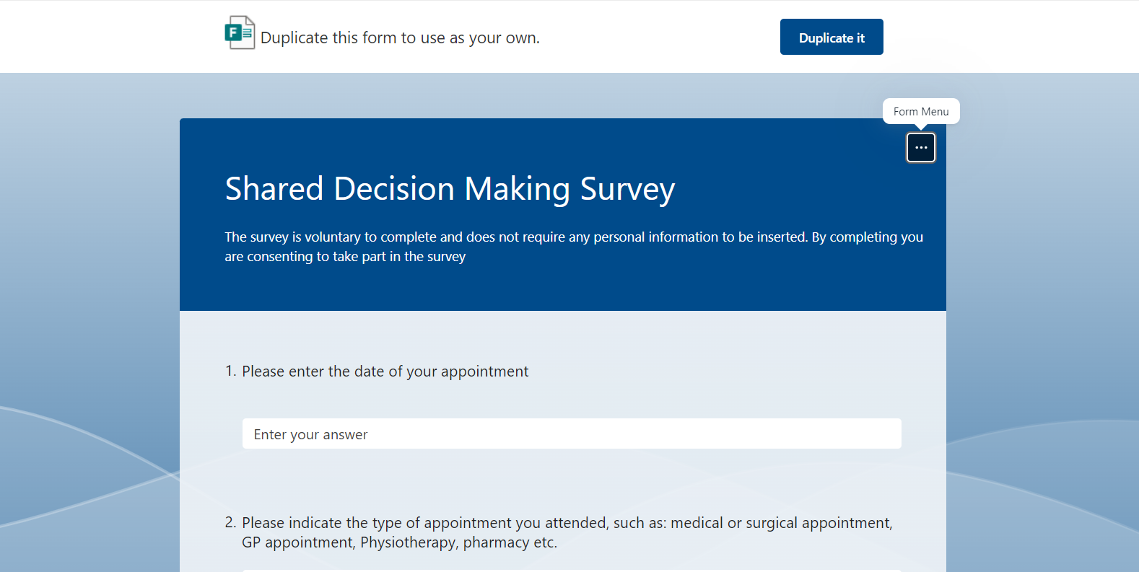
Conference 2024: Reform and Recovery

Slide 16
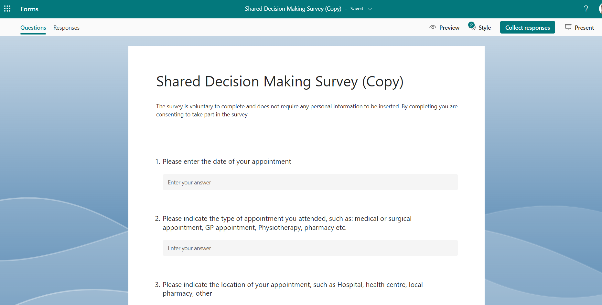
Conference 2024: Reform and Recovery

Slide 17
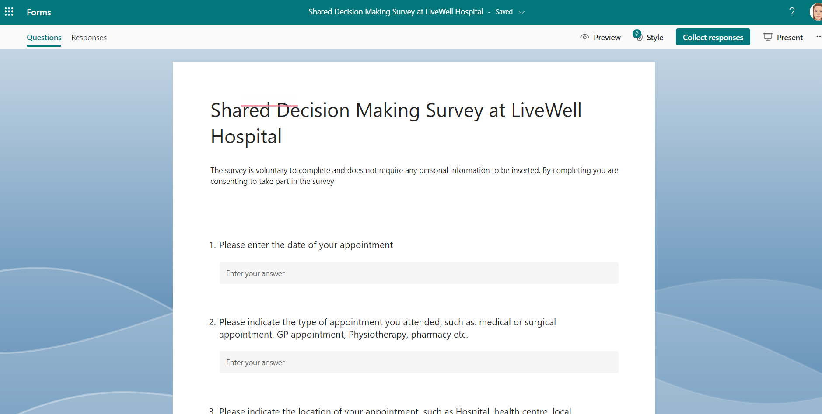
Conference 2024: Reform and Recovery

Slide 18
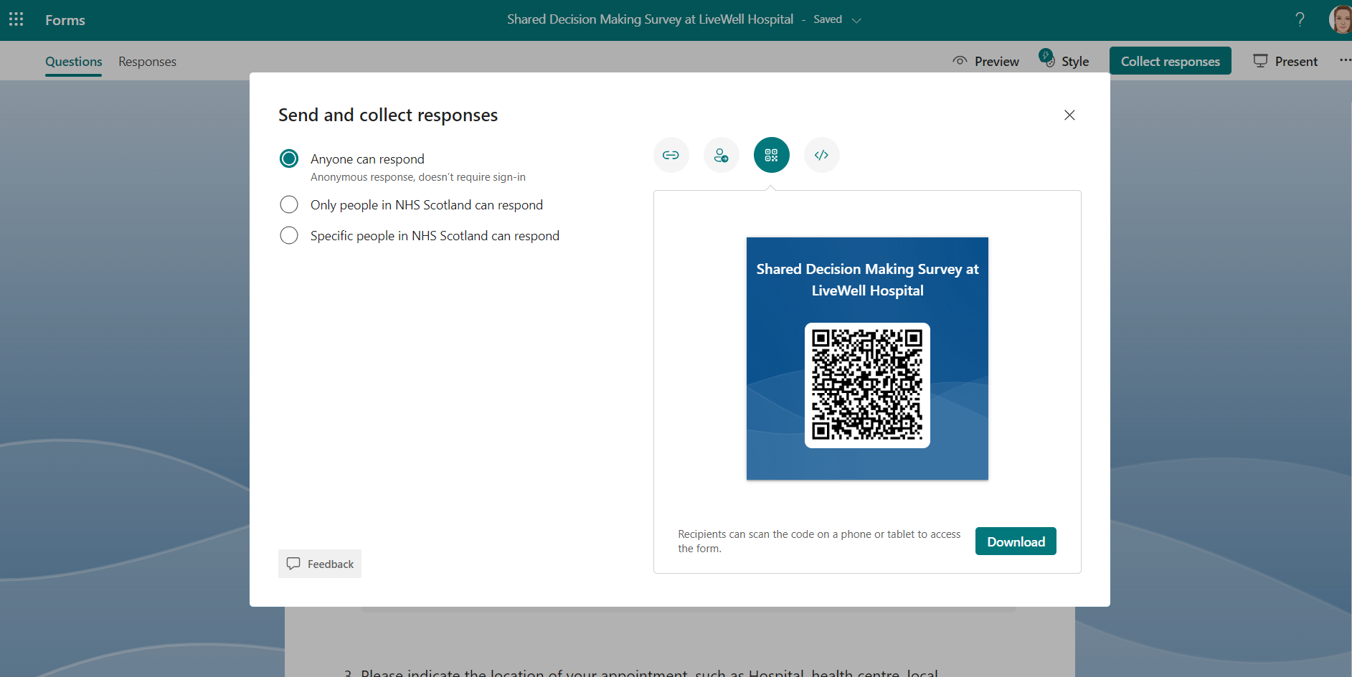
Conference 2024: Reform and Recovery

Slide 19
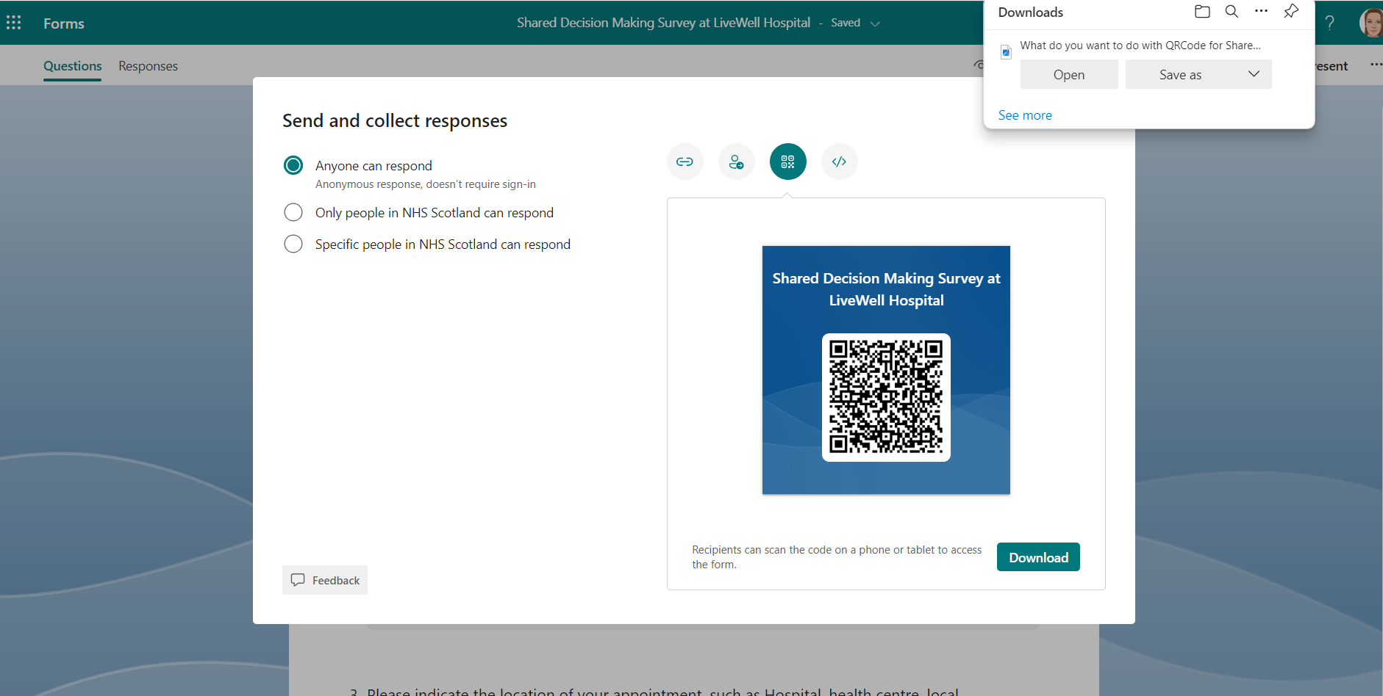
Conference 2024: Reform and Recovery

Slide 20
Conference 2024: Reform and Recovery

Slide 21
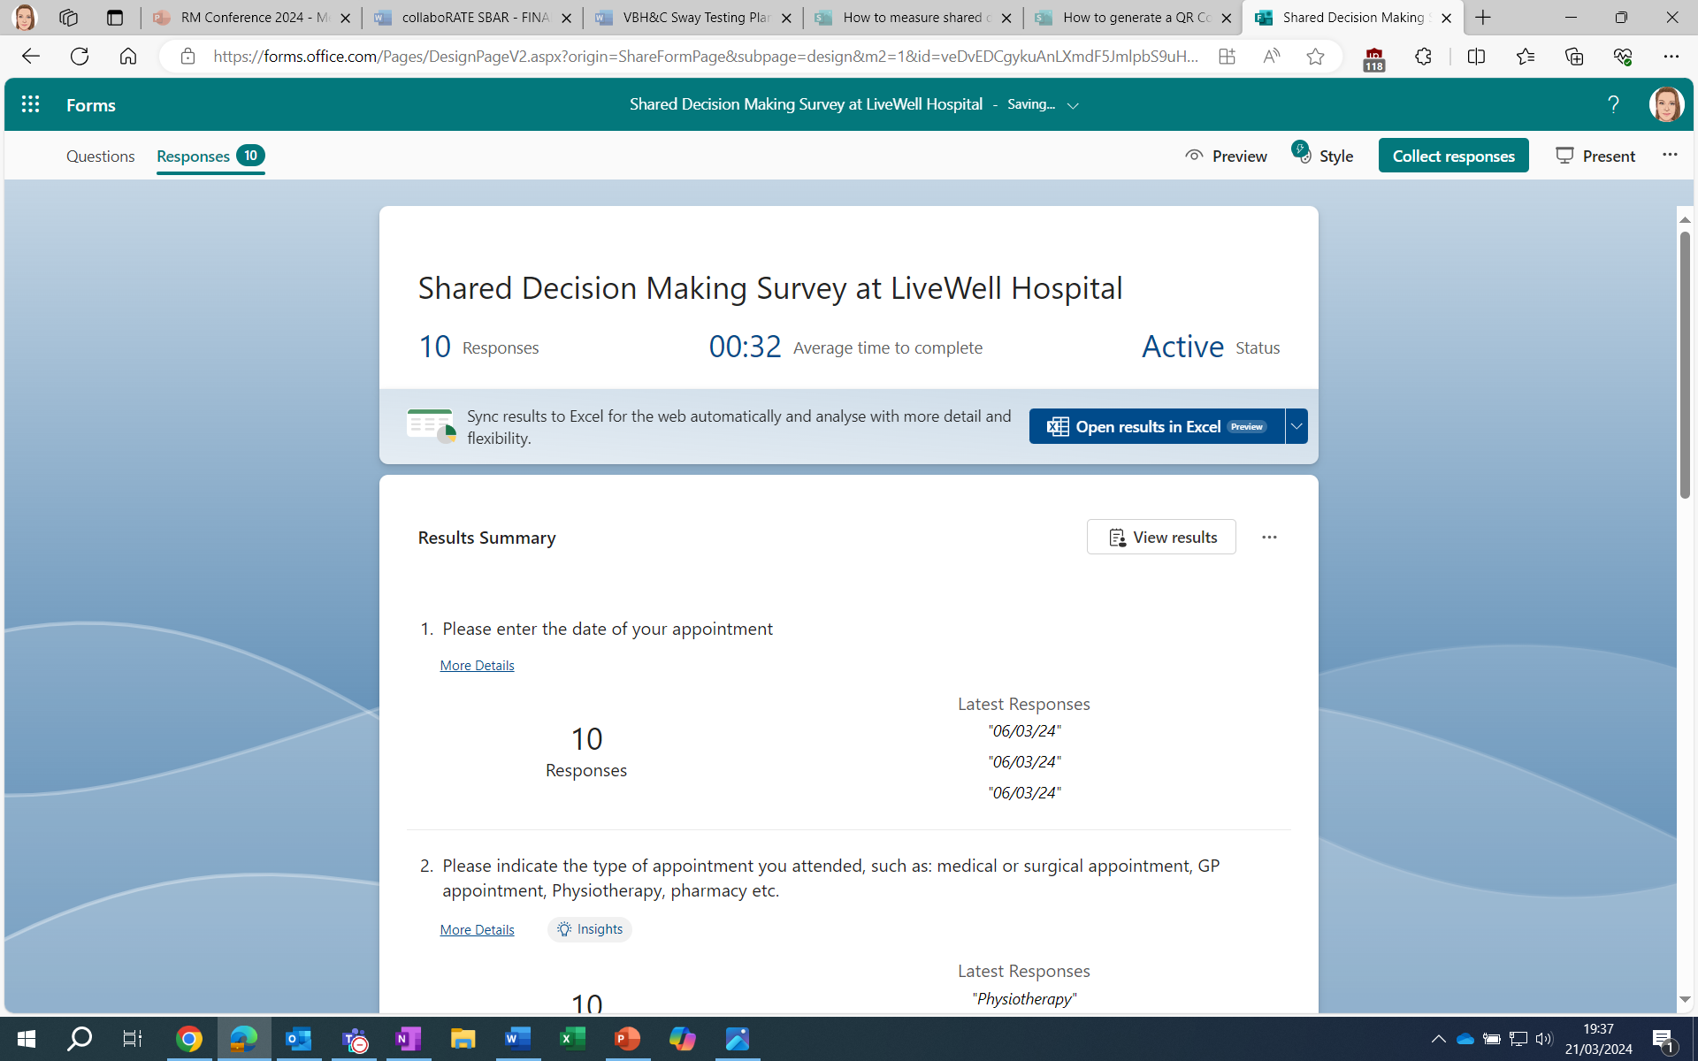
Conference 2024: Reform and Recovery
Notes:
Once youre survey is live, you can then go in and look at the responses either at a glance or by downloading it into excel…..

Slide 22
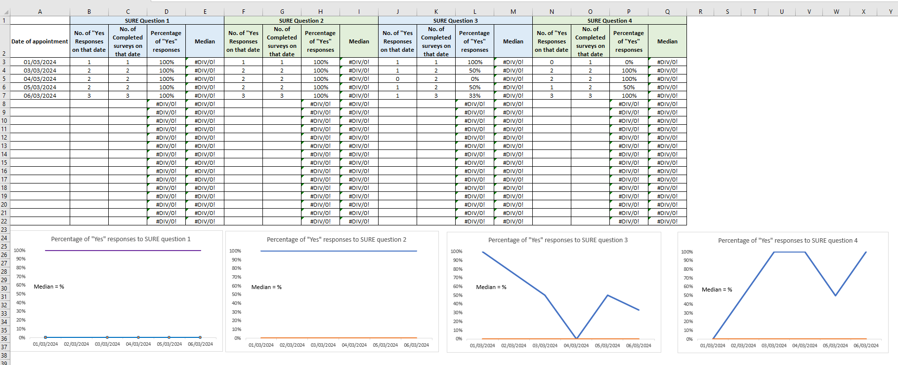
Conference 2024: Reform and Recovery
Notes:
….. so you can start to use the Data Collection Tool which is also found on the Sway Resource.
collaboRATE Data Collection Tool | Turas | Learn (nhs.scot)

Slide 23
Conference 2024: Reform and Recovery
Notes:
Questions/comments

Slide 24
Conference 2024: Reform and Recovery
This Photo by Unknown Author is licensed under CC BY-NC-ND
Notes:
Now you know how easy it is to create the survey, you need a plan for what’s going to happen with it next.

Slide 25
Measurement
Conference 2024: Reform and Recovery
Notes:
8 mins
The toolkit also contains instructions on how to create a patient survey and a data collection spreadsheet.
The data collection spreadsheet is another downloadable tool designed for you to enter your data into the template allowing it to auto-generate the run charts for you.
CLICK: To prepare for the collection of data, you may want to think about creating a short measurement plan, detailing the who, what, where and when of the data collection.
ACTIVITY: Individual or paired work 5 mins.
Work individually or in pairs to create the start of your plan for how you might use this covering Who, How, Where and What.

Slide 26
Conference 2024: Reform and Recovery
Notes:
Any questions?

Slide 27
Conference 2024: Reform and Recovery
Notes:
Any questions?

Slide 28
TURAS
Resources and Information
Animations
eLearning
Conference 2024: Reform and Recovery
Notes:
1 min
The RM pages on Turas are a great source of information accessible to all colleagues across the health and care system.
Again, themed under the 6 pillars and VBH&C, there are animations, eLearning and additional resources and information highlighted and signposted.

Slide 29
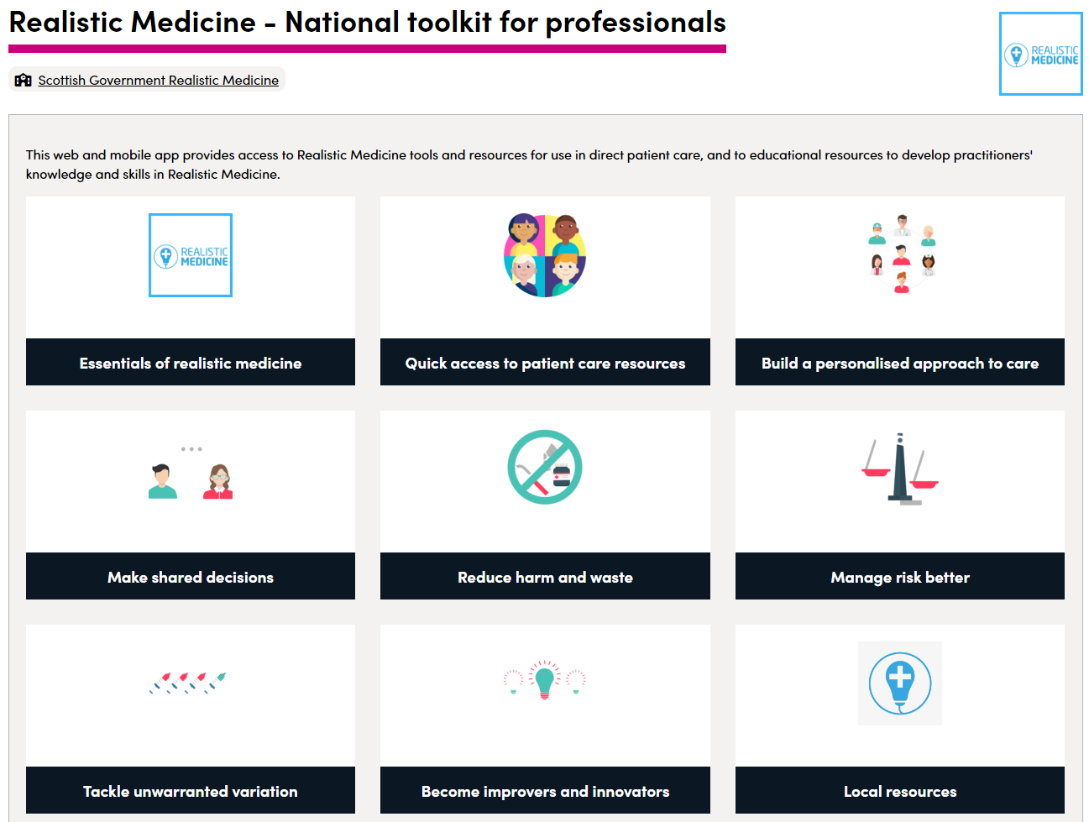
Right Decision Service
Conference 2024: Reform and Recovery
Notes:
1 min
The Right Decision Service hosts a toolkit for professionals, with resources themed under the 6 pillars of RM.

Slide 30
What other resources would support you to practice Realistic Medicine?
Conference 2024: Reform and Recovery
This Photo by Unknown Author is licensed under CC BY
Notes:
2 mins
In the spirit of practicing what we preach, we have created a QR code for you to offer us insight into what other resources you would find helpful in supporting you to practice RM.
We would love to hear your feedback (now if there’s time) about how we can further support you in understanding, applying and creating a culture of realistic medicine in your workplace.

Slide 31
@realisticmed
@realisticmed
#RealMed2024
#RealMed2024
www.realisticmedicine.scot
www.realisticmedicine.scot

