Slide 1
Conference 2024:
How to... Make every opportunity count
Beyond signposting, connecting communities in NHS Grampian
Reform and Recovery
Laura Sutherland, Locality Manager
Lisa Taylor, Health Improvement Team Lead (acting)
Alice Illingworth, Realistic Medicine Wellbeing Coordinator
Nicole Davison, Realistic Medicine Wellbeing Coordinator
Katy Styles, Realistic Medicine Clinical Lead
@realisticmed
#RealMed2024
www.realisticmedicine.scot

Slide 2
Workshop Plan
Introduction
The Team
How the session will run
Intended learning outcomes
Project 1 – Making Every Opportunity Count ageing well toolkit & pilot
Project 2 – Improving Migraine Management, a story about putting people first
Summary
Q&A
Key Takeaways
Conference 2024: Reform and Recovery

Slide 3
Learning Outcomes
By the end of the workshop, participants will be able to:
Recognise and describe approaches implementing Making Every Opportunity Count (behaviour change conversation and signposting)
Describe opportunities to connect with local community in innovative ways
Awareness of adapted Rockwood frailty score tool
Conference 2024: Reform and Recovery

Slide 4
MeOC Ageing Well Tool
Connecting older people, their families and carers to early intervention support services to support ageing well.
Conference 2024: Reform and Recovery
Notes:
Introduction slide,
We begin by introducing ourselves (and roles on next slide)

Slide 5
Realistic Medicine Wellbeing Coordinators
Key Areas of focus:
Improving outcomes for those living with frailty and prefrailty conditions through engagement - 'What matters to you'
Promoting early intervention/prevention support through the development of the Ageing Well tool
Collaborating with Communities, Primary/Secondary Care and LA and third sector partners – Shared Decision Making
Investigating the use of Digital Health Interventions
Conference 2024: Reform and Recovery
Notes:
Funded through Value Improvement Fund, 24months of funding, post started July 2023
The roles are continually developing

Slide 6
Early Intervention Prevention
GIRFE
Realistic Medicine Wellbeing Coordinators
Sustainability through training
HIS Frailty Collaborative
Community Engagement & Collaboration
Grampian Realistic Medicine
Conference 2024: Reform and Recovery
Notes:
Links to National/Regional Strategic Drivers and Local Programmes with a focus on realistic medicine principles

Slide 7
Background to Ageing Well Tool
Moray's Population is older than the National average
Based on established MeOC (Making every Opportunity Count) work in Moray
Using MeOC Approach to target older people
Project fits in with Local & National Strategies
Partners in Care: Moray H&SC Strategic Plan
Value Based Health and Care Action Plan
Conference 2024: Reform and Recovery

Slide 8
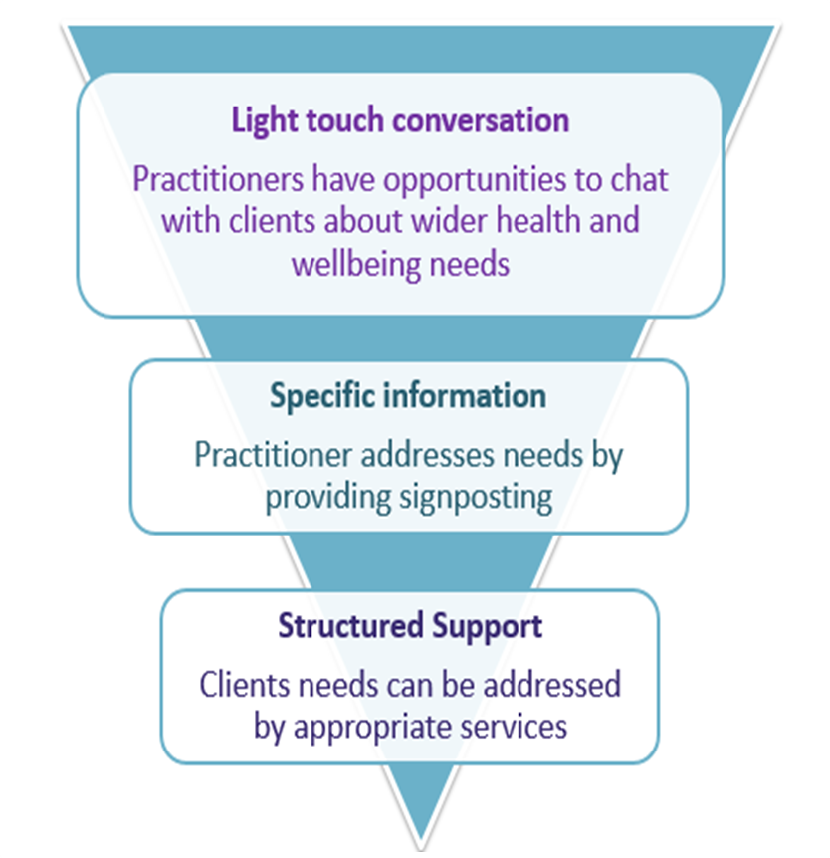
Making Every Opportunity Count
•Early intervention
•Providing staff with the tools to engage in conversations on lifestyle and life circumstances – ‘what matters to you’.
•Maximising resources by providing the right information to people at the right time.
Conference 2024: Reform and Recovery
Notes:
Explain MeOC process/approach.
We give practitioners the resources and support needed to have simple light touch conversations with people.

Slide 9
Developing Ageing Well Tool
Quality Improvement Methods used to develop MeOC Ageing Well tool
The tool was tested at over-75 Vaccination Clinics throughout Moray
Changes to the tool were made using the feedback from each session
Adapting Rockwood Frailty Score to promote a uniformed approach
Use of Pilot as opportunity to investigate technology use, health information sources and community involvement
Plan
Do
Study
Act
Conference 2024: Reform and Recovery
Notes:
Catch them where they are!
People are waiting after their vaccinations
Chatting to people during this wait
giving them a questionnaire to fill in and a resource sheet to take home with them

Slide 10
Realistic Medicine Principles
Personalised approach to care
encouraging personal ownership of health and health behaviours
Reducing Unwarranted Variation
locality specific data collection for wider service planning
Become Innovators and Improvers
rapid cycles of testing and adjustment
Conference 2024: Reform and Recovery

Slide 11
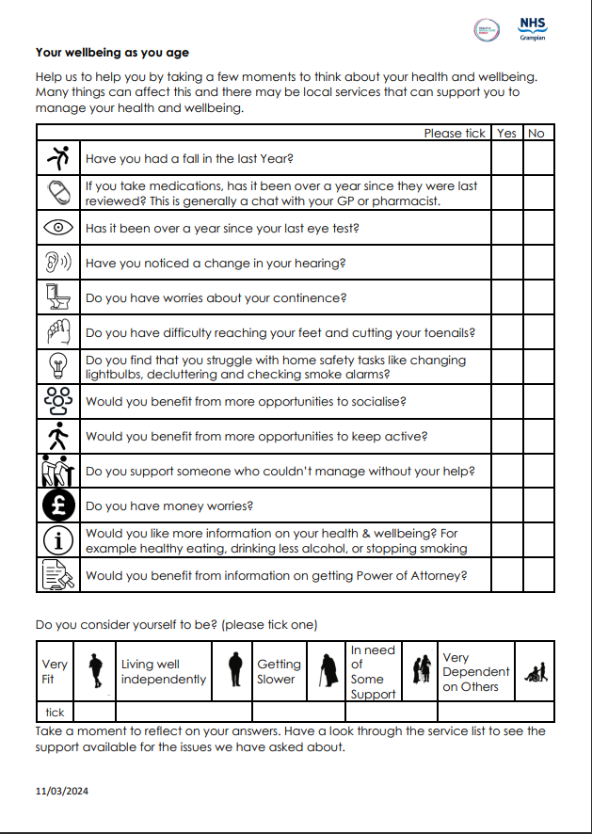
Conference 2024: Reform and Recovery
Notes:
This is the tool in it's current form
Asks questions about various topics impacting health of older people

Slide 12
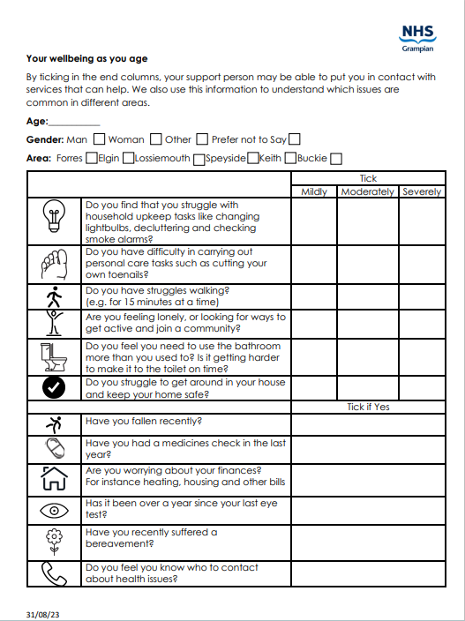
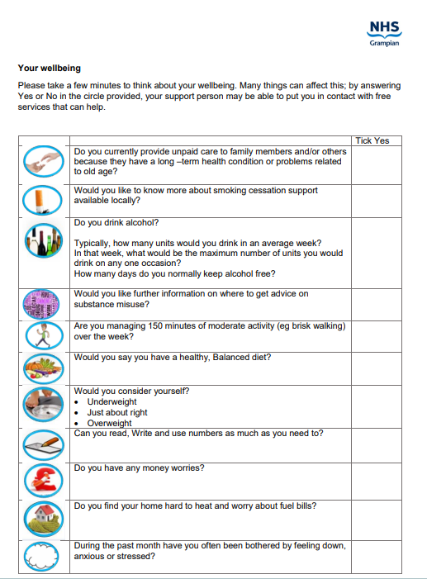
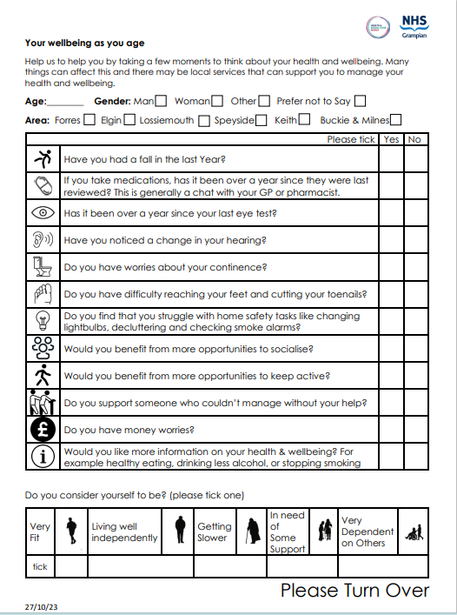
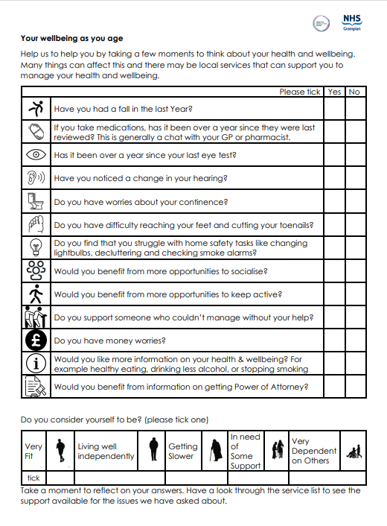
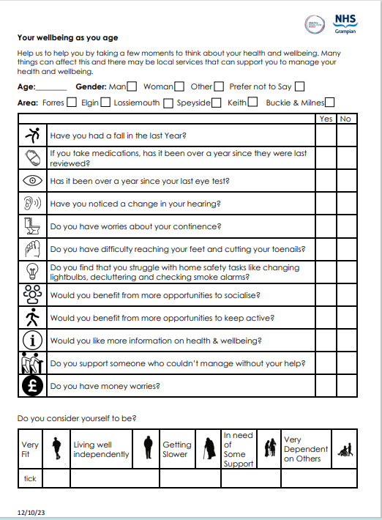
Conference 2024: Reform and Recovery
Notes:
Pics are
Generic Self-Check
First go at adapting for ageing well
After consultation with professionals
Changes during pilot
Current Version

Slide 13
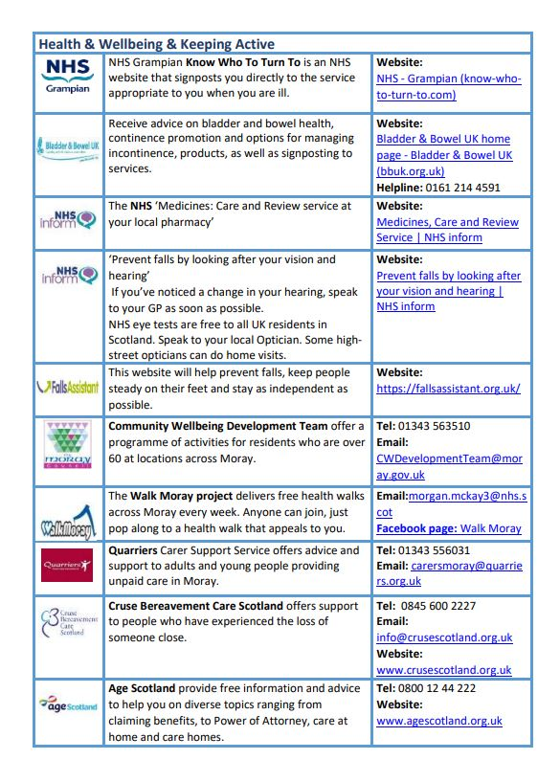
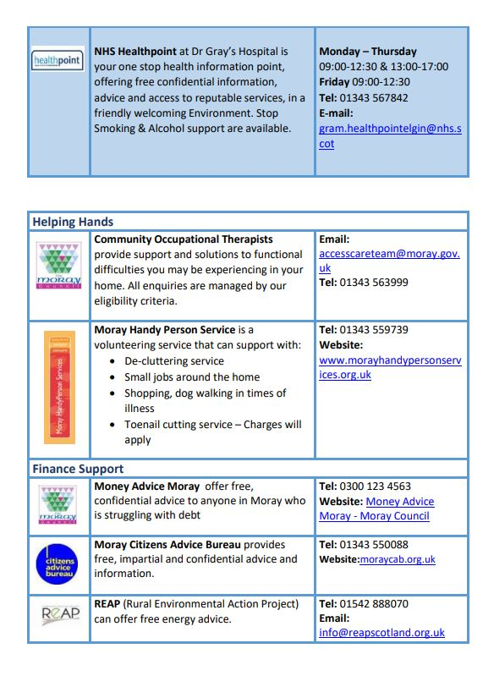
Conference 2024: Reform and Recovery
Notes:
Service List
Biggest text we could over 2sides a4

Slide 14
Over to You!
Have your phones at the ready.
Conference 2024: Reform and Recovery
Notes:
Introduce interactivity!
Explain the game:
We're going to tell you a story , and ask you who you would go to

Slide 15
Fred's story
Fred is a 78-year-old retired policeman. His wife died 5 years ago and since then he has spent most of his time on his own.
He was diagnosed with Rheumatoid arthritis 3 years ago and has trouble with some of his joints.
His Brother lives in Australia and they keep in touch on Facebook.
His daughter lives nearby but works a lot. She makes time to bring his grandchildren round with a Sunday lunch every week.
He tripped on a rug in his living room a few weeks ago but felt okay afterwards so didn't feel the need to talk to anyone about it.
Conference 2024: Reform and Recovery
Notes:
Simplified version of self-check , just shows Fred's "yes" answers

Slide 16
Which service would you go to?
NHS Inform: Information about medications checks
Walking Group
Falls advice website
Local Council information on activity groups for older people
Local voluntary organisation for household tasks and personal care
Conference 2024: Reform and Recovery
Notes:
Participants vote using QR code
Presenters switch from slide to slido
Most votes follows through - (kind of choose your own adventure)
We skip to slide with most most and tell Fred's story about going to the service
Add note of slide numbers once structure/order confirmed

Slide 17
NHS Inform: Information about medications checks
Fred finds out about the Medicine's care and review service at his local pharmacy.
He and his pharmacist talk about the medications he's on and work out a care plan together that considers the side effects of his medications and his routines.
Conference 2024: Reform and Recovery
Notes:
Bring it back to Self-check concerns, see how it answers problems

Slide 18
Walking Group
Fred went to the Facebook page and found a walking group near him on a Thursday and started going regularly. He enjoys catching up with the walkers every week.
He loves walking and after a few weeks he joins the faster group, wanting to push himself a bit further as he notices the pain in his joints getting a bit easier to manage.
Conference 2024: Reform and Recovery
Notes:
Bring it back to Self-check concerns, see how it answers problems

Slide 19
Falls Advice Website
Fred finds out about some changes he can make around the home so he's less likely to fall again, he gets his daughter to help him tidy up the cables and other tripping hazards. Reducing the risk of falls.
He sets up an emergency plan with his daughter for if he falls again
Conference 2024: Reform and Recovery
Notes:
Bring it back to Self-check concerns, see how it answers problems

Slide 20
Local Council information on activity groups for older people
Fred gets in contact with the community wellbeing team and they tell him about a Men's Shed that recently got started in his village.
He goes along on a Tuesday lunchtime and meets the other shedders getting to know them while they build some benches for the local park.
Conference 2024: Reform and Recovery
Notes:
Bring it back to Self-check concerns, see how it answers problems

Slide 21
Local voluntary organisation assisting with household tasks and personal care
Fred gets in contact with the Handy Person service and a volunteer, Linda, comes to cut his toenails. While she's there they share a pot of tea and talk about his family and time working in the police force. They build a rapport, and he looks forward to her visits.
Linda also removes the rug Fred tripped on and changes the lightbulb in Fred's bathroom on her visit.
Conference 2024: Reform and Recovery
Notes:
Bring it back to Self-check concerns, see how it answers problems

Slide 22
Betty's story
Betty is 85 years old. She lives at home with her husband John, who she looks after. John has dementia and needs reminding to do a lot of daily tasks.
John used to do most of the household jobs, like changing light bulbs. He also managed the couple's finances. Betty is struggling to cope with keeping the house safe for herself and John. She's also worried about paying her bills, as energy prices keep increasing.
Betty is noticing changes in her body as she ages, she gets up to go the toilet many times during the night and hears less than she used to. She hasn't told anyone about these issues because she doesn't think there's anything that can be done.
Conference 2024: Reform and Recovery

Slide 23
Which service would you go to?
NHS Inform: Information about hearing and sight
Energy advice service
Carers support charity
National Bladder and Bowel Charity Helpline
Local voluntary organisation assisting with household tasks and personal care
Conference 2024: Reform and Recovery
Notes:
Participants vote using QR code
Presenters switch from slide to Forms: Present mode – we see the votes come in
Most votes follows through - (choose your own adventure)
We skip to slide with most votes and tell Betty's story about going to the service
Add note of slide numbers once structure/order confirmed

Slide 24
NHS Inform: Information about hearing and sight
Betty makes an appointment with her GP about her hearing. She gets a hearing test and is then given some hearing aids. She is amazed at how much she was missing before! She finds it easier to communicate with the doctors about John's care and notices she's less tired after conversations with her friends.
Conference 2024: Reform and Recovery
Notes:
Bring it back to Self-check concerns, see how it answers problems

Slide 25
Energy advice service
Betty phones Reap and talks to an advisor about her energy worries. The advisor talks her through her energy bills, explaining each part of it and helps her to change energy supplier, which makes her bills more affordable. They also discuss things she can do to make her house more energy efficient
Betty understands her bills better – and is paying less. She is comforted after she gets this help.
Conference 2024: Reform and Recovery
Notes:
Bring it back to Self-check concerns, see how it answers problems

Slide 26
Carers support charity
Betty calls Quarriers and finds out about some support they offer to carers.
She connects with some other carers, making friends with people who share her experiences.
They also help her arrange some respite care so she can recharge her batteries and focus on herself.
Conference 2024: Reform and Recovery
Notes:
Bring it back to Self-check concerns, see how it answers problems

Slide 27
National Bladder and Bowel Charity Helpline
Betty calls the Bladder and Bowel Helpline and hears about continence products she could use. She feels better knowing that what she's experiencing is normal but could be helped with medical help, so she makes an appointment to see her GP.
Conference 2024: Reform and Recovery
Notes:
Bring it back to Self-check concerns, see how it answers problems

Slide 28
Local voluntary organisation assisting with household tasks and personal care
Betty calls the Handy Person Service and a volunteer comes round to change the lightbulb in her hallway and to check the fire alarms throughout the house.
The volunteer changes the batteries in the smoke alarm in the bedroom.
Betty feels comfortable knowing her fire alarms are working and is less worried about falling in her hallway at night now the bulb is replaced.
Conference 2024: Reform and Recovery
Notes:
Bring it back to Self-check concerns, see how it answers problems

Slide 29
Feedback on MeOC Approach
“Using the MeOC approach in our
diabetes clinics has changed the way we have our conversations”
“It’s such an easy approach and it makes sense"
“People feel that we actual DO care by providing information to services that can support them”
Small conversations do make big differences to health and wellbeing
Conference 2024: Reform and Recovery

Slide 30
Pilot Evaluation
100% of Participants found the format easy to read
98.6% of Participants said they found the questions easy to understand
80.4% of Participants said they more aware of services than before
Conference 2024: Reform and Recovery

Slide 31
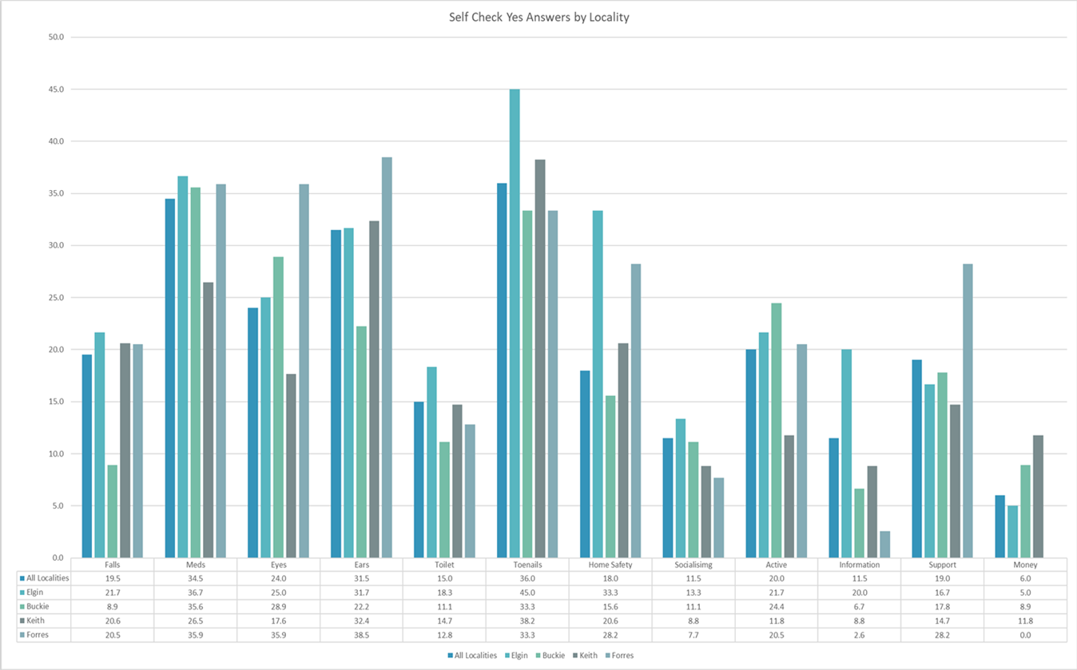
Localised Data
Conference 2024: Reform and Recovery
Notes:
Can see from Chart that this process produces a huge amount of useful data – no time to go into it here, and it's not so relevant to your work
This is a chart showing % of yes answers for each question by locality
Tool Allows us to identify which issues are most and least common. Because we collected locality and age information this can be further broken down to understand where needs are.
Highest proportion of “yes” answers were:
•Struggling to Cut Toenails (36%)
•Over a year since last medications check (34.5%)
•Noticing a change in hearing (31.5%)
The Least Common “yes” answers were
•Concerns about Money (6%)
•Looking for Health Information (11.5%)
•Looking for Opportunities to Socialise (11.5%)

Slide 32
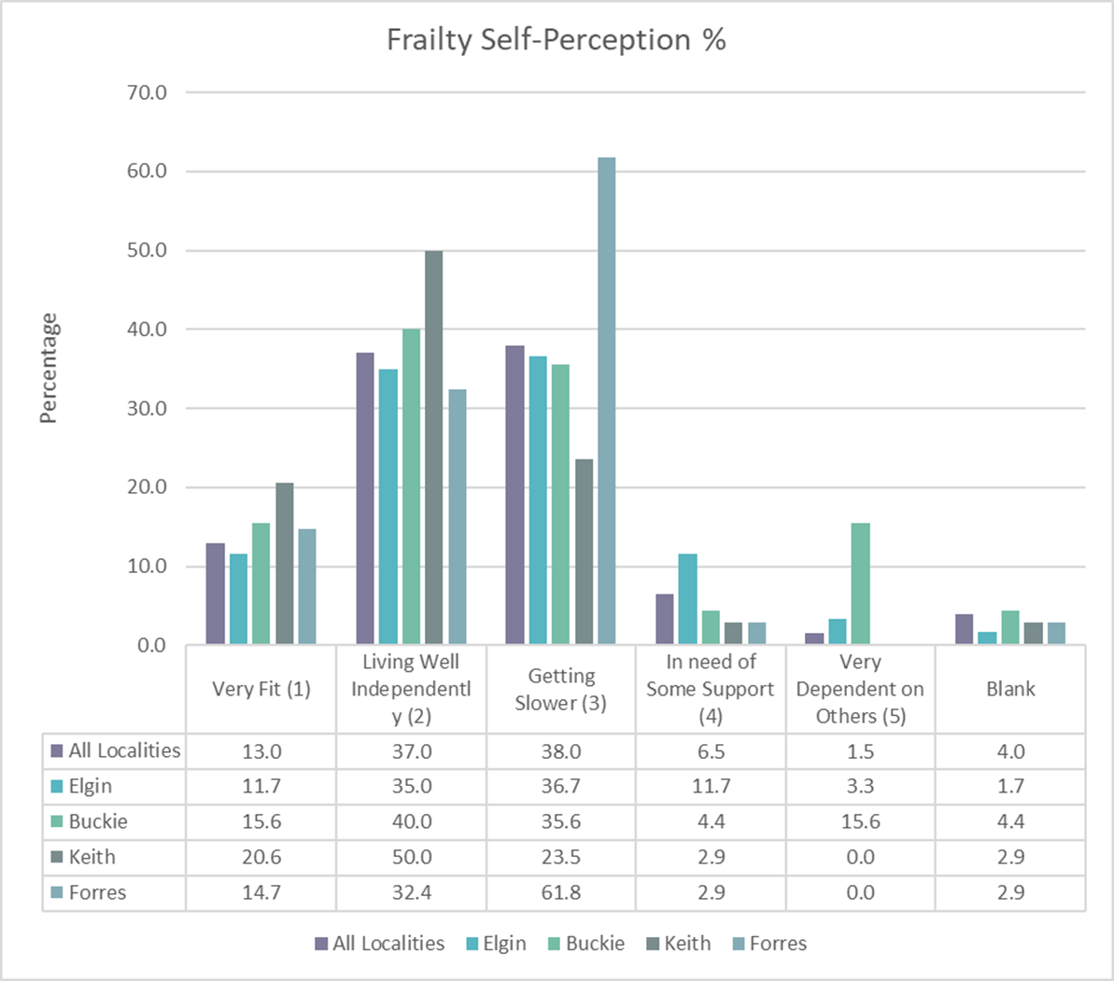
Self – Perception Frailty Scores
Conference 2024: Reform and Recovery
Notes:
Adapted Rockwood Frailty scores
we can see where certain areas are outliers
We can see Forres is has highest proportion of participants "getting slower" - start point for further investigation (61.8%)
Keith also outlier in that 1/5 considered themselves "very fit" (20.6%) (avg, 13.0)- anecdotally we spoke to a lot of people from farming communities in keith, they were also less likely to be looking for opportunities to keep active. The data is all linked
Shows tool MeOC is adaptable, Data is useful

Slide 33
Sample of Engagement Findings
The most common community groups were for physical activity, including Walking groups and other exercise groups
Technology Use
Mobiles were the most commonly used device (84%)
Sources of Health Information
TV / News (41.3%) and Health Professionals (34%) were the most common sources of health information
Community Services and Groups
72% used landline
Conference 2024: Reform and Recovery
Notes:
These are just some of the findings from the engagement questionnaire
Having this data is really useful
Shows how the tool feeds in to wider work in moray
- We chose to ask questions around use of technology. Exploring digital options to support health and wellbeing is part of our agreed scope but we also link in with the Digital Health & Care Innovation Centre who have been funded in Moray to research and innovate activities aligned to the digital health and care agenda.
- Locality Service Planning
Prove tool is adaptable
When talking through devices mention wood turning lathe!
When talking about community say someone wanted more men in their sheltered accommodation

Slide 34
Impact of Engagement
Vintage Teas
MeOC Self-Check
Conference 2024: Reform and Recovery
Notes:
Moray used a Vintage Tea engagement model for over 60s to promote positive health and wellbeing and identify gaps in community opportunities. 10 events were held which attracted over 700 people.
Examples – there was an ask for a living well resource where people can get information and advice about how to stay well - healthpoint outreach services available in both clinical and non clinical settings in each locality.
Priority identified for those in the Buckie area was for more activity groups – Health Walks are now up and running, including evening walks and a sheltered housing group.
MeOC standard self check tool was used by DWP colleagues in the Buckie area. The data gathered through the tool highlighted the need for smoking cessation support. As a response we put a healthpoint advisor to Buckie to deliver the support. Without the data, we wouldn't know where the need was – increase value and impact.

Slide 35
Next Steps
Further roll out of the MeOC Ageing Well tool
MeOC – Ageing Well Training embedded in Care @ Home Induction Programme
Data gathering on signposting uptake
Measure impact via Case Studies
Utilise MeOC tool data to inform service planning/commissioning of services at locality level
Develop and Deliver Shared Decision Making Masterclasses
Deliver rolling Health & Wellbeing Programme to Older People's groups
Explore Ageing Well Health Checks
Conference 2024: Reform and Recovery

Slide 36
Improving Migraine Management
A story about putting people first
Conference 2024: Reform and Recovery

Slide 37
The Blurb
Migraine prevalence
Successful funding bid - Scottish Government Neurological Care & Support Framework
Joint project – The Migraine Trust & NHS Grampian
Phase 1: January 2023 – January 2024
Upskill 50 pharmacists on migraine management
Produce materials for 132 pharmacies
Deliver a "manage your migraine" patient webinar
Conference 2024: Reform and Recovery
Notes:
Long term neurological disorder
Third most common health condition globally
Second highest cause of disability (first in women aged 15 – 49)
Significant impact on daily living including work
Under diagnosed

Slide 38
Chapter 1 - where did we start?
10 pharmacists at focus group
23 survey responses
16 patients at ​
focus group​
​
162 survey responses​
The brief was clear – how did we know it was right?
Putting people first approach
Explore pharmacists' learning needs – focus group & survey
Explore perspectives of people living with migraine – focus group & survey
Conference 2024: Reform and Recovery

Slide 39
Chapter 2 - What did we do?
Setting up for success
Start small
Recognise that our staff are our patients
Daily Brief used as initial communication tool – focus group
Social media – wider survey
What did we hear?
What good support from pharmacy would look like
Awareness campaign messaging suggestions
Enablers to accessing support from pharmacy
Conference 2024: Reform and Recovery

Slide 40
Chapter 3 - What did we do with what we heard?
We shared it with pharmacy teams
We built it into training
The impact of migraine
Patient stories – videos incorporated into eLearning
Signposting
We used it to inform the public awareness campaign
We used it to inform the patient webinar
Conference 2024: Reform and Recovery

Slide 41
Chapter 4 - How did we keep the conversation going?
Continuing the story
Mailing list - sway
Daily Brief
Social media
Public Awareness Campaign
Local radio
Bus adverts
Sports venues' banners
Public information webinar
Conference 2024: Reform and Recovery

Slide 42
Chapter 5 - A happy ending?
How many people signed up for the webinar?
300
600
900
Conference 2024: Reform and Recovery

Slide 43
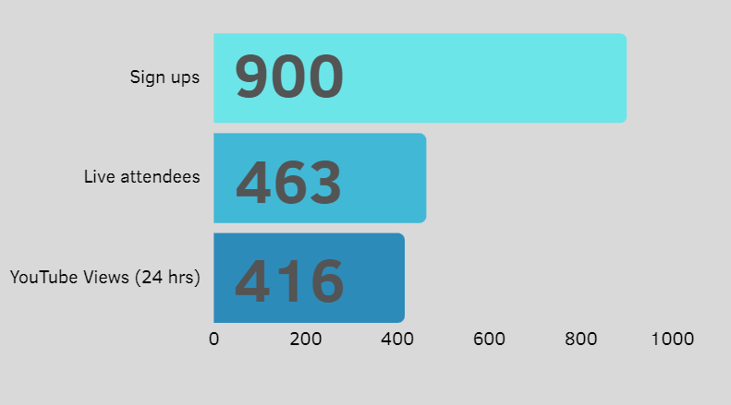
Conference 2024: Reform and Recovery
Notes:
Last time I looked, almost 900 YouTube views

Slide 44
How did people hear about the webinar?
Facebook
Word of Mouth
Twitter/X
Instagram
Daily Brief
Other
Conference 2024: Reform and Recovery

Slide 45
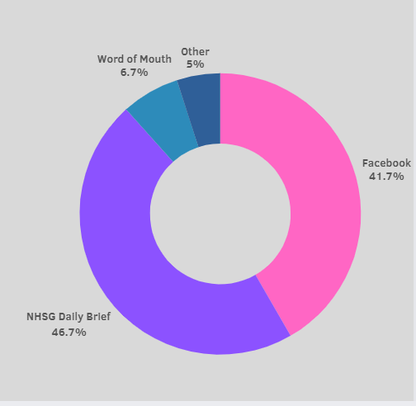
Conference 2024: Reform and Recovery

Slide 46
How many said they would attend a future event?
Conference 2024: Reform and Recovery

Slide 47
Conference 2024: Reform and Recovery

Slide 48
A sequel?
Project Phase 2
Funding extended for a further year
Roll out in at least 3 other Boards (Lanarkshire, Lothian, Tayside, Orkney, Shetland & Highland)
Further embed in Grampian
Continuing the conversation
Putting People First – The Approach
Strategy
Next steps – Adapt/adopt (eg Brain Health Service) & Community Appointment Days
Conference 2024: Reform and Recovery

Slide 49
Bringing it together -what have we learnt?
The importance of a connector (social prescribing)
Think about how to reach your community
Start somewhere: listen, learn, improve
People value being part of the story, and they make the story better
Conference 2024: Reform and Recovery

Slide 50
Questions
gram.realisticmedicine@nhs.scot
Conference 2024: Reform and Recovery
Notes:
Also just hands up in the room
Link for when slides get sent out post-presentation

Slide 51
One Key Takeaway
gram.realisticmedicine@nhs.scot
Conference 2024: Reform and Recovery

Slide 52
@realisticmed
@realisticmed
#RealMed2024
#RealMed2024
www.realisticmedicine.scot
www.realisticmedicine.scot

