Slide 1
Understanding Public Awareness​​
Engagement with Public & Staff - BRAN & Shared Decision Making​
Jude Marshall​
Paul Hayes​​
Notes:
JM

Slide 2
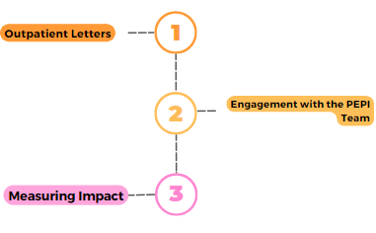
Where we were​
Staff Responses​
We issue BRAN Information with all outpatient letters reaching approx. 25,000 each month.
Scoped out how we could hear from patients about their understanding of BRAN and awareness of materials
We conducted an engagement exercise to assess the effectiveness of this method and inform our next steps.
Notes:
JM – reflecting on what we did and how we improve
This info included in all letters
We have RM medicine network group – Daniel suggested the involvement/help from the PEPI team – drawing on range of contacts to help with this sort of thing
Set out with PEPI to look at impact of BRAN questions in app letters, - opportunity to take stock across staff and public to understand

Slide 3
What did we do?
Staff Responses​
Share with Involving People Network
Reflect on what we know, what we need to know and what would be nice to understand
Develop accessible survey in partnership with PEPI and RM Team
Review and reflect on findings, commonalities between groups, and points of difference
Share with through staff leads
Notes:
PH + JM
X questions,
approx time to complete
Questions were a mix of fee text, likert, tick box and had positive response rates
Equalities info not captured in this instance (directly – people were offered opportunity)
Hand over to Jude for Staff leads sharing

Slide 4
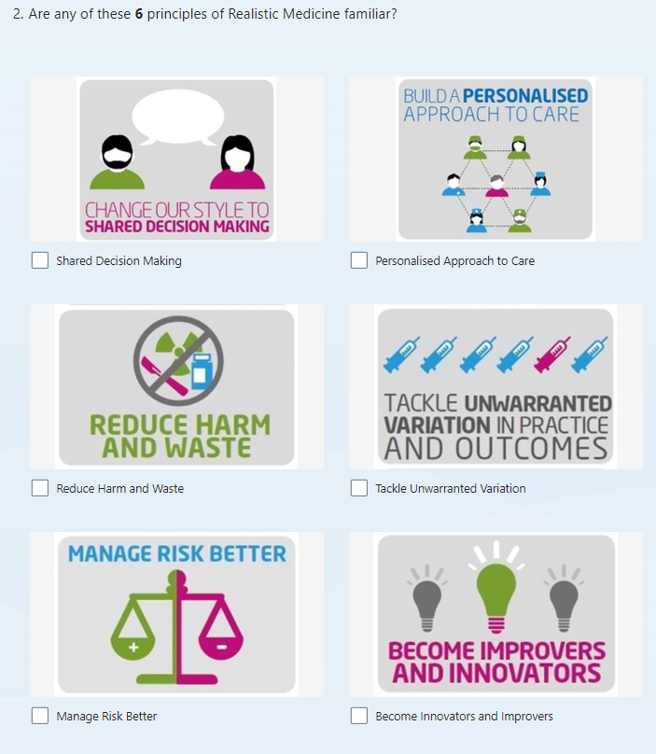
What we got back and reflections
Staff Responses​
703
853
Staff responses
Patient responses
20 to
22
11
Questions
Questions
10 min
7
min
Average response time
Average response time
Reflections:
Useful opportunity to gauge staff awareness and recruit future RM champions
Timing is important, on reflection December wasn’t the best time to undertake this type of work, though still happy with responses
Notes:
JM
Staff had more questions to dig into training as well as knowledge of RM and BRAN. Skip logic was used so survey length varied.

Slide 5
Have you heard about Realistic Medicine ?
Staff Responses​
71%
STAFF RESPONSES
of Staff responding had heard of Realistic Medicine.
Small number were unsure of the term while 21% were not aware of it.
85%
of Patients that responded had not heard of Realistic Medicine.
Awareness of BRAN materials in appointment letters was low
PUBLIC RESPONSES
Notes:
PH
How many replies from staff and from patients
Staff from across ggc from a range of sectors, specialities and

Slide 6
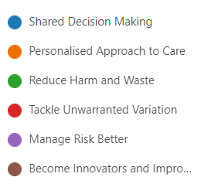
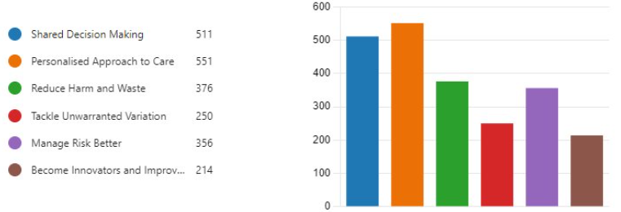
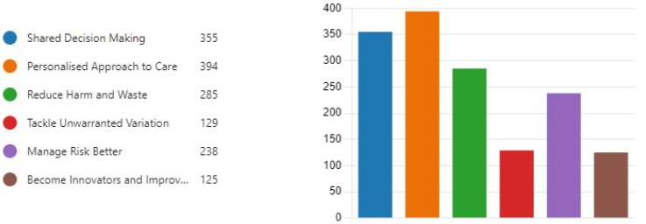
Familiarity with the Principles of Realistic Medicine​
Staff Responses​
STAFF RESPONSES
PUBLIC RESPONSES
551
394
511
355
376
285
356
238
250
214
129
238
Similar awareness of Realistic Medicine Principles across patients and staff, presenting opportunities to reflect on;
Language used, and how accessible it really is for both groups,
What our core message is, and how do we make the principles more accessible and meaningful to different groups
Notes:
PH

Slide 7
What we heard from public?
Staff Responses​
What do you feel would better support you or other patients to have shared decision-making conversations?
Easier access to appointments
More time for discussion with Health Care Processionals
Open and honest communication
Alongside these points, it was shared repeatedly by patients their openness to RM as an approach is very dependent on on staff being approachable and open to conversations.
It also came through strongly that after learning about shared decision-making, people showed a strong desire to be more proactive in healthcare discussions, particularly if encouraged by professionals.
Notes:
PH
What do you feel would better support you or patients to have shared decision-making conversations?
Easier access to appointments
More time for discussion with Health Care Processionals
Open and honest communication
After learning a bit about shared decision making during this survey, would you approach conversations about your health differently?​
​
Desire from people to be more proactive in their healthcare conversations, especially if invited and encouraged to have conversations by professionals ​
They shared their openness is contingent on staff being approachable and open to conversations​
​
Do you have any suggestions about how we can raise awareness of shared decision making and BRAN with the public?​
​
Materials on Shared Decision making in Health settings​
Community Outreach and conversations​
Staff supporting and prompting these questions​
More time at appointments to have conversations ​
Make sure patient advocacy groups are aware of these options​

Slide 8
What we heard from staff?
Staff Responses​
What do you feel would better support you or patients to have shared decision-making conversations?
Sufficient consultation time
Clear communication and respect
Information sharing better integrated into technology
From initial survey analysis, staff identified training and development they felt would help with Realistic Medicine:
Digital learning was identified as helpful, with a mix of interactive sessions and more practical learning experiences being suggested.
Training and discussions around RM should be expanded to encompass all members of MDTs to better encompass the entire care pathway to improve the patient's journey.
Notes:
PH
What do you feel would better support you or patients to have shared decision-making conversations?
Easier access to appointments
More time for discussion with Health Care Processionals
Open and honest communication
After learning a bit about shared decision making during this survey, would you approach conversations about your health differently?​
​
Desire from people to be more proactive in their healthcare conversations, especially if invited and encouraged to have conversations by professionals ​
They shared their openness is contingent on staff being approachable and open to conversations​
​
Do you have any suggestions about how we can raise awareness of shared decision making and BRAN with the public?​
​
Materials on Shared Decision making in Health settings​
Community Outreach and conversations​
Staff supporting and prompting these questions​
More time at appointments to have conversations ​
Make sure patient advocacy groups are aware of these options​

Slide 9
Public Participation
Our achievements so far

Slide 10
What did we do?
Text message reminders
First Appointment letters
Article in our Local paper
Community events
Notes:
So we know why it is important so how did we attempt to engage our local community - what did we do to help empower people to ask questions about their care with BRAN being a framework they could use

Slide 11
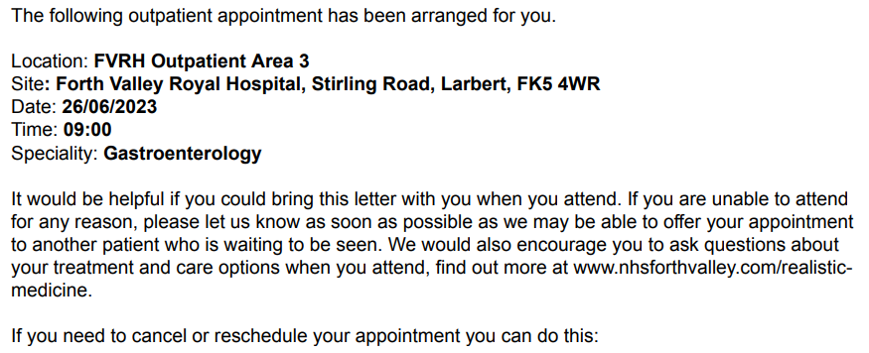
Text Message Reminders and Appointment Letters
Example of TRAK appointment letter

Slide 12
Hits to the RM Webpage
3,942
Jan – Mar 2024
10,679
Jan – Oct 2023

Slide 13
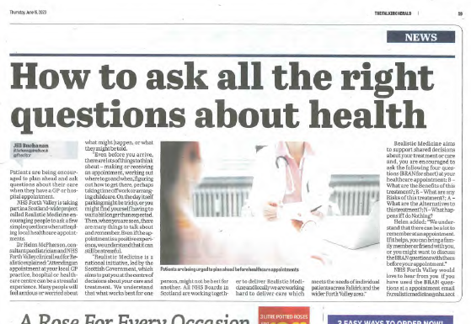
Local paper The Falkirk Herald
The Falkirk Herald readership is currently 27,196 per issue.

Slide 14
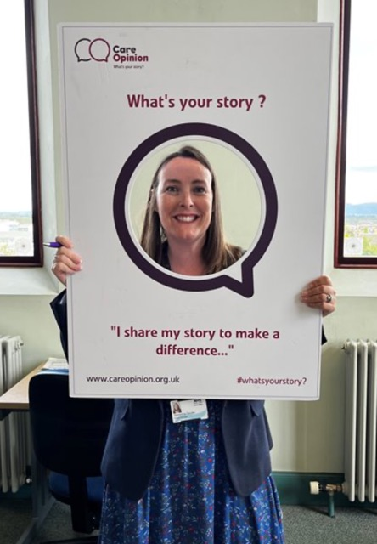
Community Events
It's ok to ask... | Care Opinion

Slide 15
How do you achieve results? Webteam eHealth Governance Comms TRAK team Health & Corporate Record Services Care Opinion Scottish Ambulance Service Health and Social Care Partnership Steering Group 3rd sector
Our ongoing Realistic Medicine Team Priority:
Network
It is not policy or strategy that affects change its people

Slide 16
Future Plans, sharing learning
Public participation event outwith NHS setting
Person Centred Week within our Board
Learning from NHSGGC and doing the same patient survey so we can start to get a picture of where we are nationally
Repeat CollaboRATE on a larger scale
Learn from Forth Valley's engagement to guide the development of our communication and engagement.
Development of board wide shared decision-making plan, looking to carry out ongoing engagement with the public and staff.
Increase accessibility of Realistic Medicine language
Re-run survey to measure changes in knowledge
Share our learning and results with other Boards e.g., Forth Valley.
Notes:
JM +
Identify improving cancer journey work and links with links workers and similar groups to ensure community awareness of RM and pricniples. Jude mention next steps – started by looking at BRAN questions, due to wealth of data now taking in boardwide development plan to approach/tackle this topic holisticly.

Slide 17
Table Discussion
What are you doing within your board to increase public participation?
What suggestions do you have to increase public participation in your board?
Notes:
Explain tables and facilitation/conversation - PH
JM Q 1
Helen Q2

Slide 18
Get in touch
samantha.goudie2@nhs.scot
helen.mcpherson@nhs.scot
judith.marshall@nhs.scot
malcolm.watson@ggc.scot.nhs.uk
paul.hayes2@ggc.scot.nhs.uk
ashley.mclaren@ggc.scot.nhs.uk
Samantha Goudie: RM Programme Lead
Helen McPherson: Secondary Care RM Lead
Judith Marshall: Primary Care RM Lead
Malcom Watson: Secondary Care RM Lead ​
Paul Hayes: PEPI Manager
Ashley McLaren: RM Programme Manager
Notes:
So we know why it is important so how did we attempt to engage our local community - what did we do to help empower people to ask questions about their care with BRAN being a framework they could use

