Slide 1
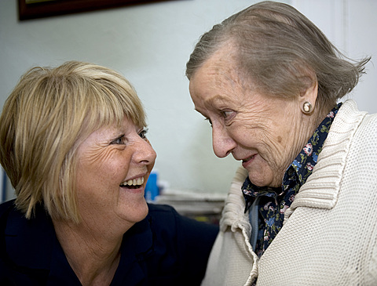
CEIM
Experience improvement model for health and social care
How to collect and use feedback stories to improve outcomes and experiences of care
Welcome
Notes:
Title slide 2

Slide 2
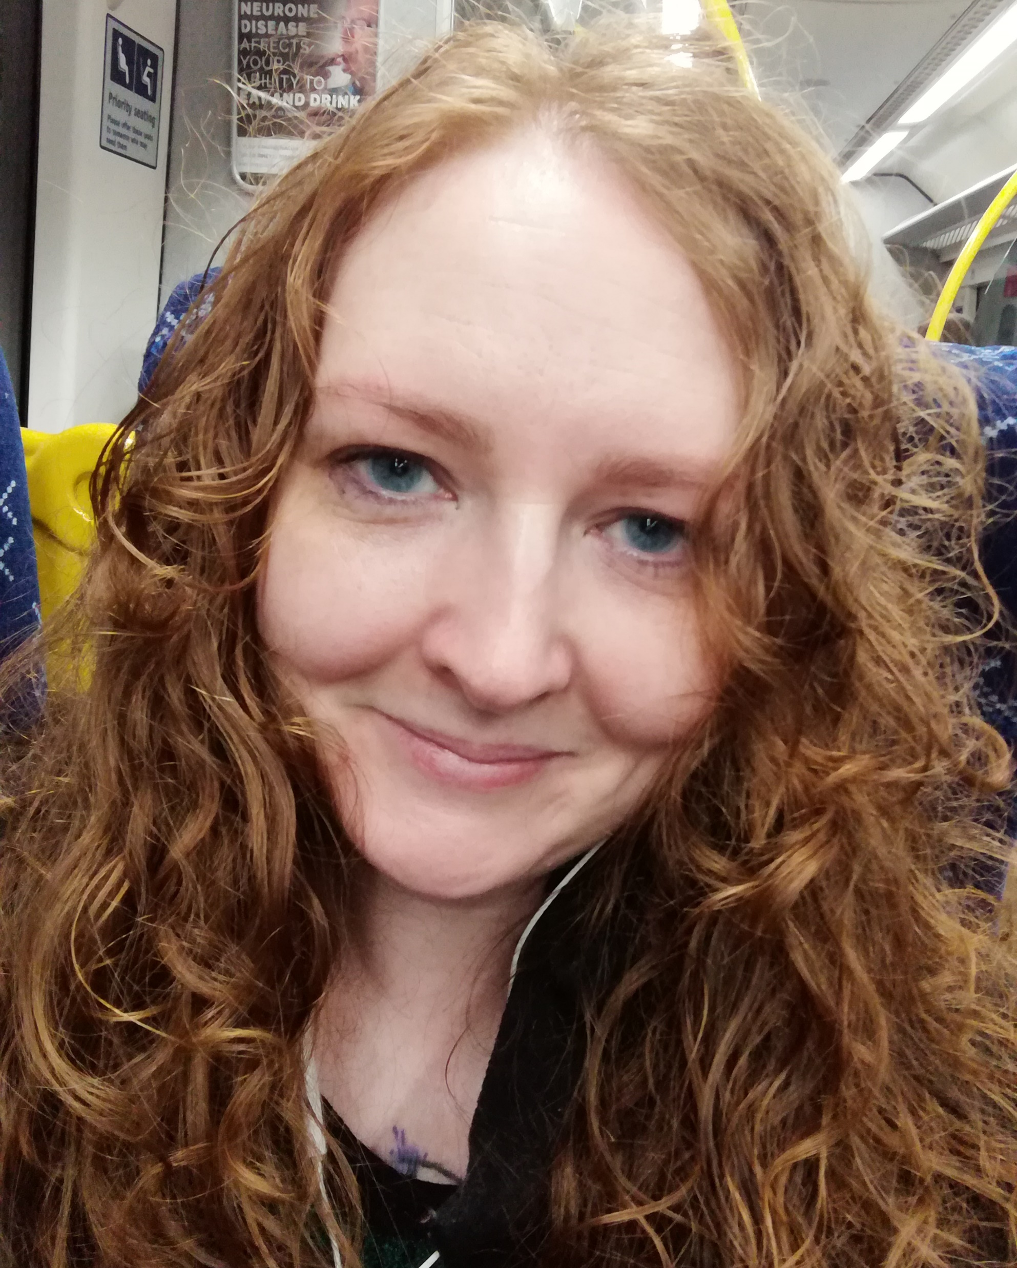
Session hosts
Diane Graham
Senior Improvement Advisor
Person-centred Design and Improvement Team (ihub)
Healthcare Improvement Scotland
e: diane.graham@nhs.scot
@dgmfg | @PersoncentredSco
Lisa Maynard
Improvement Advisor
Quality Improvement Support Team
Care Inspectorate
e: Lisa.Maynard@careinspectorate.gov.scot
@CareInspect | @LisaMImprove

Slide 3
Agenda
Valuing feedback stories and an introduction to the CEIM Experience Improvement Model
Experience Discovery Conversations
Visualising stories for improvement
Close

Slide 4
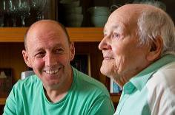
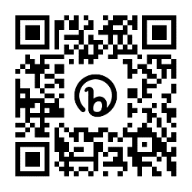
Listening to and responding to feedback helps us to…
Improve outcomes (Meterko et al 2010; Bezold C, 2005, Stewart, M. et al.,2000, Doyle et al 2013)
Improve cost effectiveness (Olsson et al; 2009, Picker, 2016)
Improve adherence to treatment and medication regimes (Haynes et al 2008; NICE, 2009)
Increase trust in clinicians (Keating et al 2002)
Improve service user experience and satisfaction (Raleigh et al 2009)
Improve staff experience (Raleigh et al 2009; The King’s Fund, 2012)
https://bit.ly/CEIMRefs

Slide 5
The problem
Sheard, L., Marsh, C. et. al. (2017)
Martin G. P., McKee L., Dixon-Woods M. (2015)
Notes:
Keep

Slide 6
Bridging the gap
Sheard, L., Marsh, C. et. al. (2017)
Martin G. P., McKee L., Dixon-Woods M. (2015)

Slide 7
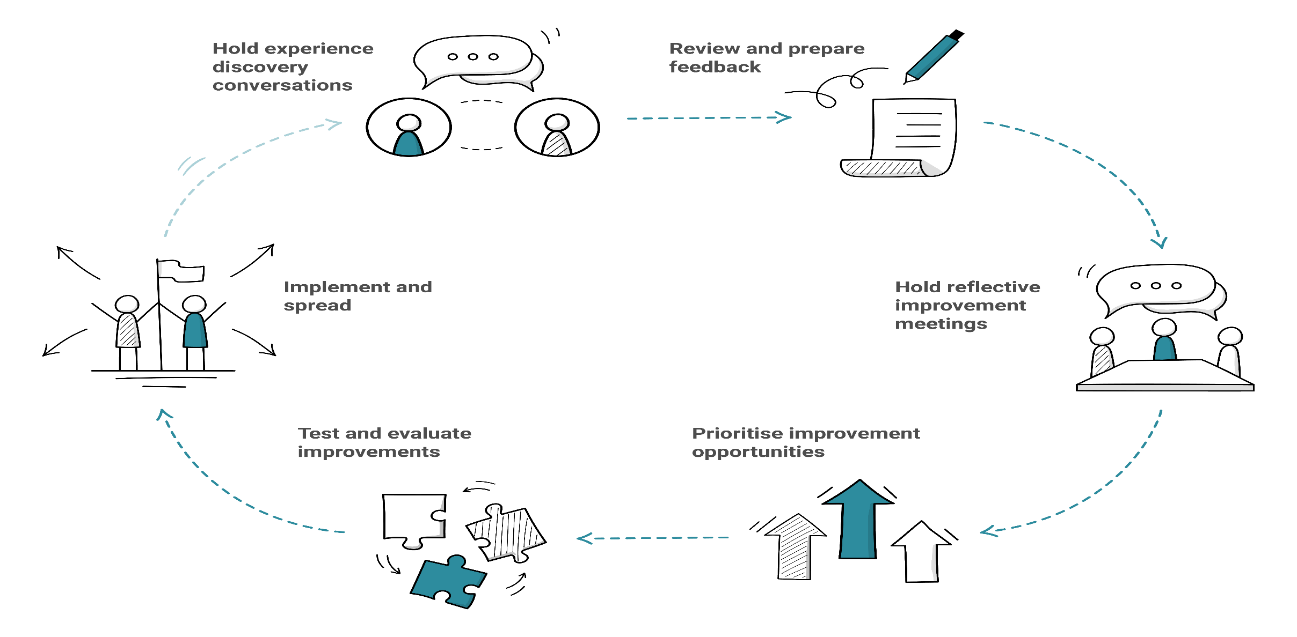
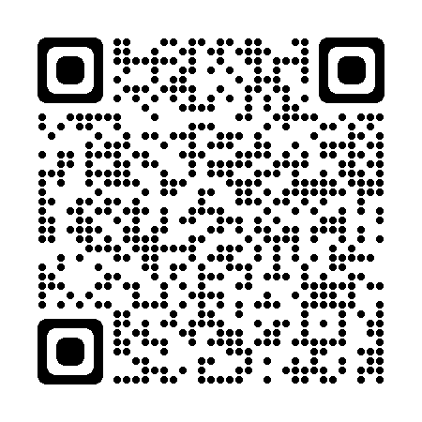
The CEIM Experience Improvement Model
start here
‘A simple framework that ensures feedback can result in meaningful improvements that are maintained over time’.
Notes:
Discovery Conversations as the first step of the wider CEIM framework
Links to embedded and sustained improvement in the organisation
Not just a person-centred approach but an essential part of organisational approach to improvement. 'Nothing about me without me' etc etc
Creating systems and services that work for the person
If we knock out slides 4-7 we can reference them by saying here 'discovery conversations have a clear evidence base, and help us to close the gap between what we hear through feedback and making sustained improvements' etc etc
Finish here at the 10 minute mark maximum (if we do this)

Slide 8
Experience discovery conversation approach
1
Define the care journey steps and touchpoints
2
1-2 Discovery questions per step
3
1-5 Dig Deeper questions
4
Record the words of the person

Slide 9
Experience Journey’s are…
The sequence of care or support events or steps that a person follows from the point of their entry into the service until discharge, or they no longer require care or support.
CC Image credit: Microsoft 365 Stock

Slide 10
Mapping experience journey ‘touchpoints’
Creating a conversation framework
Touchpoints:
Moments of engagement or interaction with Service, People or Environment that are experienced or perceived by the person receiving care or support
CC Image credit: Microsoft 365 Stock

Slide 11
Experience journeys could be as simple as…
arriving in the service reception
being greeted by staff
complete admission documentation

Slide 12
Using discovery questions
Discover the person’s experience by exploring the touchpoints across their experience journey using 1-2 broad open-ended questions or prompts at each journey touchpoint.
Tell me about…
Walk me through what happened when…
What happened then?...
What came next?...
What else?...

Slide 13
Using digging deeper questions
Dig deeper to explore the experience and emotions around a journey touchpoint and to clarify facts (aim for 1-5 questions per touchpoint)
Explore emotions (open questions):
How did that make you feel?
What did that feel like?
What were your first impressions?
What was important to you about that?
Tell me a little more about that
Clarify facts (closed questions):
who, what, when, why, how

Slide 14
Creating conversation experience journey frameworks
A visit to the Emergency Department
GP
ED (A&E)
Nurse
triage room
waiting room
treatment room
doctor
Mr Gardner’s story

Slide 15
Gathering insights through an experience journey lense
Mr Gardner’s story
Listen for [1] | Emotion words used at each broad touchpoint
Listen for [2] | Clarifying quotes what is being said / significant memories that clarify context
Experience Story
Activity

Slide 16
Emotions Don’t have to be pure emotion words
the annoying thing
Nice and Kind
Irritated
I was fine after that
Annoyed
Relaxed
Showing concern

Slide 17
Clarifying quotes what was being said / significant memories
it was busy
people who came after me being taken through to see the doctor
they take you into a wee room
I understand the pressure they’re under
then put you back out in the waiting room
we had a blether
I’d never seen a doctor
talking me through things

Slide 18
Creating an experience journey map
Touchpoints
GP
A&E
Nurse
Triage room
Waiting Room
Treatment Area
Doctor
What’s being experienced
the annoying thing
Showing concern
nice and kind
Annoyed
I was fine after that
Irritated
Relaxed
What’s being said
‘they take you into a wee room’
‘People who came after me being taken through to see the doctor’
‘talking me through things’
‘it was busy’
‘then they put you out in the waiting room’
‘we had a blether’
‘I’d never seen a doctor’
‘I understand the pressure they’re under’

Slide 19
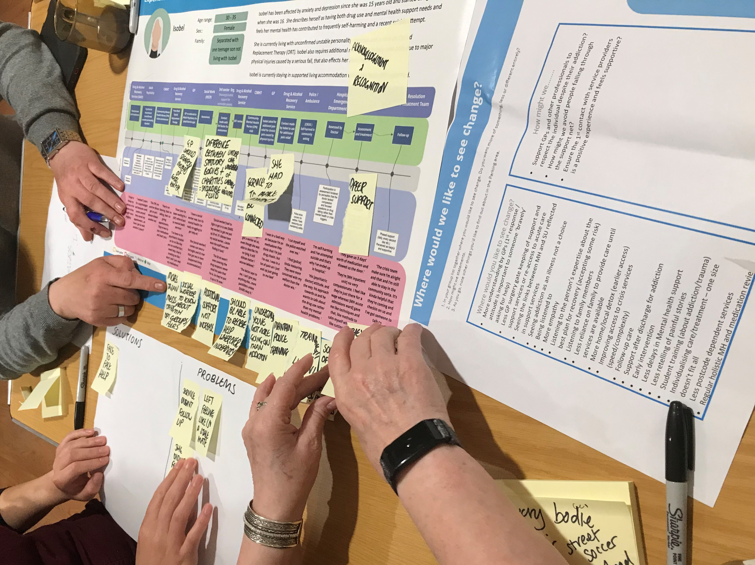
Visualising stories to inspire improvement discussions

Slide 20
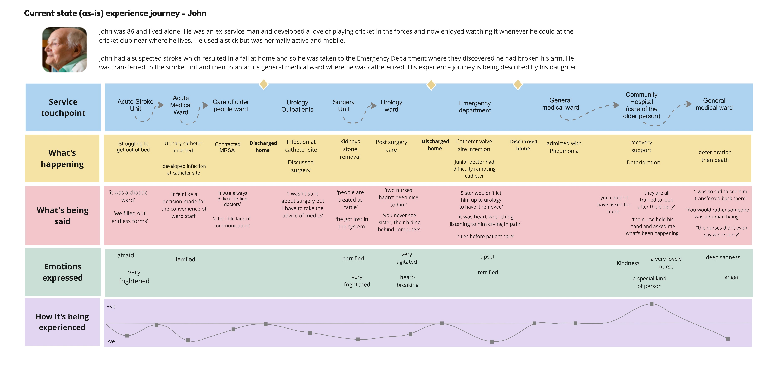
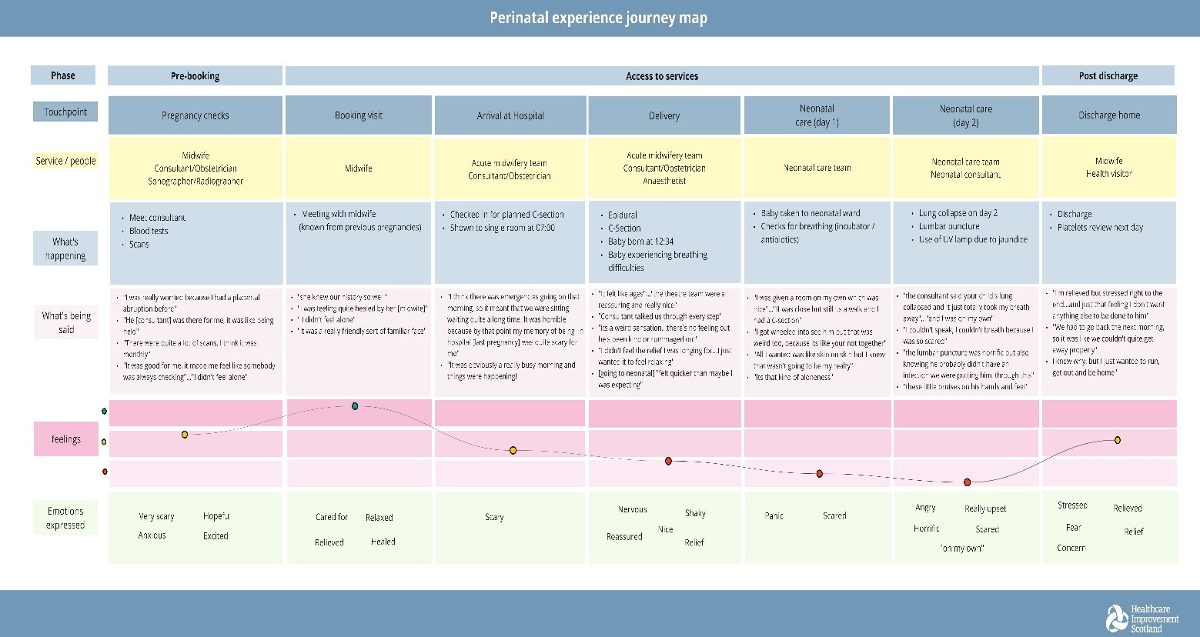
Using experience journeys to understand the problem space
In your group explore John or Rebecca’s experience journey and discuss:
What is this story telling you about their experience of care or service?
What’s helping or hindering them in achieving the outcomes we would want them to have?
What are you still curious about that you’d want to explore further?
What opportunities for improvement have you already spotted?
Activity

Slide 21
Feedback and reflections
How might you use this approach to support valuing and using feedback for improvement?
What’s next?
CC Image credit: Microsoft 365 Stock

Slide 22
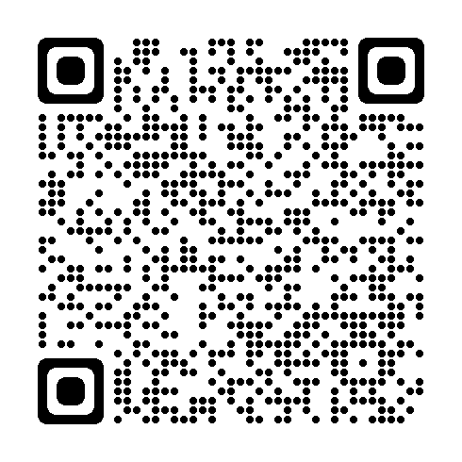
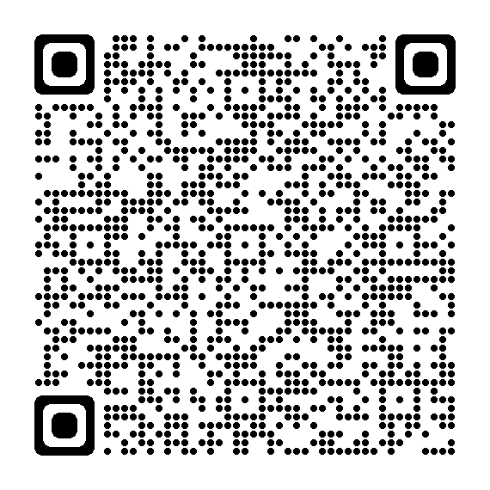
Find out more
The CEIM Experience Improvement Model https://ihub.scot/ceim
Experience Discovery Conversations
https://bit.ly/4axkCHW
Experience Journey Mapping
https://bit.ly/4cGQs6s

Slide 23
Thank you
Diane Graham
Senior Improvement Advisor
Person-centred Design and Improvement Team (ihub)
Healthcare Improvement Scotland
e: diane.graham@nhs.scot
@dgmfg | @PersoncentredSco
Lisa Maynard
Improvement Advisor
Quality Improvement Support Team
Care Inspectorate
e: Lisa.Maynard@careinspectorate.gov.scot
@CareInspect | @LisaMImprove

