Slide 1
CARE
Toward a humanly sustainable health
Victor M. Montori, MD, MSc
Robert H. and Susan M. Rewoldt Professor
montori.victor@mayo.edu

Slide 2
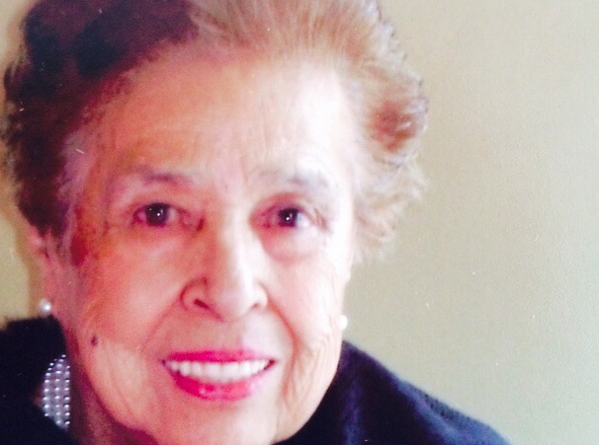
How might we respond to the problematic human situation of this patient?
Notes:
How might we respond to the problematic human situation of this patient?
Quality/process problem: right answer for this person at this time is not known, must be uncovered, discovered, invented (radical uncertainty).
Patients need to cope, adapt, thrive; setbacks are common. They need care that is maximally responsive, minimally disruptive.
Clinicians are knowledgeable and seek to notice their patient’s situation in high definition and respond with compassion and competence. Their longitudinal relationship offers resilience.
Patients and clinicians are unique.
Guidelines offer floor performance. Policies and systems must enable personomics. Plans of care are formed in unhurried conversations. Variation may be a defect or a virtue.
Problems: people, resource availability and alignment, tech, confusing efficient processing with caring.
Outcome: being able to do what needs to be done without being hindered (despite) by disease or treatment; health + care that fits.

Slide 3
Too fast
As a test result
As a statistic
As a record

Slide 4
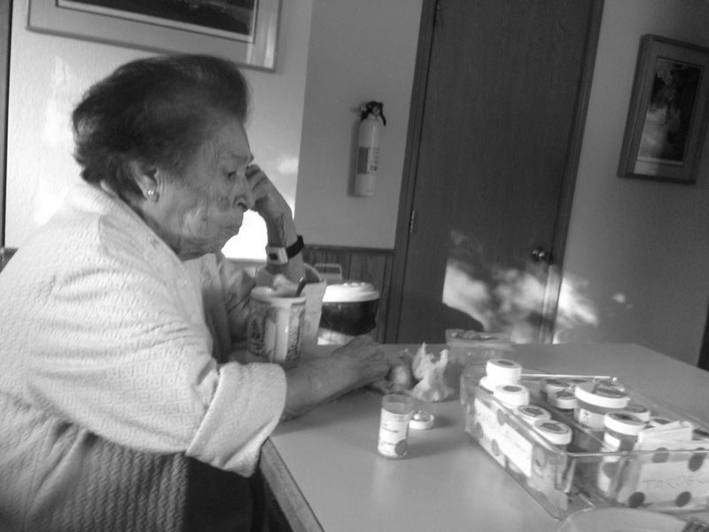
CARE FOR PEOPLE LIKE MARIA LUISA
CARE FOR MARIA LUISA
Biology
Biology
+ Biography
Written authorization to use this picture by patient’s family on file

Slide 5
Organize your information
Ask prioritized questions
Record the visit
Review the medical record
Use the portal and transmit data
Self-monitor, self-manage
Educate yourself
Manage appointments, prescriptions, bills, pre-authorizations, denials, delays
Overcome bias against your illness, class, identity
Keep everyone else informed
Advocate for self and others
W A I T
Spencer-Bonilla G, et al. Mayo Clin Proc Innov Qual Outcomes. 2021;5(2):359-67.
Written authorization to use this picture by patient’s family on file

Slide 6
Purpose
Resilience
Literacy
Health
Financial
Relationships
WORKLOAD
CAPACITY
Written authorization to use this picture by patient’s family on file
Boehmer K et al. J Clin Epidemiol. 2016;74:227-36

Slide 7
NONCOMPLIANCE
Written authorization to use this picture by patient’s family on file

Slide 8
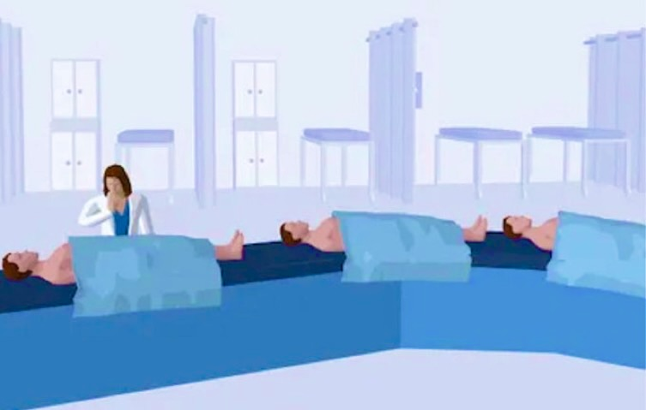
BURDEN
INDUSTRIAL
CARE
BLUR
GENERIC
CRUEL
Art by BMJ

Slide 9
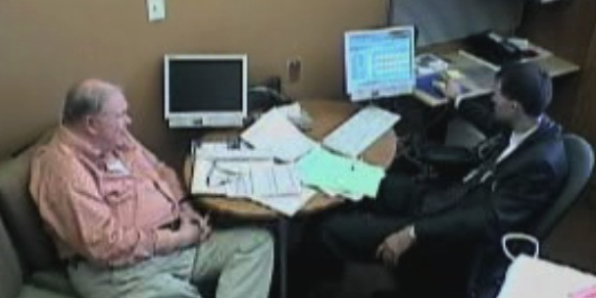
Healthcare without care is unsustainable
PATIENTS
ENCOUNTER
CLINICIANS
40%
Unsustainable burden of treatment
40%
Agenda
11”
to interrupt
40%
Intent to
leave
Tran VT et al. Mayo Clin Proc 2019; 95: 504-12
Singh Ospina N et al. J Gen Intern Med 2019; 34: 36-40
Linzer M et al. JAMA Health Forum. 2022;3(11):e224163

Slide 10
How might we respond
to this
crisis of care?
Notes:
How might we respond to the problematic human situation of this patient?
Quality/process problem: right answer for this person at this time is not known, must be uncovered, discovered, invented (radical uncertainty).
Patients need to cope, adapt, thrive; setbacks are common. They need care that is maximally responsive, minimally disruptive.
Clinicians are knowledgeable and seek to notice their patient’s situation in high definition and respond with compassion and competence. Their longitudinal relationship offers resilience.
Patients and clinicians are unique.
Guidelines offer floor performance. Policies and systems must enable personomics. Plans of care are formed in unhurried conversations. Variation may be a defect or a virtue.
Problems: people, resource availability and alignment, tech, confusing efficient processing with caring.
Outcome: being able to do what needs to be done without being hindered (despite) by disease or treatment; health + care that fits.

Slide 11
One response to the crisis of care is to assume that this is a crisis of organization, efficiency, information technology, and scale.
Organizations need to operate at scales of speed and reach that are only possible when we abandon the idea that care is only possible between people.
It requires more consumption of data, medications, technologies ignoring consequences for other economic priorities or the planet.
The other response assumes this is a crisis of care in and of itself.
Heath I, Montori V. BMJ 2023; 380

Slide 12
Sick
Health
Patient-centered
Evidence-based
High-value
CARE

Slide 13
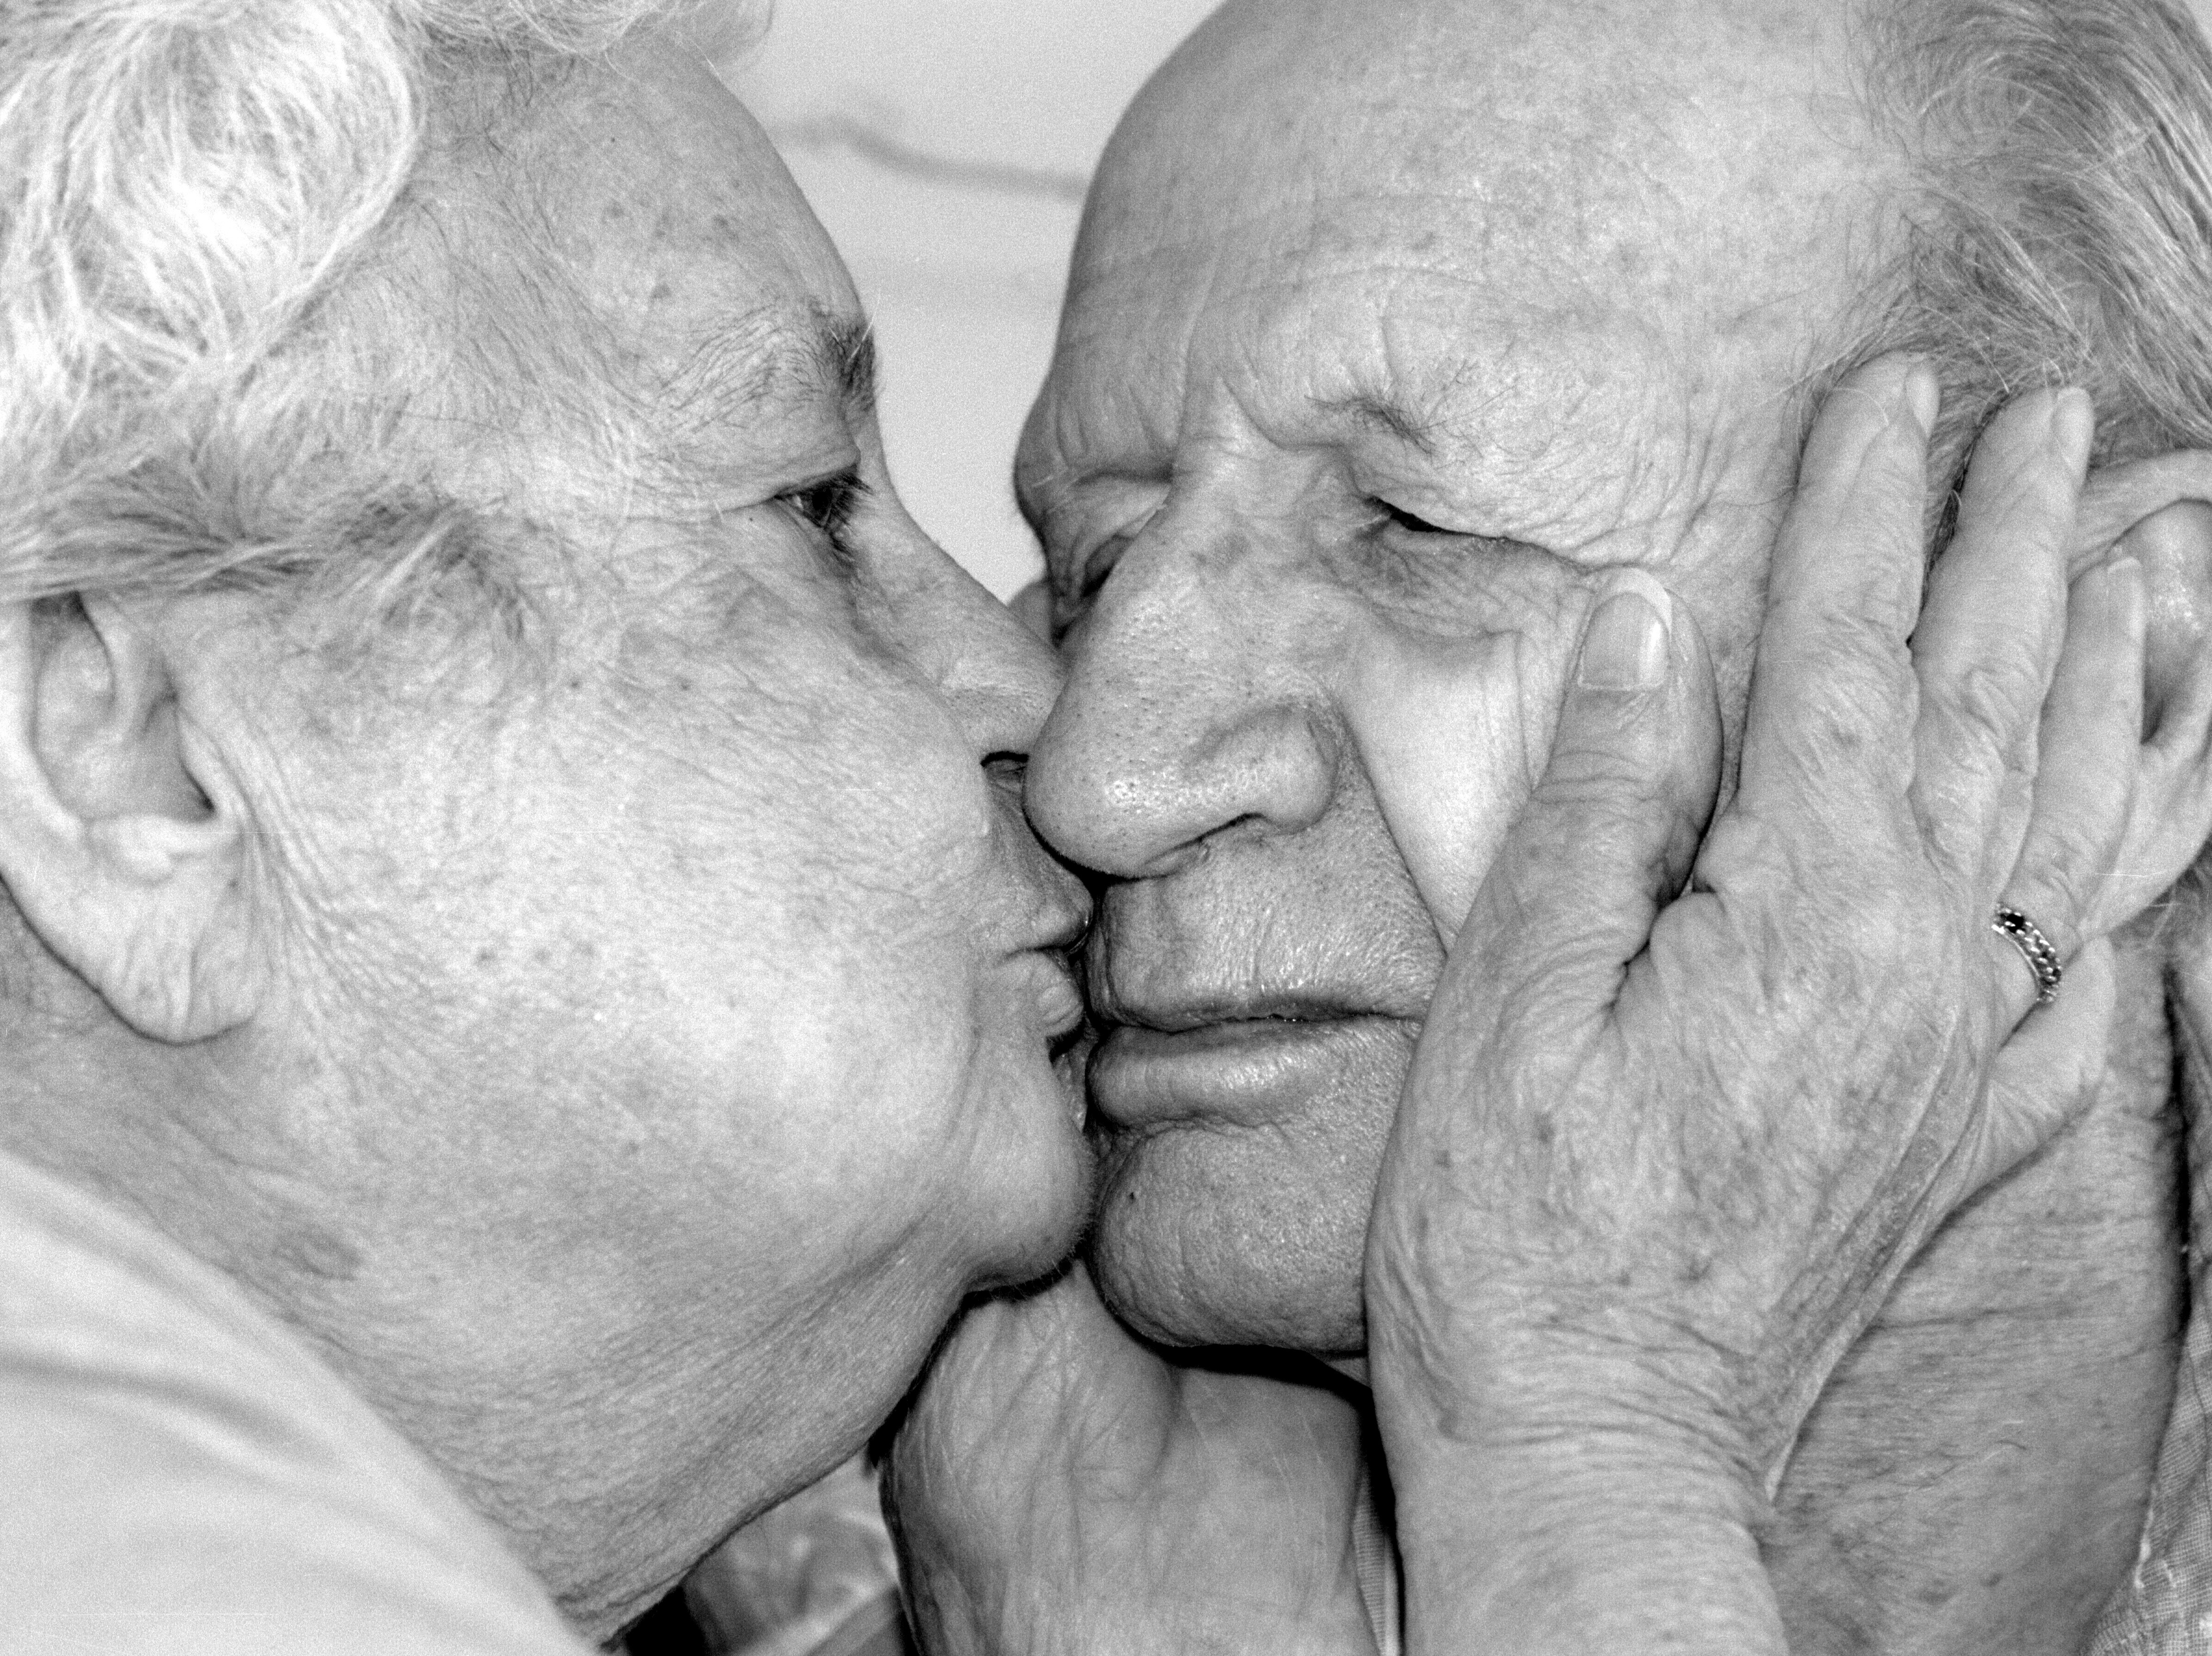
Care
is everything we do
to maintain, repair, and
improve our world
so that we may
live in it
as well as possible.
Fisher and Tronto

Slide 14
CARE
Practice and a disposition
work with
competent
compassionate
Give
attention
situation in HD
needs + strengths
Notice
Respond
creates possibility
invents action
Receive
response is pertinent
response is adequate
response is desirable
J. Tronto

Slide 15
Industrial Healthcare
Careful and Kind Care
?
Pathologies of Care
Blur
Burden
Hurry
Cruelty

Slide 16
CULTIVATE CARE
Care is healthcare’s core purpose
Use language of care instead business jargon
Tell stories about care + use them to drive care

Slide 17
Caring for patients with DM1
Cataract surgery
Managing symptoms, mitigating adverse effects, coping with disappointing results, preventing complications, rehabilitating sequelae, self-management support, problem solving, making care fit
CARE
Right patient/diagnosis, right cure, correctly deployed, at the right time, the first time, with right expertise and equipment.
CURE
Variance
is virtue
Variance
is defect

Slide 18
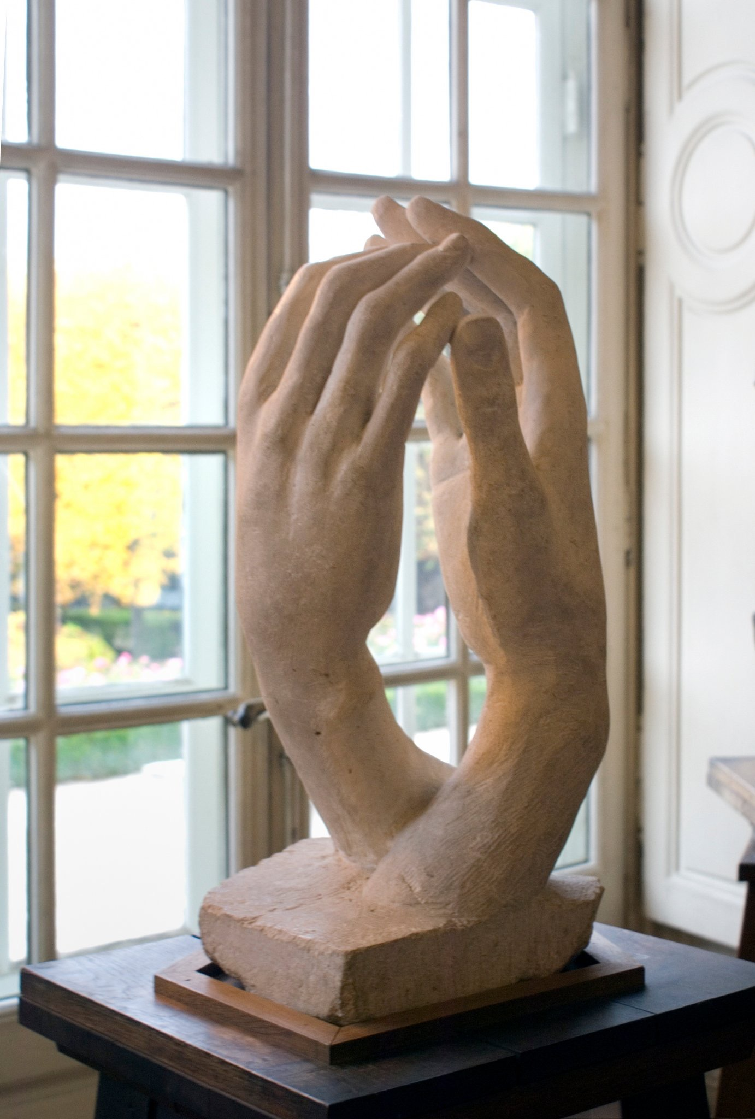

Slide 19
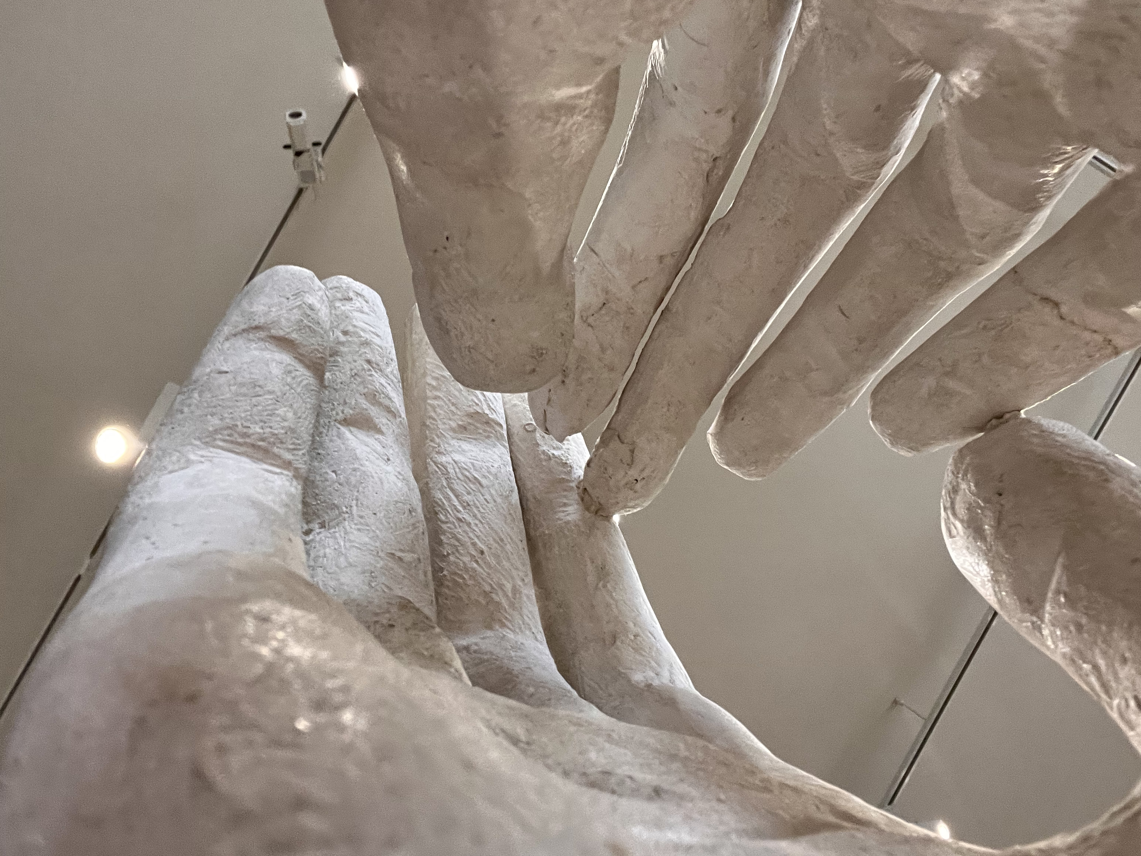
We need to
work together
to change
the conditions
for care
Radically
change
the conditions
for care
Notes:
Programs fail in hostile environments. Change the environment

Slide 20
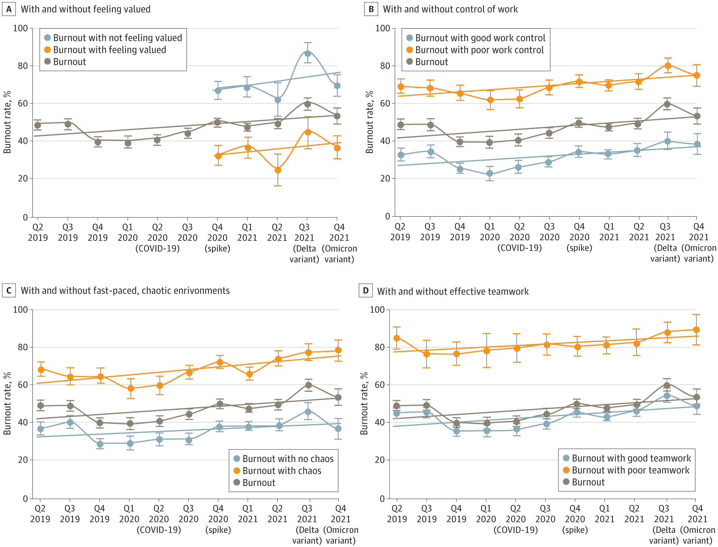
Feeling valued
Control of work conditions
Hurried, chaotic environment
Teamwork
Linzer M. JAMA Health Forum. 2022;3(11):e224163
Notes:
120 practices, mini-z; 20 increased to 40% intent to leave the practice

Slide 21
CARE
Wellbeing and competence of clinicians
Technology and innovations
Collaboration and team-based care: mutual care
Montori V et al. NEJM Catalyst Oct 2019
Poplau S, Linzer M, Allwood D, et al Designing the careful and kind clinc. BMJ Leader 2022;6:87-91.

Slide 22
Industrial Healthcare
Careful and Kind Care
Pathologies of Care
Signs of Care
Blur
Burden
Hurry
Cruelty
High definition
Minimally disruptive
Unhurried conversations
Responsiveness
Allwood D, BMJ leader. 2022;6(2):125-129

Slide 23
Ask ‘what matters to you’
Be curious about patient lives
Patient biographies in the EHR
Careful and Kind Care
Ban medical chores and errands
Understand no-shows/low fidelity
Simplify care (lean consumption)
Promote patient capacity
Signs of Care
High definition
Minimally disruptive
Unhurried conversations
Responsiveness
Limit interruptions, distractions
Enact responsive scheduling,
Implement continuity of care
Eliminate wrong doors
Make navigation easy

Slide 24
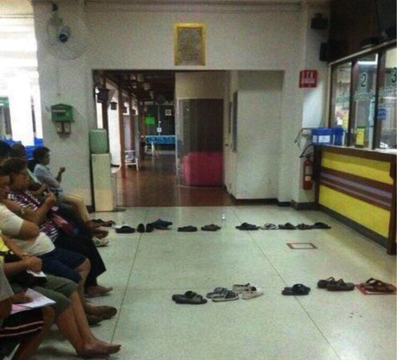
ERADICATE CRUELTY

Slide 25
CARE
Unhurried
Conversation
Co-creation
HD situation
Sensible resolution
Resilient longitudinal relationships
Care that fits
Montori V et al. NEJM Catalyst Oct 2019

Slide 26
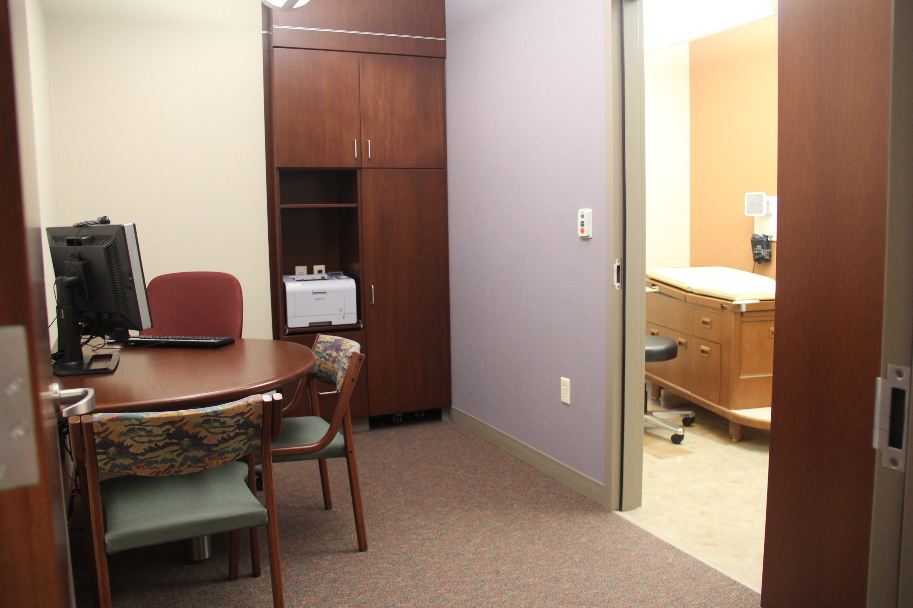
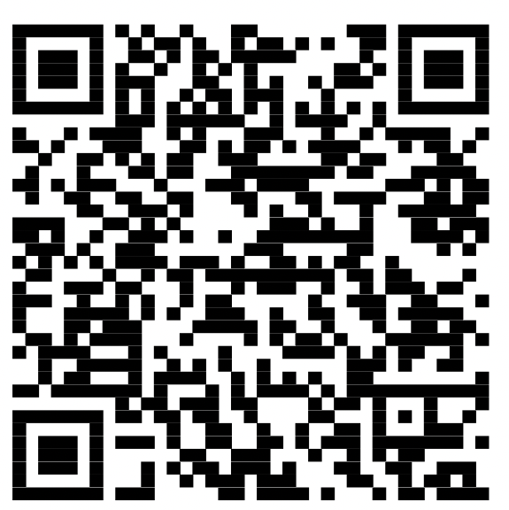
Shared Decision Making
Is a method of care. A conversation in which patients and clinicians work out what to do, co-creating care that makes intellectual, practical, and emotional sense..
Montori VM et al. BMJ Evid Based Med. 2022:bmjebm-2022-112068.
Notes:
Is consistent with evidence-based practice, can be implemented and sustained in a patient’s day-to-day life, and addresses, supports, and advances the emotional experience of illness and treatment.

Slide 27
Making care fit manifesto
“Patients and clinicians must collaborate in designing care plans that maximally respond to each patient’s unique situation and priorities while minimally disrupting their lives and loves.”
Kunneman M et al BMJ Evidence-Based Medicine 2021

Slide 28
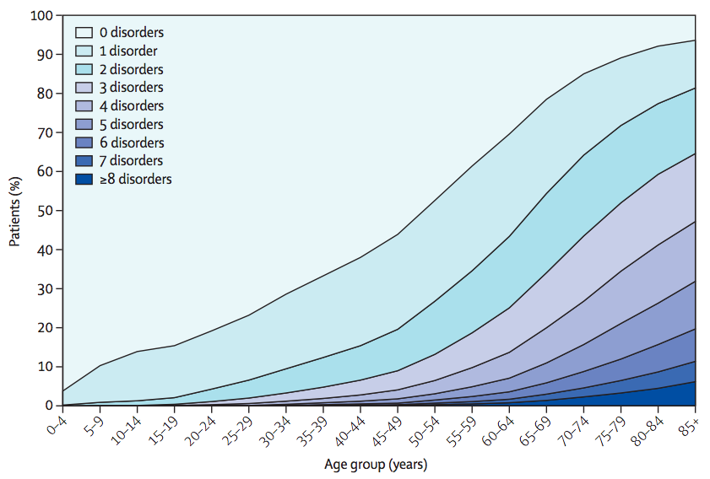
Barnett et al. Lancet 2012

Slide 29
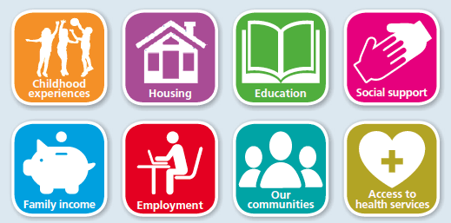
We need to cultivate common care
Environmental health
Health
Health
Professional
Care
Common
Care
Public health
Independence
Productive
Women
Invisible
Interdependence
Relational
Democratized
Recognized
Montori V. BMJ 2021;375:n2886
Notes:
Health largely managed by common care (community)
with a reduced, focused role for professional care

Slide 30
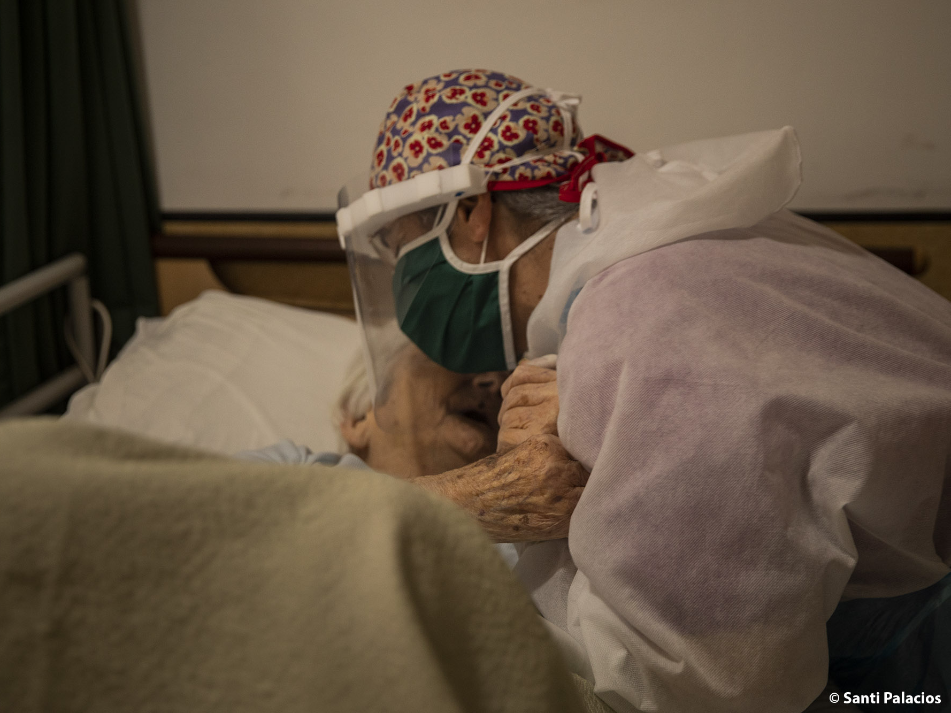
To care is human
To care is human The mission is infinite
To care is human The mission is infinite The capacity to care is not
Getty, Licensed to Mayo Clinic / Irina Velichkina

Slide 31
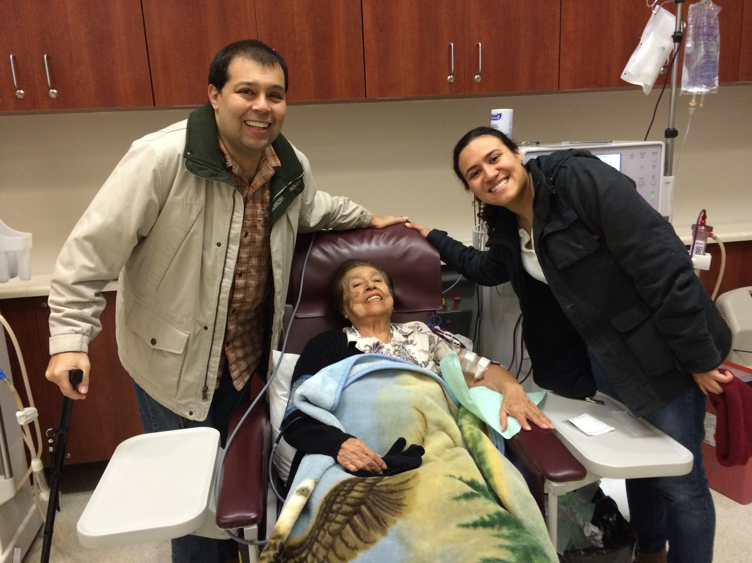
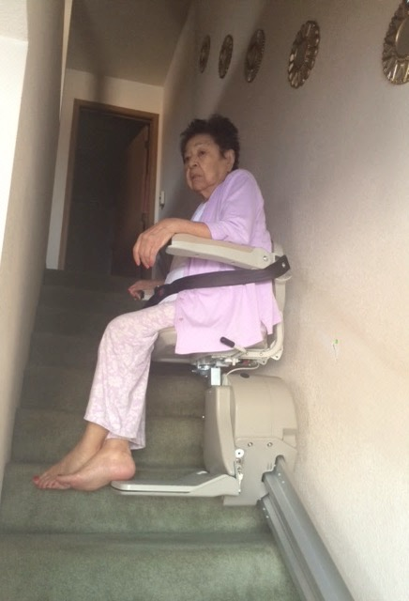
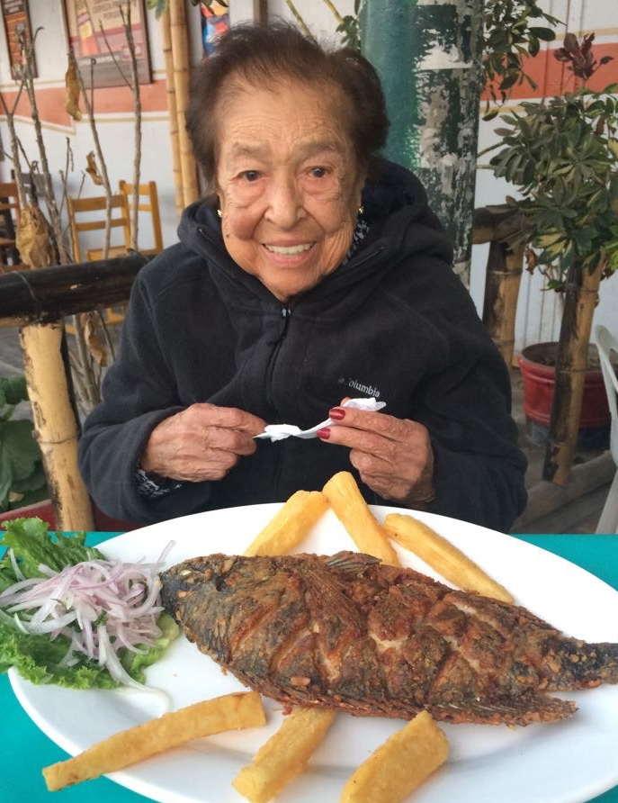
CARE IS A RENEWABLE RESOURCE

Slide 32
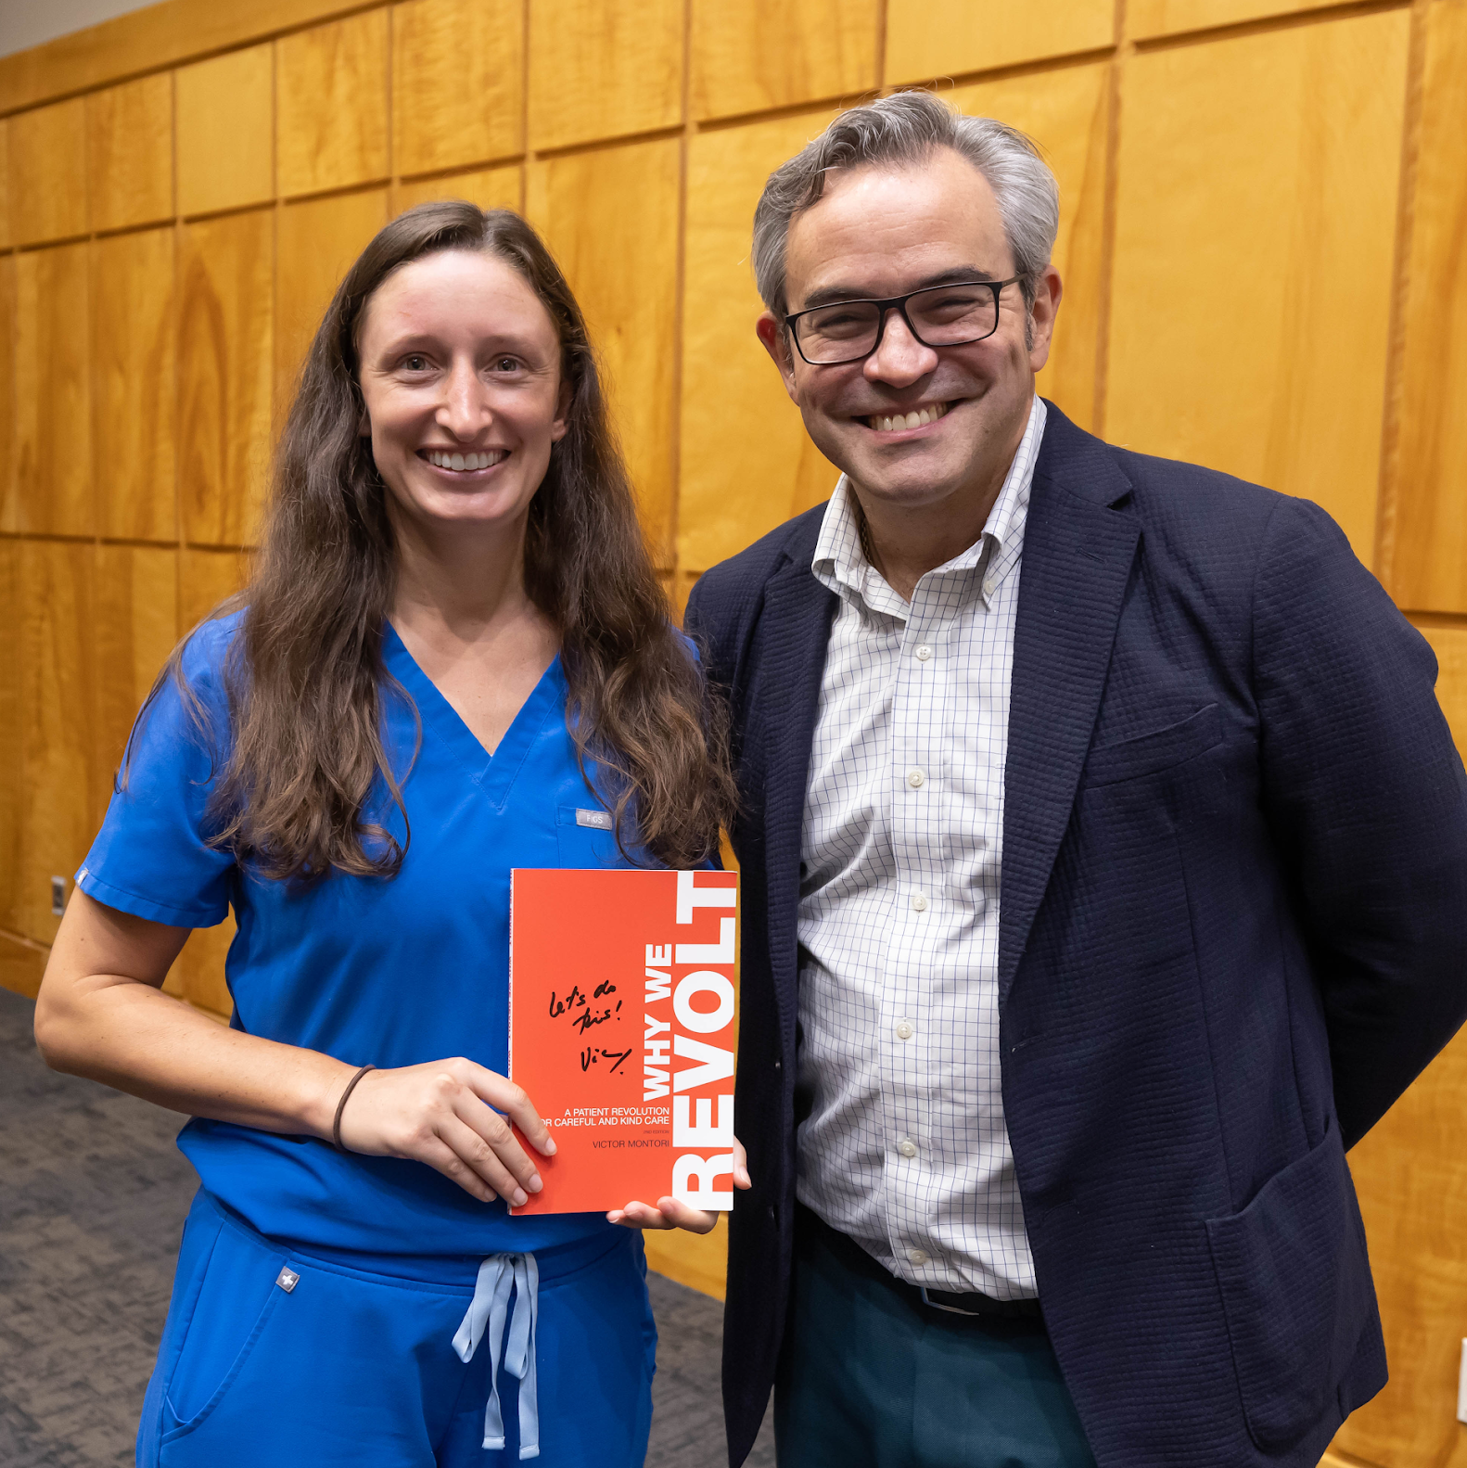
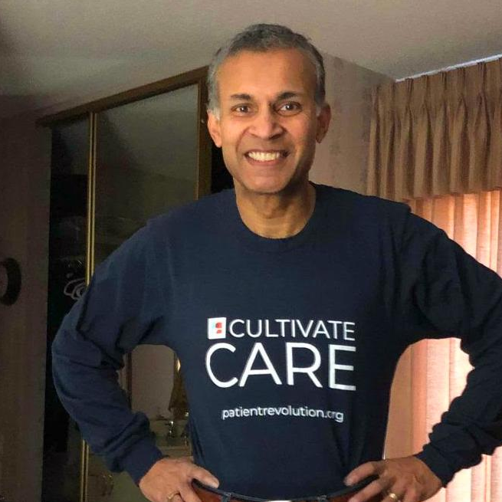
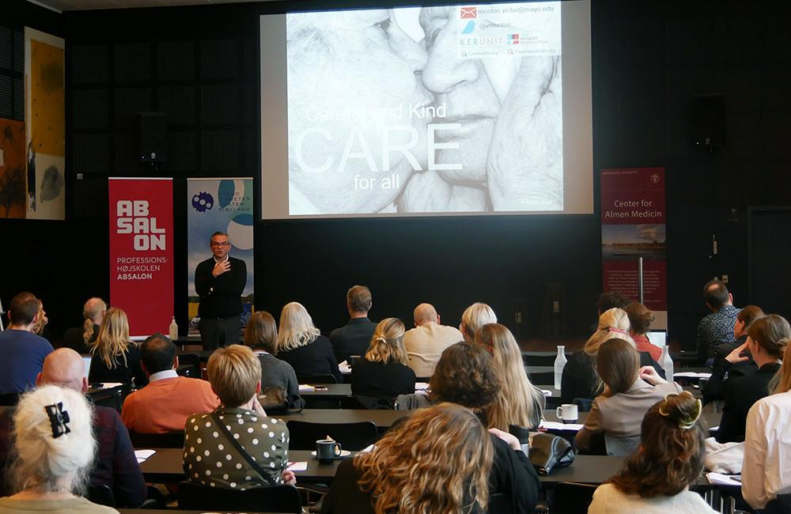
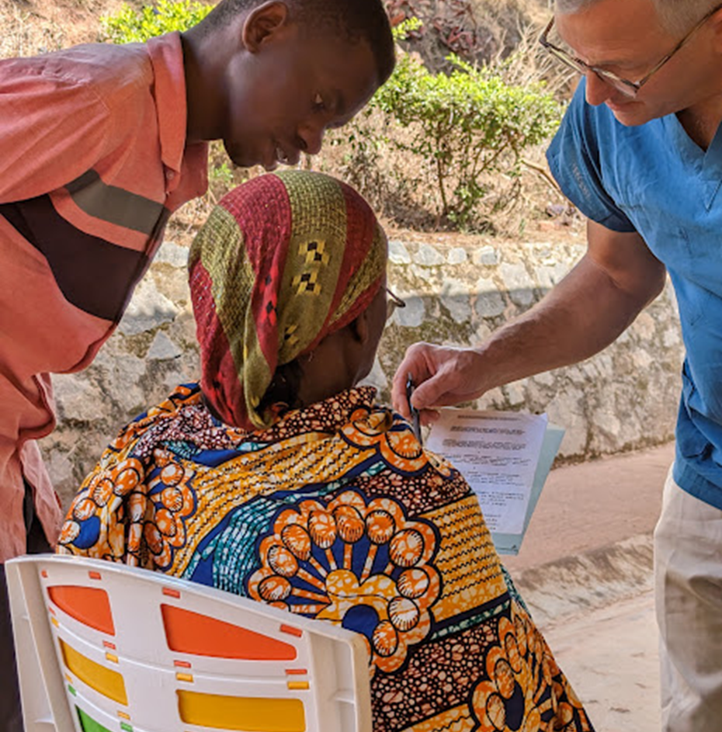
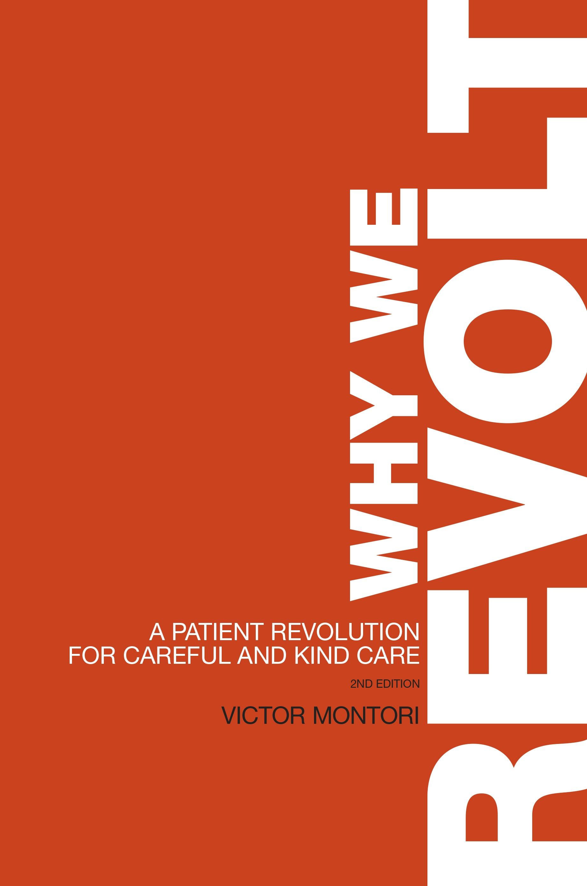
Local, immediate action
Care Activists
Global community
Courage and support
The School
Skills about care and change
The Greenhouse
Ideas and tools
TPR Capacity
The backbone
patientrevolution.org
Notes:
We do this by
Supporting their congregation (community),
Promoting their knowledge and skills (school), and
Tooling them intellectually and practically for success (greenhouse).

Slide 33
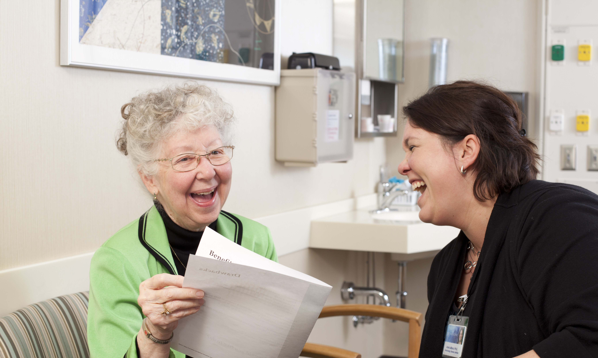
SOLIDARITY
INTEGRITY
ELEGANCE
FOR THIS PATIENT
MINIMALLY
DISRUPTIVE
LOVE

Slide 34
Careful and Kind for all
CARE
© Victoria Grant
Notes:
Adolf and Edna Bonnett © 1997 Victoria Grant

