Slide 1
Reducing health inequalities:
Collaborating to support the design of cervical screening services in West Lothian Health and Social Care Partnership
Prevention
Early Intervention
Local intelligence
May 2023

Slide 2
Foreword
To change your way to think, change your way to see
This document has been designed to provide practical and innovative support to teams across Scotland working towards reducing health inequalities.
This toolkit is focused on screening inequalities, designed in partnership with colleagues and citizens working and living in West Lothian. It shares the learning and outcomes from a collaborative project which has explored how – through the optimisation of community data, intelligence and assets – teams across West Lothian and NHS Lothian might improve informed decision making and uptake of the cervical screening programme.
NHS National Services Scotland (NSS) and colleagues working across social care, health and academia have explored screening services through a social care 'lens' to enable the design – and implementation - of upstream early, preventative interventions. This approach can support earlier identification of disease, improve outcomes of people diagnosed with cancer and enable them to live as healthy a life as possible. It also promotes Value Based Health and Care (VBHC) by building on strengths across the integrated health and social care system, targeting interventions on what really makes a difference.
This is a digital transformation programme, using national and locality digital capabilities to design personalised, sustainable interventions which optimises existing assets and resources. Although focused on one Health and Social Care Partnership (HSCP) the learning and the digital solutions generated can be used across all 31 HSCPs and support national primary and social care programmes focused on addressing health inequalities.
We're using evidence and local intelligence to target interventions on what really makes a difference to the wellbeing of people living across Scotland.
Please get in touch to learn more.
Katharine Ross
Senior Health and Social Care Integration Lead
NHS National Services Scotland

Slide 3
Introduction
This playbook will describe how you can co-design early intervention and preventative initiatives by using screening data analytics, local intelligence and expertise. It will demonstrate how adjustments to current systems have the potential to personalise health and social care resources in a more sustainable, equitable way.
Every year, over 1.6 million people across Scotland are invited to participate in screening for breast, bowel and cervical cancers; for abdominal aortic aneurysms or diabetic retinopathy.
Uptake of these programmes – designed to detect disease early, improve outcomes and prevent premature death – varies considerably. Although reasons behind this are multi-faceted we know that poor screening uptake, outcomes and health inequalities are inextricably linked.
NHS National Services Scotland (NSS) and West Lothian HSCP have been on a service design journey, exploring how cervical screening inequalities can be addressed through a collaborative process involving organisations and individuals working within the HSCP.
Early health intervention and preventative initiatives designed to support groups and individuals most at need are largely designed and delivered at a locality level. Exploring cervical screening data and processes through a social care and community lens has enabled us to consider different, innovative ways of addressing growing screening inequalities in a supportive, collaborative way.
We hope this will support HSCPs and Integration Authorities improve data informed, strategic and operational decision making about community-led screening interventions, maximising the potential of existing resources that exist across the integrated health and social care landscape.

Slide 4
Contents
What is Service Design?
Screening service patterns
Building networks
Discovery
Key information to get started
Setting the scene
Screening inequalities
Synthesis and Define
Problem statement
Integrated Screening Action Model
Develop
Ideation
Opportunity cards
Case studies of good practice
Prototyping
Deliver
Blueprinting your service
Develop a design brief
Pilot
Implement, measure and improve
Resources

Slide 5
What is Service Design?

Slide 6
What is Service Design?
Service Design is a whole systems approach that looks to understand the IT systems, the organisational infrastructure and the beliefs and experiences of users in the system before designing a solution. It is an approach that that been championed by Scottish Government as a more holistic method to understand and improve complex public sectors services for its users. They define service design as:
“The ‘Scottish Approach to Service Design’ (SAtSD) describes design as a way of exploring the problem space openly, collaboratively and with users, before a solution or service is decided.”
In terms of screening, it’s about understanding the participant experience of how they become aware of, access, engage and leave the service of screening. It also concerns the backstage or administrative processes that make the service possible.
Service Design employs a collaborative toolkit of methods including primary research with participants, administrative staff and local organisations to understand the unique needs of a given community.

Slide 7
In short:
Service Design is about working with users and putting people at the heart of your approach

Slide 8
Service Design Activities on a page

Slide 9
Screening service patterns
“A pattern is something that you can work with, and design from, once you understand it better.” –
Ben Holliday
Screening patterns are simple repeatable elements in screening that help us break down the screening journey across programmes.
They were created in collaboration with the National Screening Oversight Team as a means to standardise roles and responsibilities in the Guide to Screening.
They describe screening broadly as:
Pattern
Understand
Screening identifies the participant at the individual level, seeking to know more about individual needs of the participant
Engage
The participant is engaged via personal communication based on their individual support needs
Test
The participant attends and completes a screening test in a familiar and comfortable environment
Record
The participant receives their result as part of record of previous or future screening results that contribute to their overall health.
Result
The participant is referred where appropriate for further assessment and or treatment based on their results

Slide 10
Screening service patterns
On the previous page we described the screening patterns in a linear way. Often the user’s journey is far from this.
This is why we often express a service pattern as a hexagon as it allows us to express the main loops or directions a user may through the screening service in their lifetime.
Understand
Improvement should focus on understanding a single pattern in the journey
Engage
Record
Test
Refer
Defining the pattern:
By focusing on how we “engage” the participant we can design specific solutions from the problems found here.
Use the tool overleaf to frame this

Slide 11
In short:
Service patterns help us to define:
Which part of the screening journey are we designing for?
Understand
Engage
Refer
Record
Test

Slide 12
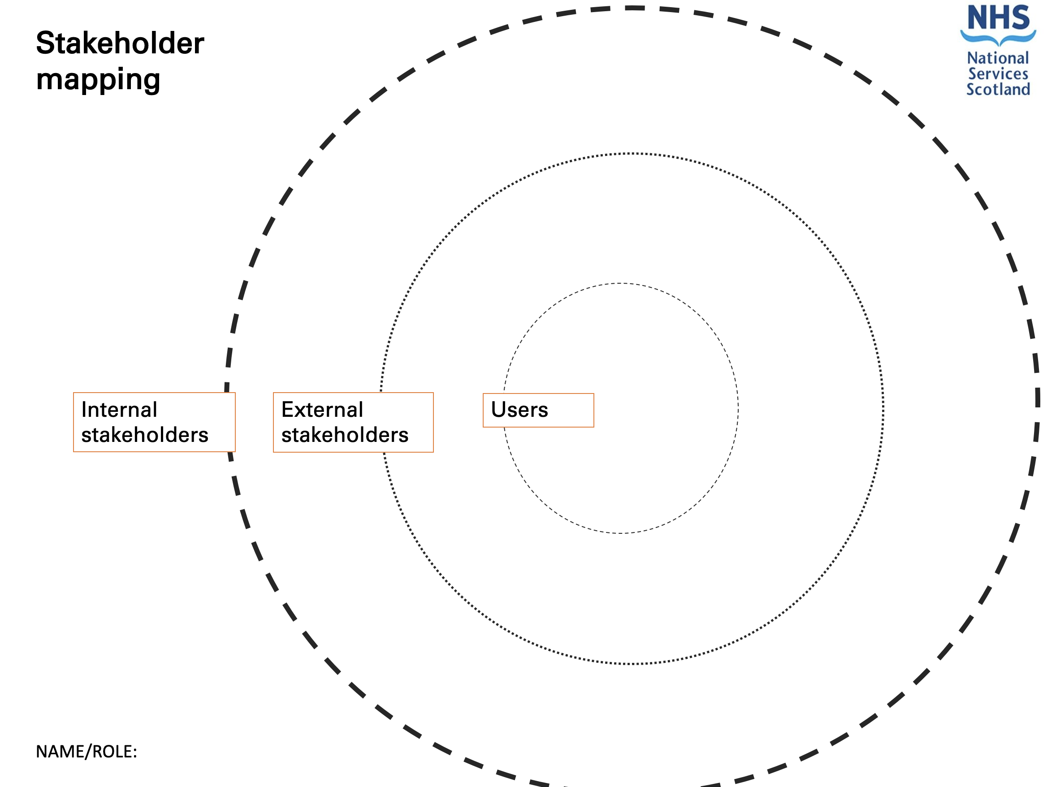
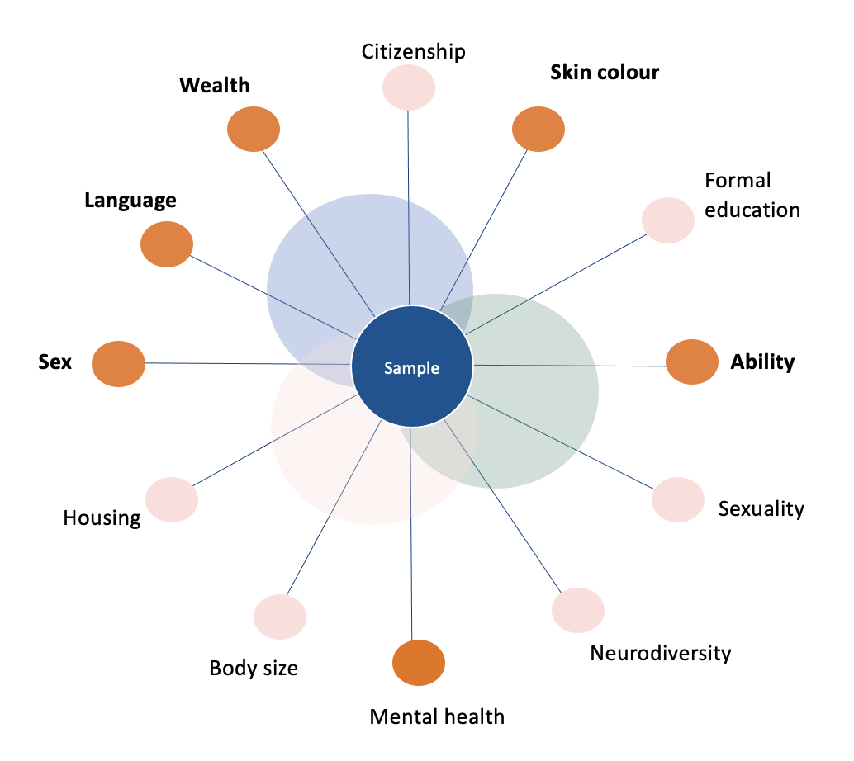
Building networks
Building networks is vital to service design. Linking into the networks in the third, independent and statutory sectors, and across local and national NHS teams is critically important. The success of the co-design workshops and was dependent on the recruitment of citizens and staff with lived experience of screening services.
There are different layer of stakeholders:
Internal stakeholders
External stakeholders
Users (both the citizen, clinical and administrative staff)
Stakeholder map tool
Wheel of privilege
The following tool is useful to map stakeholders.
A copy of the tool is overleaf
When considering the user group, it is important to consider the bias in your sample using the wheel of privilege

Slide 15
In short:
Stakeholder mapping ensures we know:
Who are the key stakeholders?
Which organisations will we engage?
How do we get access to the users we will work with?

Slide 16
West Lothian HSCP Workshops
Over the course of the service design journey with West Lothian HSCP, we engaged with a wide range of stakeholders. This is a visualisation of the engagement across the four workshops:
Organisation Type​ | Engagements​
Health & Social Care Partnership​ | 11​
NHS Territorial Health Board​ | 13​
NHS24​ | 5​
National Screening Oversight (NSO)​ | 2​
Public Health Scotland (PHS)​ | 3​
Primary Care (GP)​ | 1​
Scottish Government (SG)​ | 5​
SME/Service Provider (SME)​ | 5​
Third Sector​ | 5​
PHS
HSCP
PHS
NSO
NHS Territorial Health Board
SG
NHS24
Third Sector
SME
GP

Slide 17
Discovery

Slide 18
Key information to get started
To do focused service design work often we start with a lot of questions.
Mostly this is about understanding the scope of the service design work, so that we know who to engage, what groups to work with and the boundaries of a service to explore.
It is important to answer as many of the questions below as possible before getting started:
Key questions to answer:
Who is this for and where is the most need?
What is the percentage uptake of screening by area?
Which areas have the lowest uptake of screening? What is the relationship between lowest uptake and the affluence of the area?
What is the demographic of the people living in in the areas with lowest uptake?
How has the uptake changed over time? Has there always been low uptake in this area?
Do we know what percentage of DNA are from underserved groups?
Can we match the uptake data to demographic data?
v
v
v
v

Slide 19
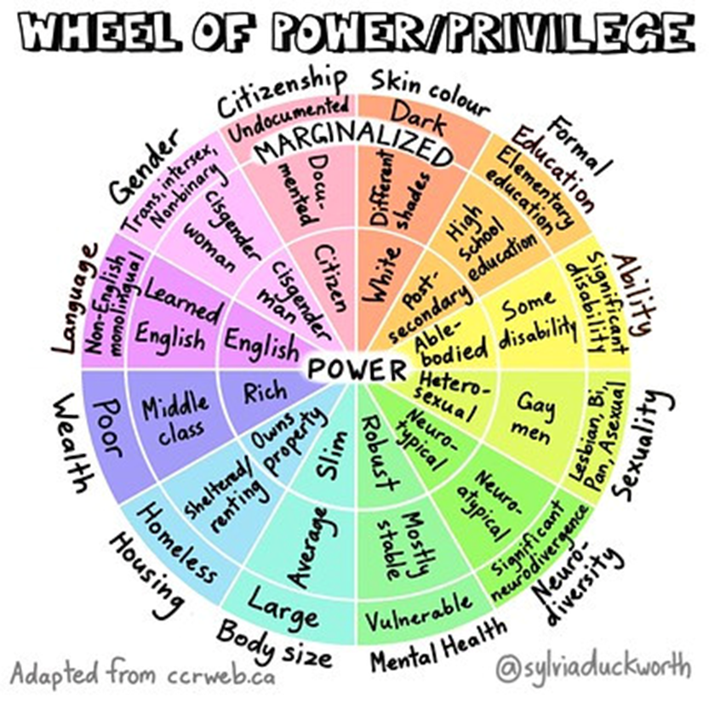
Setting the scene
Cervical screening and health inequalities
Evidence shows lower participation in cervical screening in the following groups:
25- to 34-year-olds
Women living in areas of high deprivation
Women with a learning or physical disability
Black or minority ethnic (BME) women
Lesbian and bisexual women
Trans men and non-binary people born female
Source: https://www.healthscotland.scot/health-topics/screening/cervical-screening

Slide 20
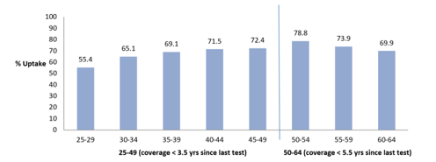
National picture
The uptake rate for cervical screening in Scotland during 2019 was 69.3% with just over one million eligible women having participated in the screening period as of 31st March 2021. Uptake has declined in recent years.
Uptake increased with age from 55% for ages 25 to 29 to a peak of 79% in those 50 to 54 years, before reducing in the oldest invited age groups.
Women from the most deprived areas are less likely to take part in the screening programme, with uptake only 63% compared with 74% in the least deprived areas.
Scottish cervical screening programme statistics​
​
Percentage uptake of cervical screening among women aged 25 to 64 who were screened within the last 3.5 or 5.5 years by age group: Scotland, 1 April 2020 to 31 March 2021
Source: https://publichealthscotland.scot/publications/scottish-cervical-screening-programme-statistics/scottish-cervical-screening-programme-statistics-annual-update-to-31-march-2021/

Slide 21
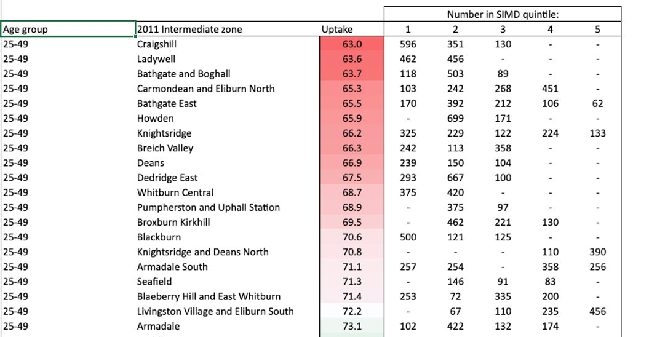
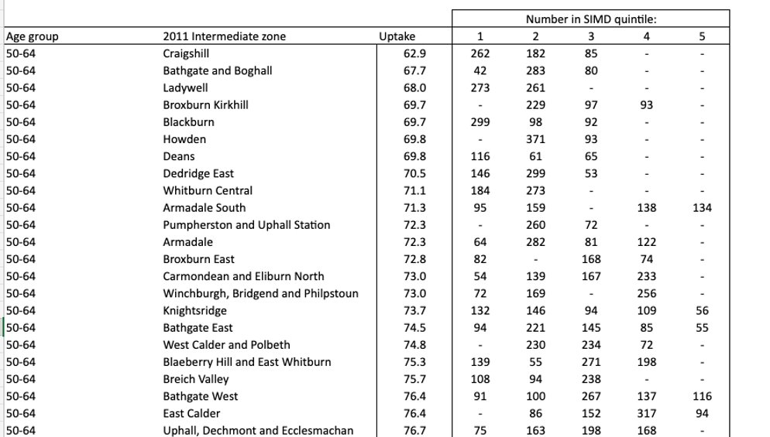
Local picture
The uptake rate for cervical screening in West Lothian was 73.3% for 2020/21.
Women from the most deprived areas are less likely to take part in the screening programme, with uptake only 62.9% compared with 84.1% in the least deprived areas.
Viewing locality intermediary data has the potential to enable NHS and social care strategic planners to allocate resources and make decisions around appropriate, targeted interventions.
Age group: 25-49
Age group: 50-64
​
Source: Scottish Cervical Call-Recall System (SCCRS)

Slide 22
Putting users at the heart
We worked with people with lived experience and community representatives – nationally and across West Lothian - to understand the groups and beliefs associated with non-attendance. Over the course of the research phase, we conducted semi-structured interviews, focus groups and workshops with the following groups:
Young women aged 24-30 with low income
Ethnic minorities
People without English as a first language
Those with sensory impairments
GPs working in deep end clinics University of Glasgow - Connect - Community and public engagement - Projects and Events - GPs at the Deep End
What we learned:
For those we engaged with we learned the means of communication for cervical screening makes women less likely to see it as a priority. The themes highlighted:
Lack of knowledge
Frequency of communication
Format of communication
The mobile phone is central to people's lives

Slide 23
Lack of knowledge
What did we learn?
The primary source of information about cervical screening is from informal social networks
Despite young women being offered the HPV vaccine in school from 2008, many were not told what the vaccine was for
For many women, the first-time hearing about cervical screening was through the invitation letter
The information leaflet sent with the invitation letter is often glanced over but not read
Women coming from abroad experienced different healthcare systems. Screening might not be offered in home country and less knowledge about cervical screening can cause apprehension
Former engagement with the NHS is a motivating factor to attendance, for example if you have full or partial immunisation status for HPV vaccine, you're likely to have a higher uptake of cervical screening. If you have no HPV immunisation status you are less likely to be engaged with healthcare and have lower cervical screening uptake.
"I think the understanding of what a cervical smear actually is across our patient group is not great, actually. And I think that they are thinking that is going to tell you if you have cancer then and there." ​
"Kind of, just through some of my friends that have had theirs done but other than that that's all I really know about it."

Slide 24
Frequency of communication
What did we learn?
With the long time between recall it is easy to forget about cervical screening
Women who are eligible for cervical screening are not expecting the letter, which makes it easier to ignore. It is also more difficult for those with additional support needs who require assistance reading letters
With reminders sent after 3 months, cervical screening is not perceived as urgent
Because national screening programmes were paused during the pandemic, the perception was that the NHS doesn't view it as a priority
"If I just got this [cervical screening invite] and had no idea what it was, then I don't know if I would have bothered to do anything about it"
"It's not something I ever think about. I get a letter through the post when it's time, which is good because otherwise I would never remember."
​
"I saw the letter, I thought that's not the right time... But then, after a month, or something I was like, I'll probably just throw it away anyway and I'll wait for next letter...I know that it's not really responsible, because I should probably answer or book another appointment, but it's just, yeah, I just put it somewhere on the side."

Slide 25
Format of communication
What did we learn?
Participants report that often a letter could be put aside or missed – or not received at all
Format of printed letter itself is not accessible for many women
Although alternative formats are available, these are challenging to access
Preferences for formats and support needs for women eligible for the cervical screening programme are not stored in the cervical screening system or shared between services
Printed letters are more difficult to translate
Many participants associate letters with bills and ignore them
Print letter can be viewed as wasteful both from an economic and sustainability perspective
The invitation letter is not received if address is not up to date
Letters are not private for all users, particularly for women with sensory needs and those living in abusive, controlling relationships
"I think it's really frustrating the amount of post. Everything is online via text, and I think that's how most people like to work. If I get anything by mail, it goes in my log burning fire. I don't like the waste and it is expensive."
"I think for me, I rarely open letters, because I just think they are all bills."
"Alternative formats are not given freely."

Slide 26
The mobile phone is central to people's lives
What did we learn?
Mobile phones are an integral part of daily life and planning, participants use their mobile phones to organise other appointments and other elements of their life
Participants find receiving a letter less preferable to the COVID vaccination booking process
Participants like the immediacy of receiving information by text
Text was the preferred format of communication, though there was some apprehension around text scams
For users with sensory impairments, the mobile device provides independence through use of accessibility apps and technology
COVID vaccination normalised use of phone for communication from healthcare services
"This phone here. It's like, if I don't have it, I feel like I'm missing a hand, or an arm or leg or limb...And that's my little diary in there, and everything's in there."​
"Text is a great way to connect with a person, because the majority of us are using a mobile phone."
"I'm an old dragon when it comes to technology, and if I can book an appointment through a calendar. Through COVID I learned how to do that."​
"When you get a text through it connects with being important. And if you can then go onto a link that alerts you to the importance of it."

Slide 27
Synthesis and Define

Slide 28
In short:
The discovery phase helps define a focused and evidence-led problem statement
Good question: How might we engage women aged 24-29 to increase the uptake of cervical screening in West Lothian?
Bad question: How might we improve cervical screening by reducing health inequalities in West Lothian?
(too broad)

Slide 29
The Integrated Screening Action Model
Research from Professor Kathryn Robb at the University of Glasgow describes how behaviours in screening are more complex than attendance and non-attendance. The Integrated Screening Action Model (I-SAM) is a helpful model to contextualise the behaviours in screening and to help target services.
​
Unaware
Unengaged
Undecided
Decided not to act
Participant influences
Environment influences
Decided to act
Acting
Repeat
SOURCE: Kathryn A. Robb, The integrated screening action model (I-SAM): A theory-based approach to inform intervention development,Preventive Medicine Reports, Volume 23,2021,

Slide 30
Behaviours in screening
“Our current approaches are failing to engage the most vulnerable.”
Professor Katie Robb, University of Glasgow
Our focus was on the four behaviours: Unaware, Unengaged, Undecided and Decided not to act.
​
Participant influences
Unaware
Unengaged
"I think the understanding of what a cervical smear actually is across our patient group is not great, actually." ​
"Homeless populations or those who are unregistered aren’t picked up by the screening service and it relies on organisations to find them"
​
Undecided
Decided not to act
"I don’t know whether it’s the information side of it or having the freedom and independence to go as and when it’s right for you, as and when it’s your business, it’s not to do with anyone else."
"Losing your vision does kind of take away the same kind of access and privacy, confidentiality that other women have. You lose a bit of that. You feel like public property."
Environment influences
SOURCE: Kathryn A. Robb, The integrated screening action model (I-SAM): A theory-based approach to inform intervention development,Preventive Medicine Reports, Volume 23,2021,

Slide 31
Behaviours in screening
Developing personas can be helpful to empathise with users and to understand their needs.
​
Unaware
Unengaged
Women can be unaware about cervical screening for any number of reasons, including:
people with lower literacy – in the UK, literacy is generally low and medical information can be difficult for many people
anyone who doesn’t have English as a first language – the invitation letter may not be accessible for them and, if they are from a country that does not have a routine cervical screening programme, the concept may be unfamiliar
having a learning disability – the invitation letter or explanation about cervical screening may not be accessible for them
There are a few myths that mean some women and people with a cervix think cervical screening isn’t relevant for them, including:
haven't been sexually active for a long time
have been through the menopause
have had the HPV vaccination
have had a subtotal hysterectomy (removal of womb but you still have a cervix)
are a lesbian or bisexual - HPV can be passed on through other forms of sexual activity
These factors could mean many women disengage with cervical screening uptake and eventually decide to not participate.

Slide 32
Behaviours in screening
Undecided
Decided not to act
It can be difficult to get to an appointment at a time that suits. This may be even worse at the moment because of pressures on primary care services. Sometimes women have commitments, including childcare or work, which clash with available appointments.
It’s natural for women to worry about their cervical screening results. This fear can cause delays with scheduling a smear test.
Familiarity with sample takers can be a problem in rural areas with tight-knit communities. Understandably, this can feel challenging with such an intimate test.
There are any number of barriers why someone could decide not to participate in cervical screening, including:
Feeling of embarrassment
Fear of pain or previous negative screening experience
Fear due to previous sexual assault or abuse
Unable to access information due to language or mode of delivery
Unable to access service – cost and accessibility of public transport
Anonymity, or lack of it, can be an issue in communities where there is shame about being sexually active outside of marriage. Even if a woman is married, there may be a belief in the community that only women who have had multiple partners need to go for cervical screening.
Intending to go but not getting around to it

Slide 33
Develop

Slide 34
Focus of our collaboration with HSCPs
Data Intelligence
Identify factors
Service Design
Predictive Analytics
Co-design solutions
Focus resources
How might we use personalised communications to help improve cervical screening uptake in West Lothian?
User needs include
Personalised communication
Accessible messaging
Targeted communications at the right time (prompts and reminders, as well as follow up information)
Welcome information on screening for people emigrating and first-time screeners

Slide 35
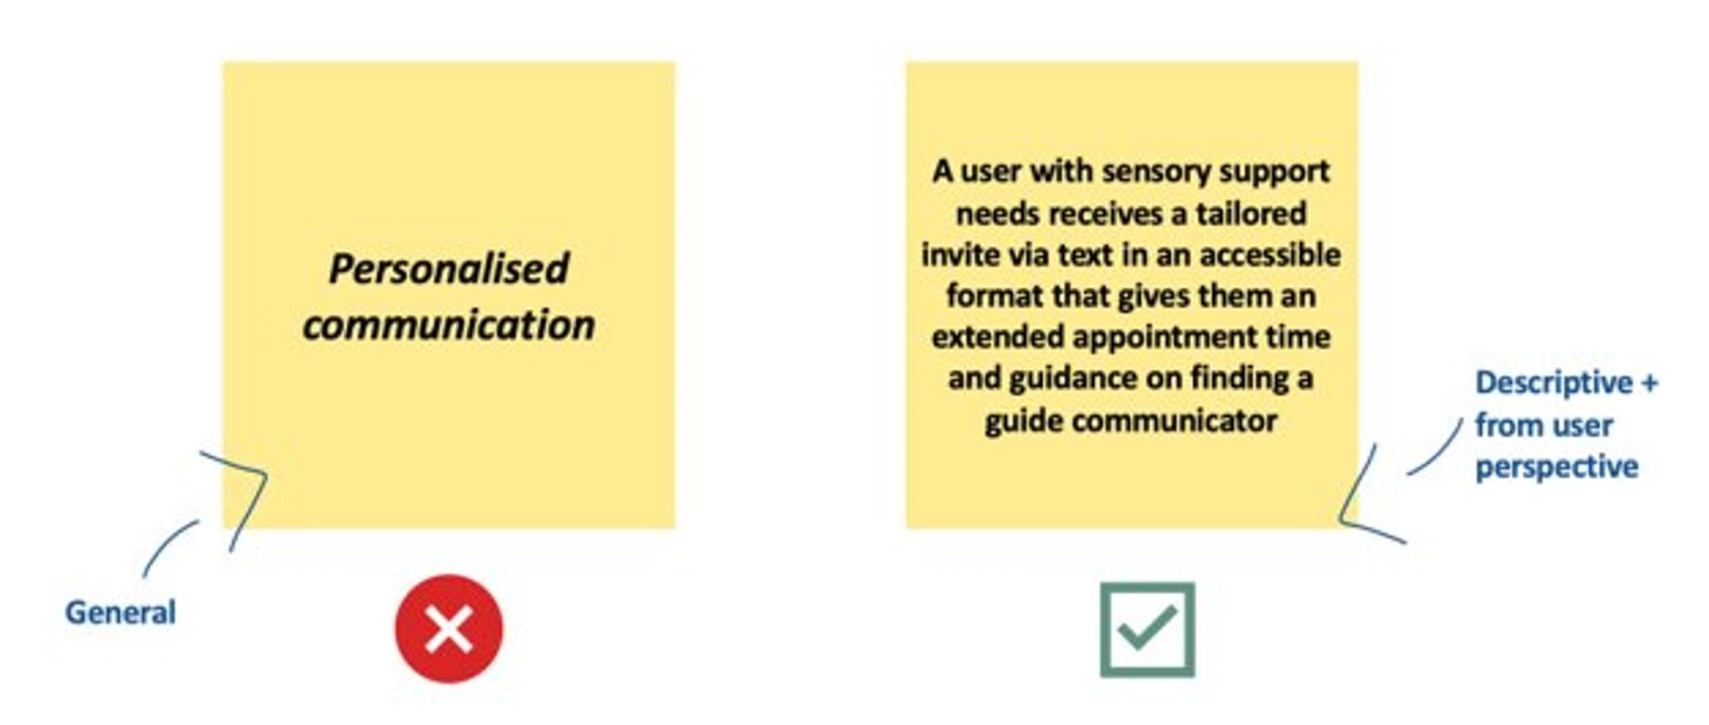
Ideation
After the discovery phase is completed and the user needs are defined, ideation is helpful to explore possible solutions that can be developed. This can be done in a workshop setting where participants are asked to provide descriptive solutions from the user perspective.
​

Slide 36
Opportunity card
An opportunity card is a helpful tool to aid in development and prioritisation. Use the tool overleaf to highlight:
Opportunity description
Customer quotes
What problem is this trying to solve?
What are the potential risks?
How will this opportunity add value?
What capabilities will be required?
How can the service respond to changing needs?
Implementation: Key enablers
​
Example:
Opportunity card
Text messaging service
CONCEPT 1
Idea description
Related interventions
Behavioral economics informed message content in text message reminders to improve cervical screening participation: Two pragmatic randomized controlled trials
Offering an app to book cervical screening appointments: A service evaluation
Increasing the uptake of cervical screening at Cornerstone Medical Practice
Reducing missed hospital appointments using text messages
How does this address screening inequalities
People without a fixed address
Gypsy, Roma, Traveller communities
People experiencing homelessness
People with sensory impairments
People with non-routine working patterns
Text invitation to be sent alongside letter invitation, signposting to relevant information and accessible formats. Reminder prompts to be sent 24-72 hours in advance with links to more information, and personalised format links if preferences are known.
Why
Text messaging was mentioned as a preferred or additional communication method for greater engagement by people with lived experience in our research. People we spoke also tended to organise their time from their phone.
In addition to our user research existing evidence (such as this rapid review of cancer screening participation interventions) suggest that text message reminders can:
be highly cost effective
play a significant role in removing barriers to screening, for instance by preventing people forgetting about an appointment, and can increase uptake among people who want to be screened
have an impact on reducing screening inequalities in those unengaged underserved communities
Behavioural category
Unengaged
Customer quote
"When you get a text through it connects with being important. And if you can then go onto a link that alerts you to the importance of it."

Slide 37
Opportunity card
Opportunity description
Customer quote
What problem is this trying to solve?
What are the potential risks?
How will this opportunity add value?
What capabilities will be required?
Implementation: Key enablers
How can the service respond to changing needs?

Slide 38
Screening text message principles
Evidence-based principles for the effective use of screening appointment text message reminders in reducing inequalities and supporting informed choice have been developed by the Office for Health Improvement and Disparities.
These principles were developed as part of the Public Health England national screening inequalities strategy to support NHS screening services to make the most effective use of text message (SMS) reminders for screening appointments.
Existing evidence (such as this rapid review of cancer screening participation interventions) suggests text message reminders can:
be highly cost effective
play a significant role in removing barriers to screening, for instance by preventing people forgetting about an appointment, and therefore increasing uptake among people who want to be screened
have an impact on reducing screening inequalities¹
Additionally, evidence suggests that GP-endorsed messaging have been highly effective means of communicating with patients at scale, while also relieving practices of the administrative workload.²
Short message service (SMS) based interventions are widely used in healthcare and have shown promising results to improve cancer screening programs. However, more research is still needed to implement SMS in the screening process.³ Specifically, guidance is lacking around the practicalities of text messaging, such as their content and timing.⁴
​

Slide 39
Case study
Behavioural economics informed message content in text message reminders to improve cervical screening participation: Two pragmatic randomised controlled trials
The objective of the reported research was to assess the impact of text message (SMS) reminders and their content on cervical screening rates.
Method: Randomised control trial
Location: Borough of Hillingdon, London, UK
Timeframe: The study took place between February and October 2015, with follow-up until February 2016.
Sample size: A total of 3139 and 11,458 women were randomized in Studies 1 and 2, respectively
Result: In Study 1 participation was significantly higher in the SMS-PCP arm (31.4%) compared to control (26.4%, aOR, 1.29, 95%CI: 1.09–1·51; p = 0.002). In Study 2 participation was highest in the SMS-PCP (38.4%) and SMS (38.1%) arms compared to control (34.4%), (aOR: 1.19, 95%CI: 1.03–1.38; p = 0.02 and aOR: 1.18, 95%CI: 1.02–1.37; p = 0.03, respectively). The results demonstrate that behavioural SMSs improve cervical screening participation. The message content plays an important role in the impact of SMS.
Source: Sarah Huf, Robert S. Kerrison, Dominic King, Tim Chadborn, Adele Richmond, Deborah Cunningham, Ellis Friedman, Heema Shukla, Fu-Min Tseng, Gaby Judah, Ara Darzi, Ivo Vlaev,
https://doi.org/10.1016/j.ypmed.2020.106170.
(https://www.sciencedirect.com/science/article/pii/S0091743520301948)
​

Slide 40
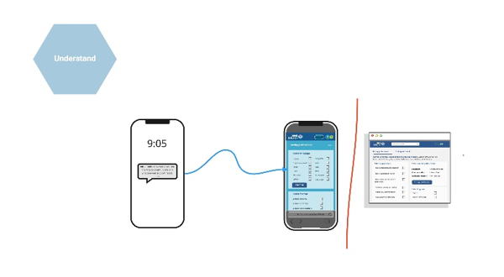
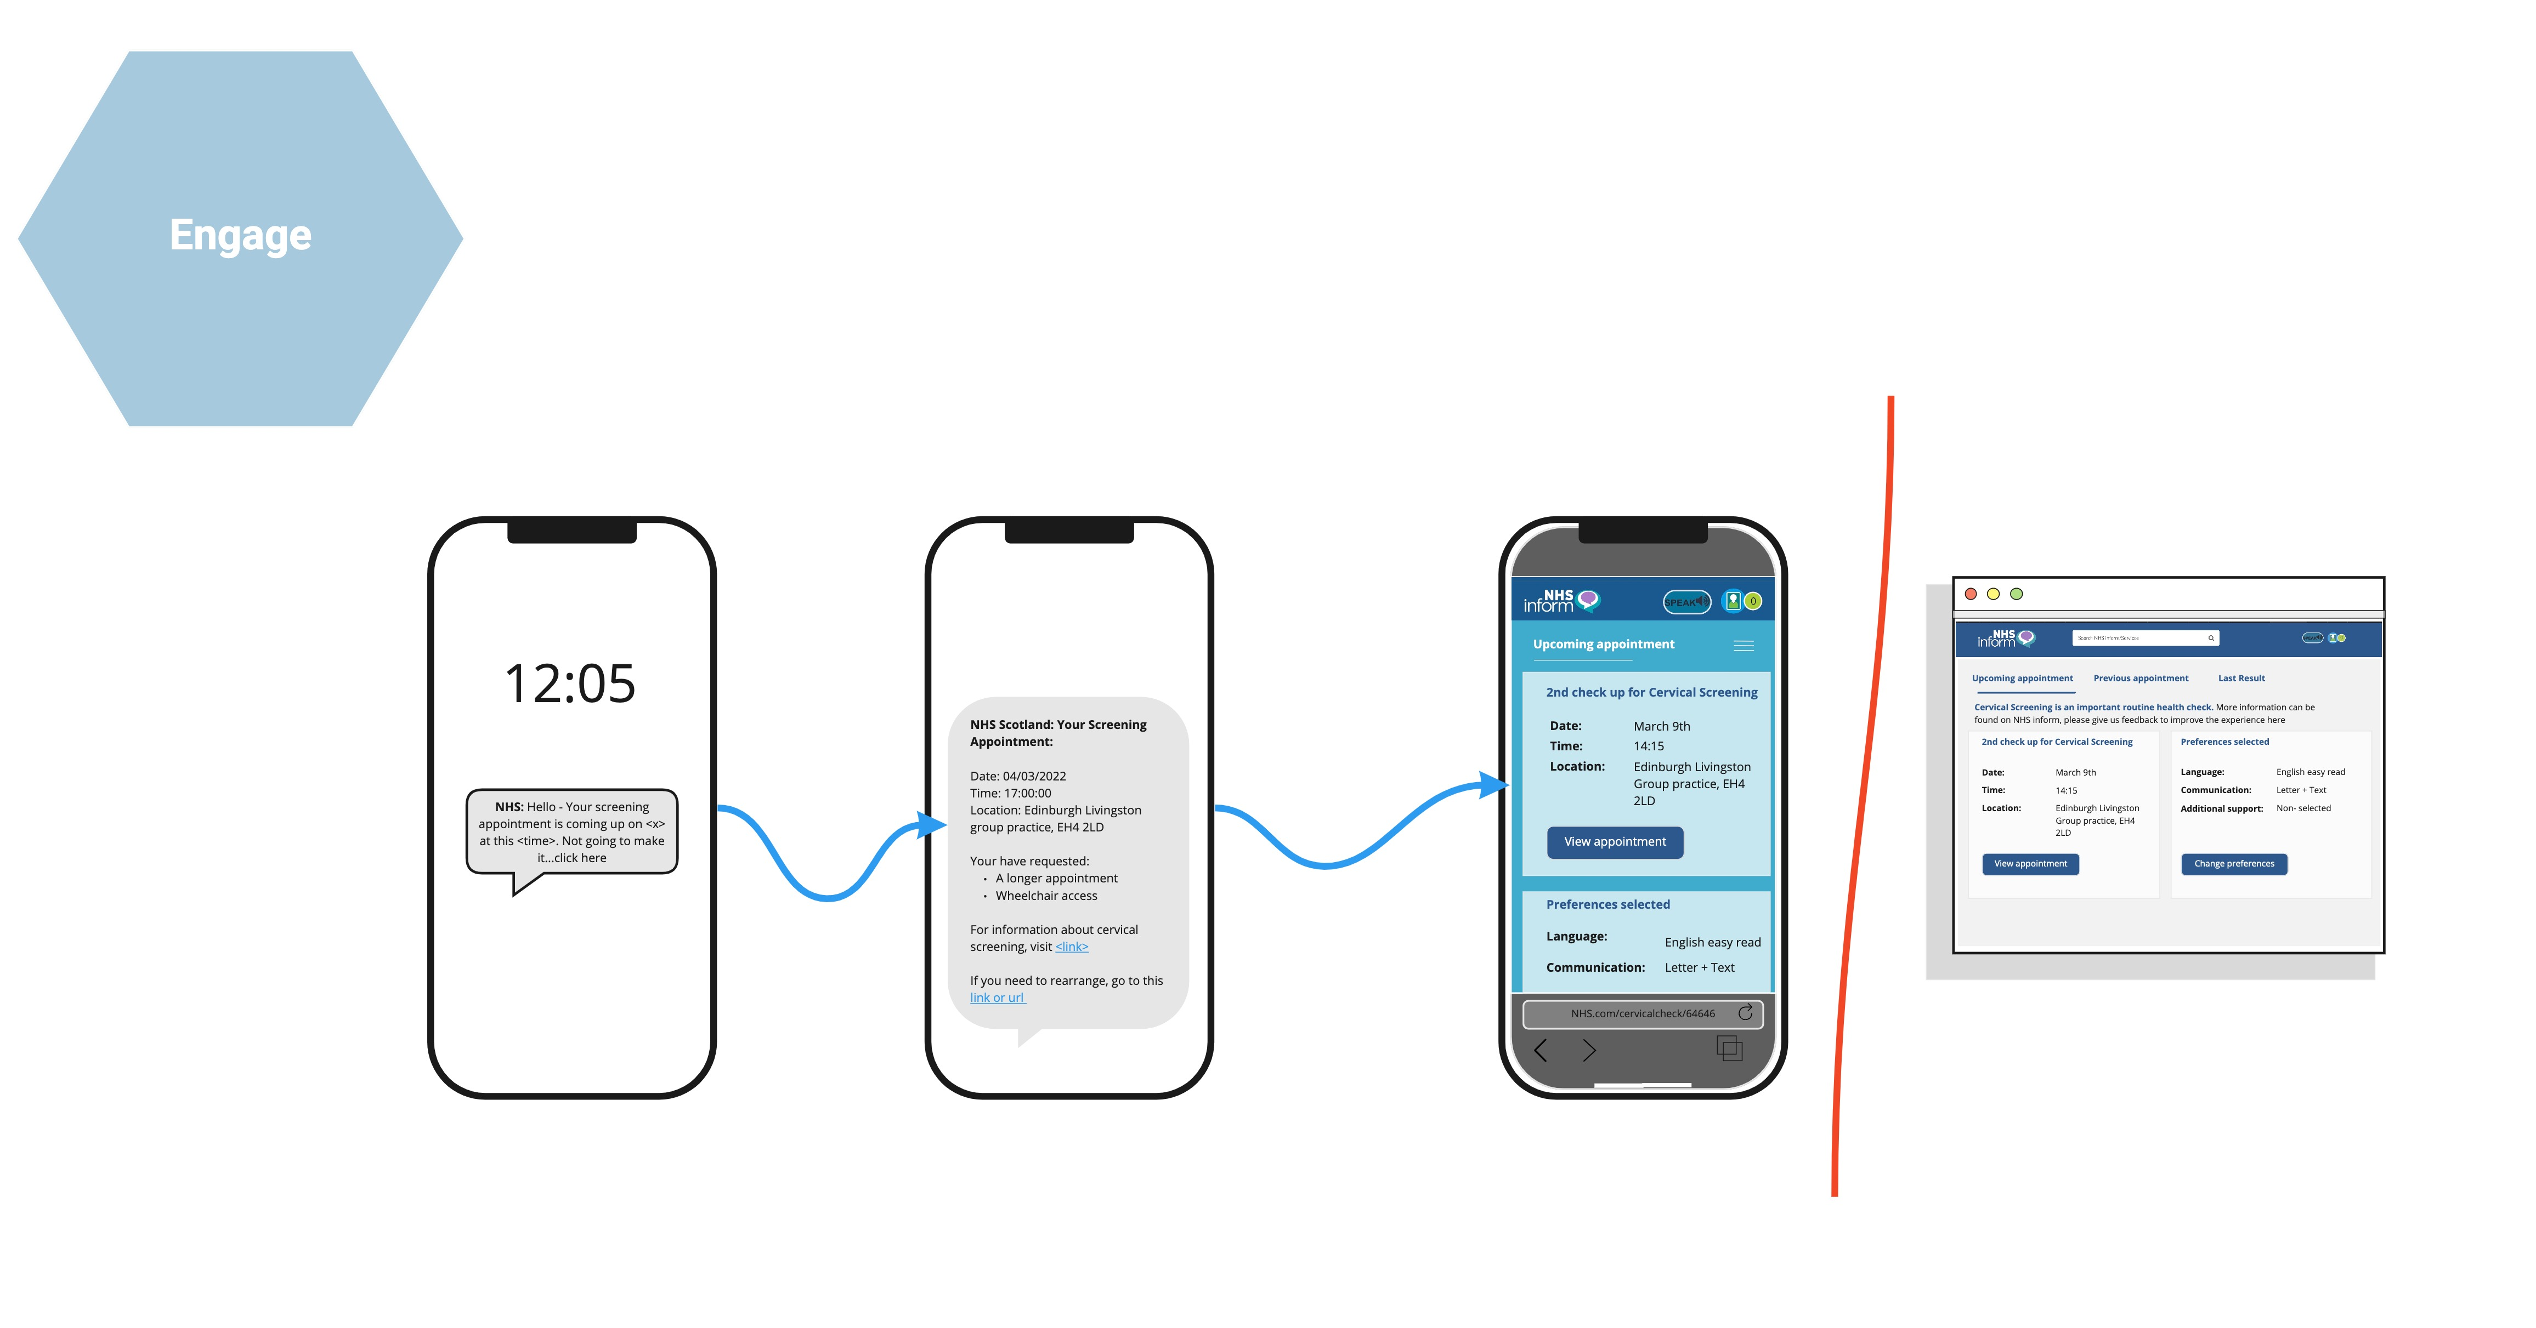
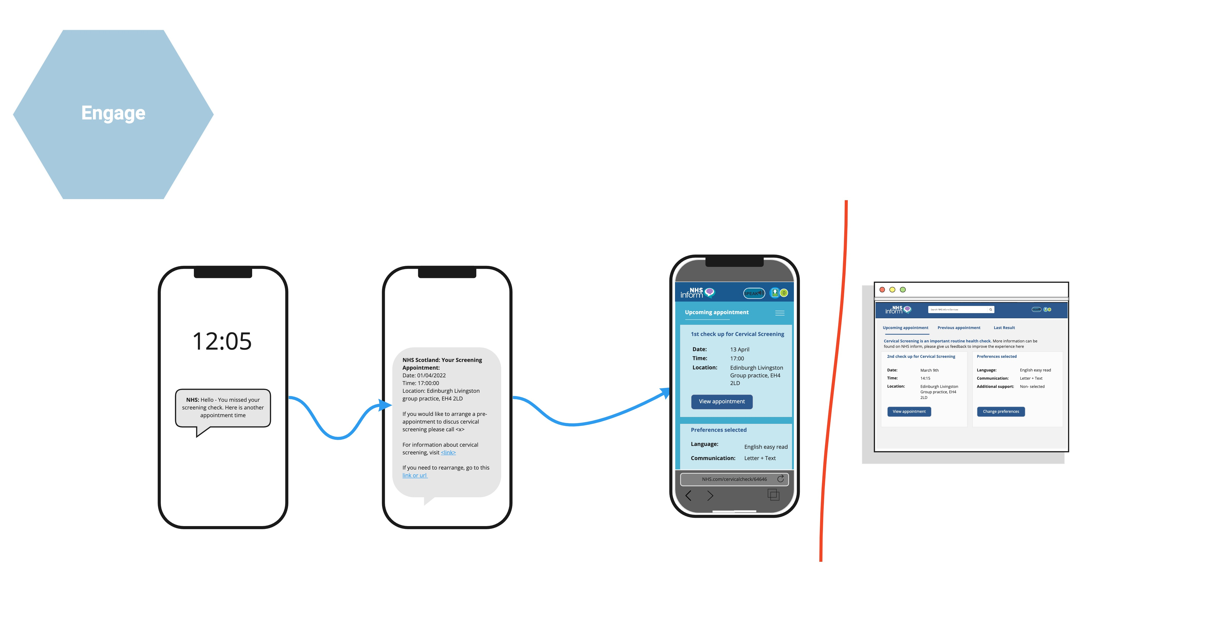
Prototyping
Prototypes are helpful to develop concepts with low effort. This is an example of a low fidelity storyboard:
​
Text prompt if no appointment is made
To be sent during opening hours with phone number to call to schedule appointment. URL to NHS Inform about the importance of cervical screening in accessible formats
Text reminder before cervical smear
Text prompt if someone does not attend
Text would include link to helpful information 24-72 hrs before appointment and if assistance is needed to attend.
Content design should not be shameful or coercive. Data collection on why they did not attend. Text would include information on how to reschedule

Slide 41
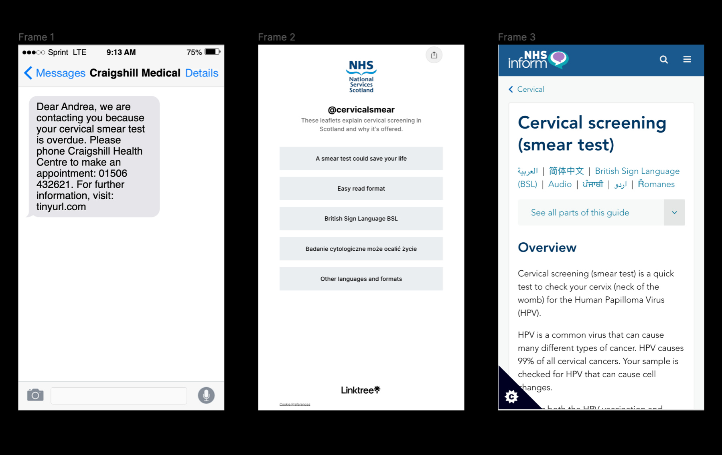
Prototyping
Prototypes can also be designed in high fidelity. Some tools which can be used for prototyping include:
MURAL - https://www.mural.co/
Figma - https://www.figma.com/
​
View an example of a prototype created in Figma:
https://www.figma.com/proto/vScAAydElSfmywdIB2w59o/Text-message-service?node-id=101%3A2&scaling=scale-down&page-id=0%3A1&starting-point-node-id=101%3A2
​

Slide 42
Deliver

Slide 43
Blueprinting your service
Use this framework overleaf to plan a product or service experience from multiple perspectives. The top of the blueprint lets you illustrate how a customer or user would experience a specific scenario step-by-step. At the bottom of the template, you can outline the people, policies, and systems that make each step of the service function.
​

Slide 44
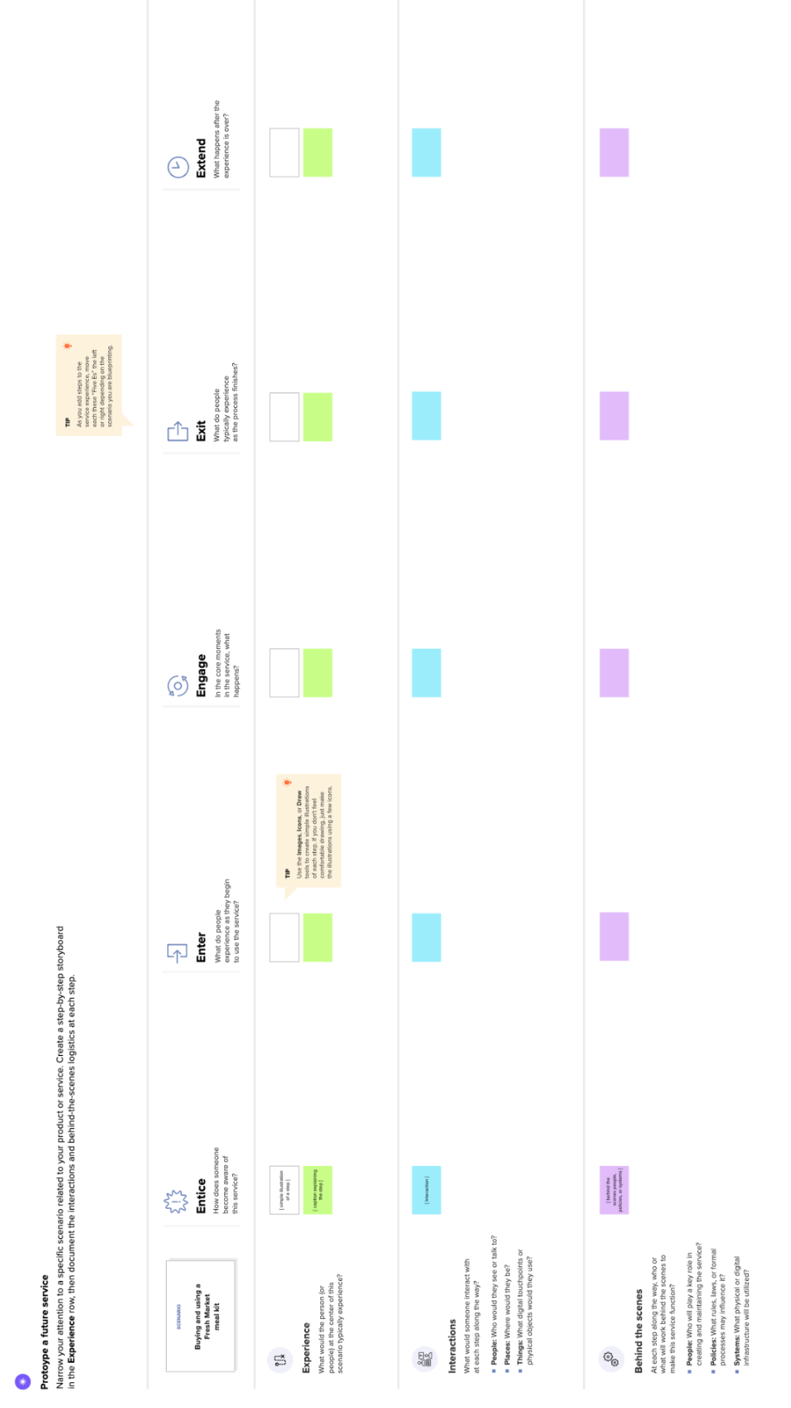

Slide 45
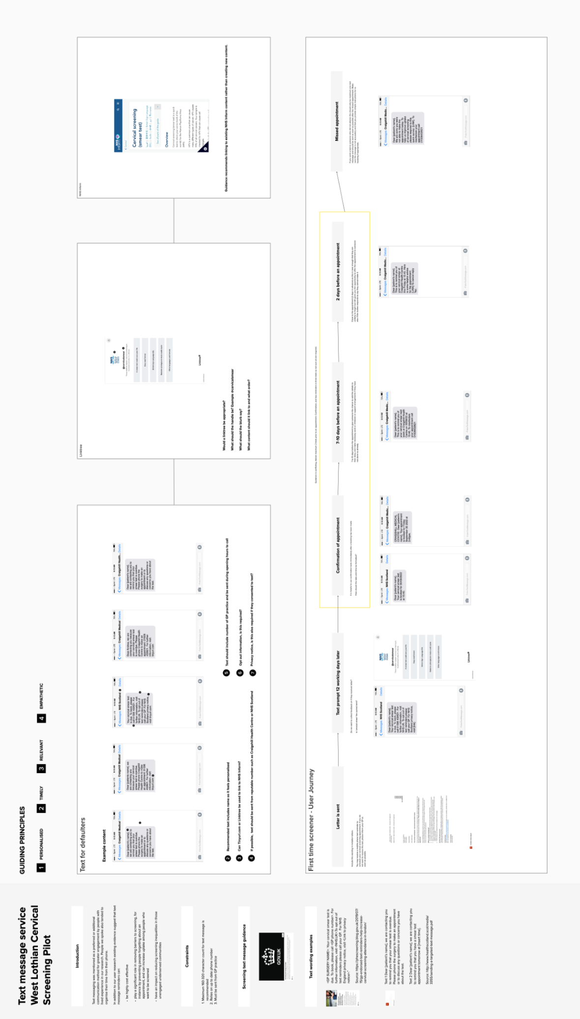
Develop a design brief
View Content Design brief:
https://app.mural.co/t/nssdigitalengagement1188/m/nssdigitalengagement1188/1662030796964/b90603c86ba1df2b7715876499da2a6ced7d942c?sender=ubd22c6c135e708617a226713
​

Slide 46
Measure
Define goals and success metrics.
​
Measure impact on attendance and DNA rates
Use of locality and ward data to inform early intervention and prevention programmes across West Lothian HSCP
Monitoring uptake from minority groups where possible. Considerations around unreliable/lack of data for accurate evaluation.
Feedback from service users (this might include GP Practice surveys or feedback via patient representative groups)
Decrease in cost of invitations over time
Outcomes of the test (early diagnosis)
Number of text messages opened by smear completed
Measuring preference or support need recorded by smear completed
Decreased recall backlog
Key experience indicators for each stage of the user journey
Reduced missed appointments
Greater understanding of locality uptake resulting in targeted interventions

Slide 47
Screening resources
1. Campbell, H. E., Gray, A. M., Watson, J., Jackson, C., Moseley, C., Cruickshank, M. E., Kitchener, H. C., & Rivero‐Arias, O. (2020). Preferences for interventions designed to increase cervical screening uptake in non‐attending young women: How findings from a discrete choice experiment compare with observed behaviours in a trial. Health Expectations, 23(1), 202–211
2. Gabriella Stuart, Danielle D’Lima. (2021) Perceived barriers and facilitators to attendance for cervical cancer screening in EU member states: a systematic review and synthesis using the Theoretical Domains Framework. Psychology & Health 0:0, pages 1-50
3. Kathryn A. Robb, The integrated screening action model (I-SAM): A theory-based approach to inform intervention development, Preventive Medicine Reports, Volume 23, 2021
4. Menekse Suphi, Scott Porter Research & Marketing Limited, Determining information needs to support informed uptake of cervical screening, December 2015
5. Nelson M, Patton A, Robb K, Weller D, Sheikh A, Ragupathy K et al. Experiences of cervical screening participation and non-participation in women from minority ethnic populations in Scotland. Health Expectations. 2021 Jun 17. https://doi.org/10.1111/hex.13287
6. Oyegbite, A., Roberts, J., & Bircher, J. (2021). Increasing the uptake of cervical screening at cornerstone medical practice. BMJ Open Quality, 10(3), 1126
7. Sarah Wilding, Sarah Wighton, Daisy Halligan, Robert West, Mark Conner & Daryl B. O’Connor(2020) What factors are most influential in increasing cervical cancer screening attendance? An online study of UK-based women, Health Psychology and Behavioral Medicine, 8:1, 314- 328, DOI: 10.1080/21642850.2020.1798239
8. Staley H, Shiraz A, Shreeve N, Bryant A, Martin-Hirsch PP, Gajjar K. Interventions targeted at women to encourage the uptake of cervical screening. Cochrane Database Syst Rev. 2021 Sep 6;9(9)
9. Quyn AJ, Fraser CG, Stanners G, et al. Uptake trends in the Scottish Bowel Screening Programme and the influences of age, sex, and deprivation. Journal of Medical Screening. 2018;25(1):24-31. doi:10.1177/0969141317694065
10. Cervical screening: ideas for improving access and uptake. Guidance, Gov.uk March 2020: https://www.gov.uk/guidance/cervical-screening-ideas-for-improving-access-and-uptake
11. Evidence on increasing cervical screening uptake, Cancer Research UK: https://www.cancerresearchuk.org/health-professional/screening/evidence-on-increasing-cervical-screening-uptake#cervical_increase2

Slide 48
Screening resources
12. Cervical screening: support for people who find it hard to attend, Guidance, Gov.uk, May 2021: https://www.gov.uk/government/publications/cervical-screening-support-for-people-who-find-it-hard-to-attend
13. Overcoming barriers to cervical screening, Jo’s Trust: https://www.jostrust.org.uk/professionals/cervical-screening/barriers
14. Improving access to cervical screening, Jo’s Trust: https://www.jostrust.org.uk/professionals/cervical-screening/improving-access
Public Health Scotland
https://www.healthscotland.scot/health-topics/screening/cervical-screening
https://publichealthscotland.scot/publications/scottish-cervical-screening-programme-statistics/scottish-cervical-screening-programme-statistics-annual-update-to-31-march-2021/

